Slide 1
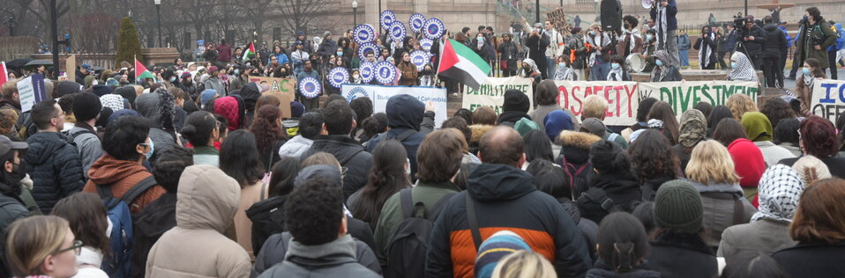

Career guidance, social justice and impartiality
Tristram Hooley, Professor of Career Education, University of Derby
Presentation to the University of Birmingham

Slide 2
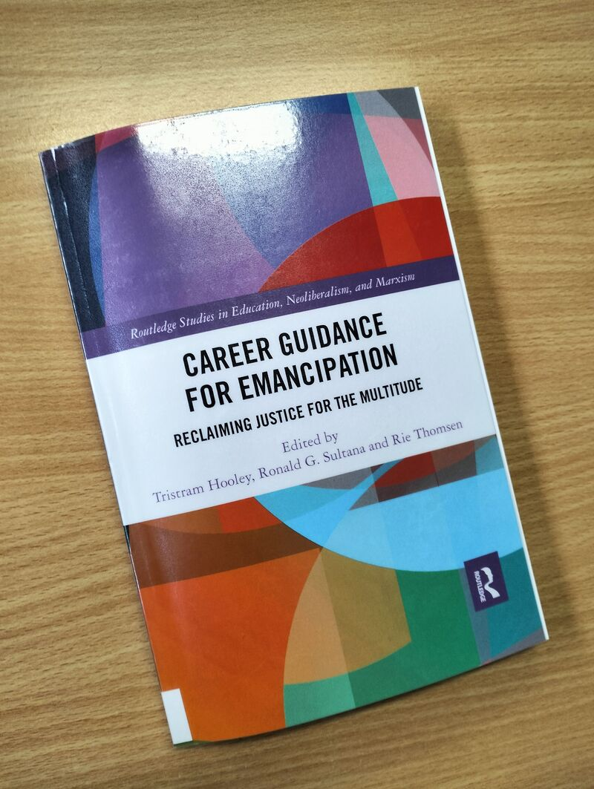
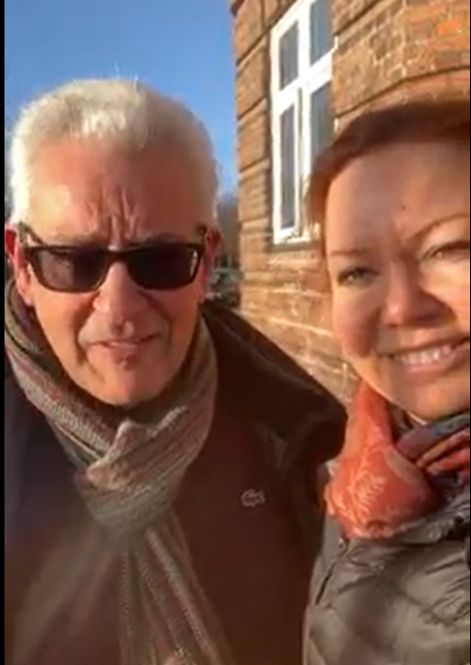
This is not all my own work
There is a growing community of scholar, practitioners and thinkers arguing that career guidance must be a force for social jusitce.
I have been especially blessed to work closely with Ronald Sultana and Rie Thomson in this area.

Slide 3
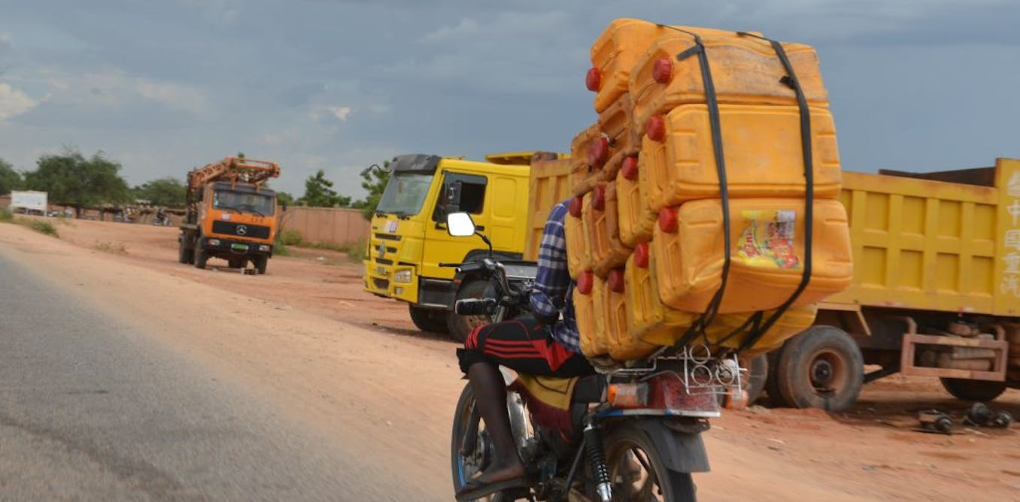

Life isn’t fair

Slide 4

Wellbeing and inequality

Slide 5
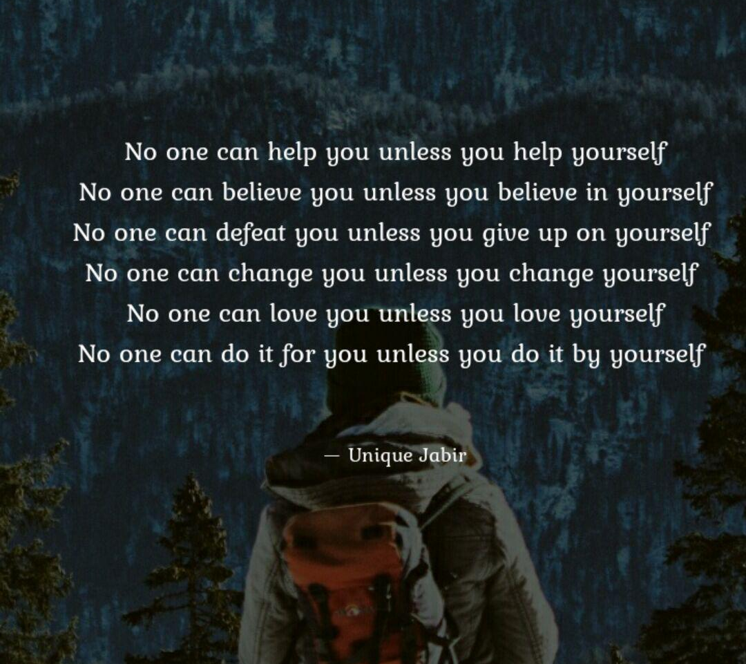
Responsibilisation

Slide 6

Career guidance
“Career guidance supports individuals and groups to discover more about work, leisure and learning and to consider their place in the world and plan for their futures… Career guidance can take a wide range of forms and draws on diverse theoretical traditions. But at its heart it is a purposeful learning opportunity which supports individuals and groups to consider and reconsider work, leisure and learning in the light of new information and experiences and to take both individual and collective action as a result of this.”
Notes:
Rie

Slide 7
The five signposts towards socially justice career guidance
Build critical consciousness
Help people to understand the situation, not just to react to it on a personal level.
Name
oppression
Help people see injustice and organise in solidarity to access a decent career.
Question what is normal
Spend time discussing what normality means and whether it is necessarily desirable.
Encourage people to work together
Facilitate social interaction and collaboration
Work at a
range of levels
Intervene into individual, group, organisational, social and political systems.
Notes:
Tristram

Slide 8
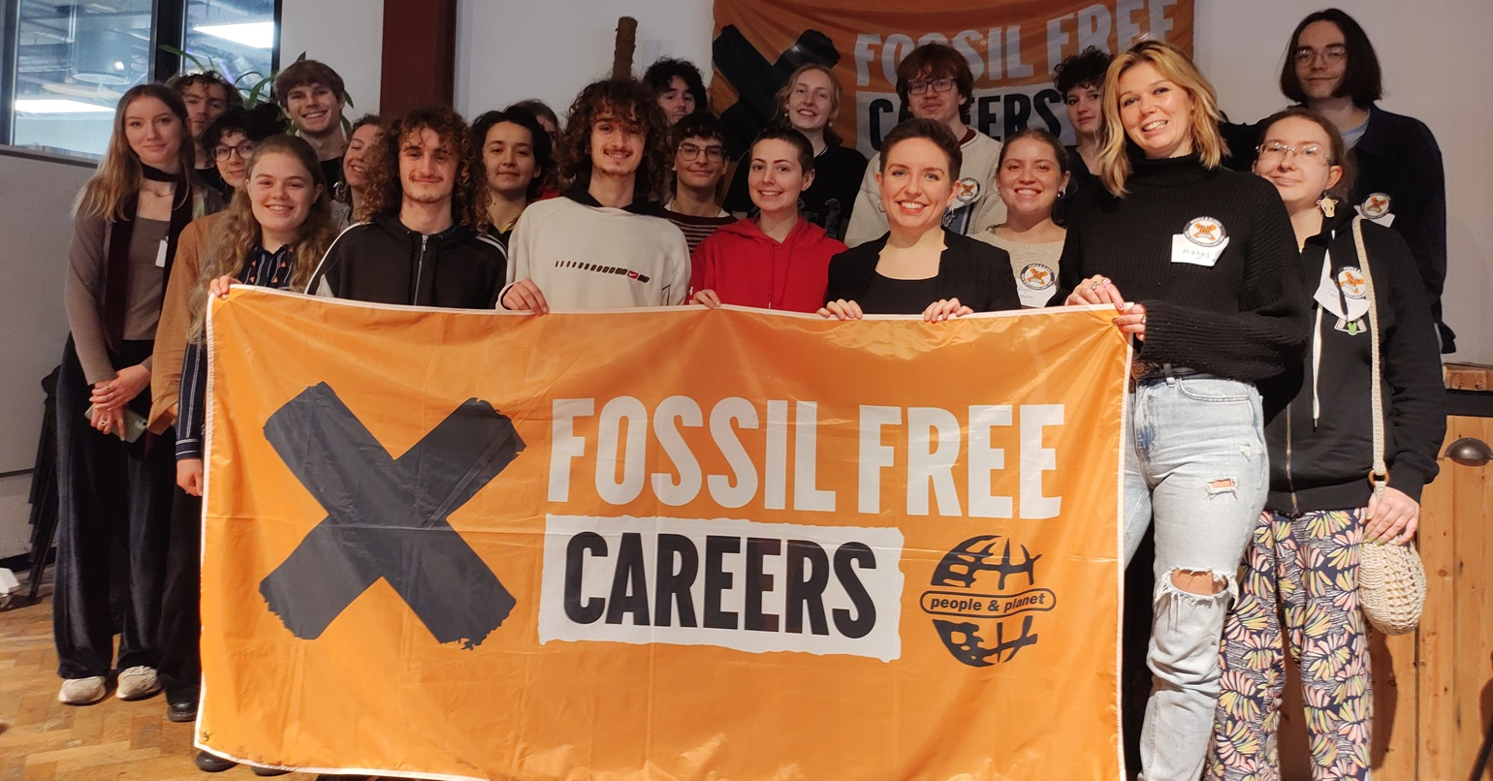

Slide 9

Impartiality

Slide 10
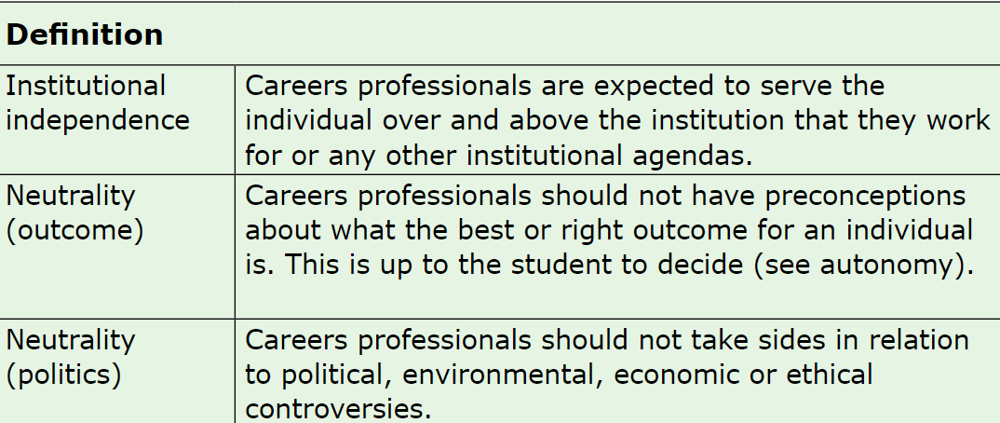
Impartiality: Definitions

Slide 11
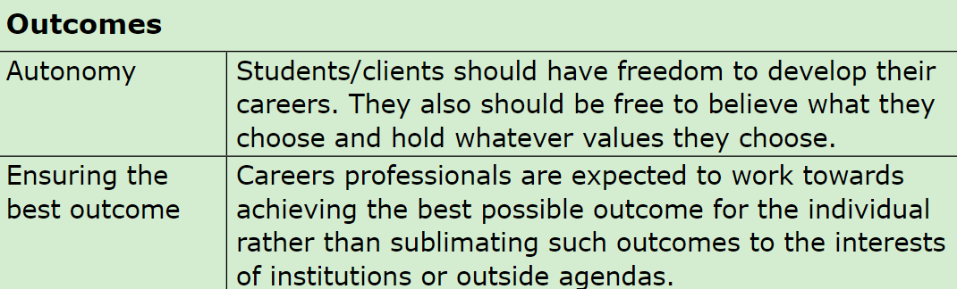
Impartiality: Outcomes

Slide 12
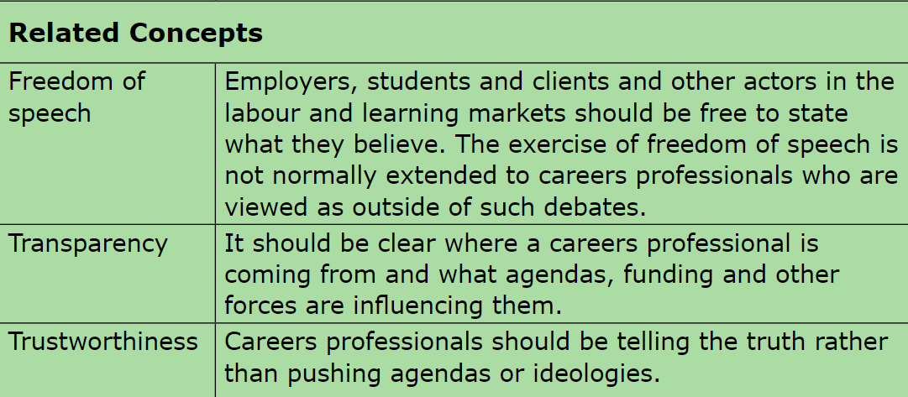
Impartiality: Related concepts

Slide 13
Challenges with impartiality
Ambiguity
Application in (different forms of) practice
Alignment of impartiality with career theory
Tensions with other ethical values
Practicing impartiality within partial funding regemes

Slide 14
My reflection
“I would be in favour of narrowing the terminology of ‘impartiality’ to focus on the careers professionals right to support clients in a way which is independent from the institutional interests of their employer or the funders of their service. I would also argue for some rebalancing of professional ethics away from impartiality and towards transparency, as such an approach seems to me to foster an open and reflexive way of handling issues of partiality.”

Slide 15

Questions?

Slide 16
Further reading
Hooley, T. (2023). Impartiality: A critical review. Journal of the National Institute for Career Education and Counselling. 50, 41-53. https://doi.org/10.20856/jnicec.5005
Hooley, T., Sultana, R. & Thomsen, R. (2018). Career guidance for social justice: Contesting neoliberalism. Routledge.
Hooley, T., Sultana, R. & Thomsen, R. (2019). Career guidance for emancipation: Reclaiming justice for the multitude. Routledge.
Hooley, T., Sultana, R., & Thomsen, R. (2021). Five signposts to a socially just approach to career guidance. Journal of the National Institute of Career Education and Counselling, 47, 59-66. https://doi.org/10.20856/jnicec.4709

Slide 17
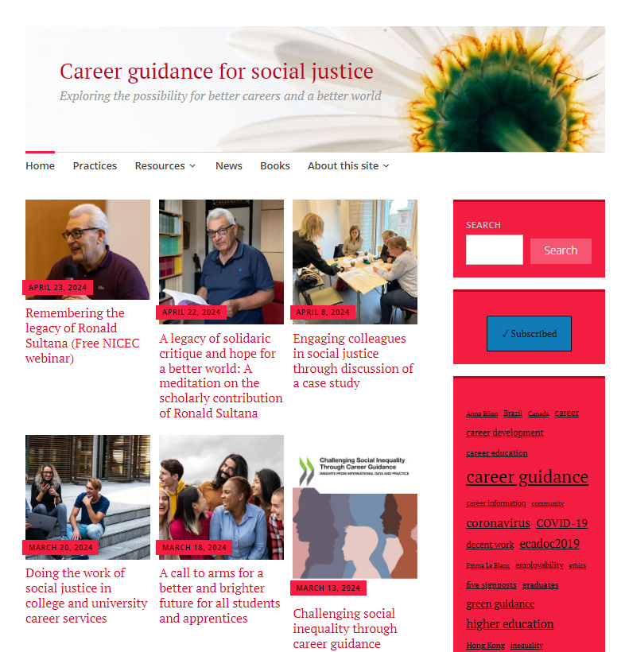
Career guidance for social justice website
https://careerguidancesocialjustice.wordpress.com/

Slide 18

Study at iCeGS
MA in Career Guidance and Development
Focused on developing career practitioners across the sector
Taught on Saturdays, Caries QCD (awarded by CDI)
Full-time or part-time with an integrated placement
Often funded through PG loan
Contact Tom Staunton – t.staunton@derby.ac.uk
EdD or PhD
Full-time or part-time
To discuss ideas for doctoral study please contact Professor Siobhan Neary (Head of iCeGS) at s.neary@derby.ac.uk.
For further information https://www.derby.ac.uk/research/themes/public-services/icegs/study-with-icegs/
Notes:
Our understanding of our project changes through time.

Slide 19

Final thoughts
It is impossible to think about wellbeing in career, without addressing issues of inequality and oppression.
The raising of political issues creates a tension for our professional value and ethics.
But, simply taking refuge in the concept of impartiality won’t cut it any more.
So we have to think carefully and critically about how we address issues of partiality in our practice.

Slide 20
Thank you
Tristram Hooley
tristram.hooley@inn.no
@pigironjoe
https://adventuresincareerdevelopment.wordpress.com/
https://careerguidancesocialjustice.wordpress.com/

