Slide 1
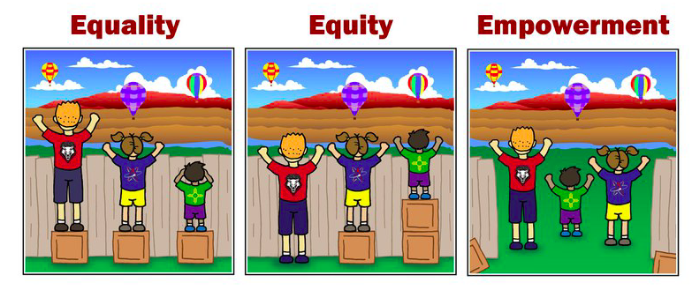
SOCIAL JUSTICE
ESTABLISHING RELATIONSHIP
Kim, Ly, Kristjana, Carolina
(The City of Albuquerque 2023)

Slide 2
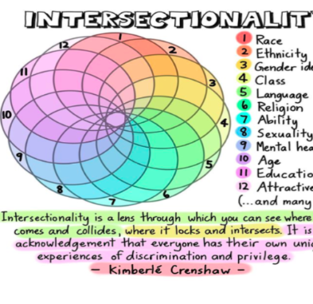
Target group:
- Marginalized group known to participants of this project
- Individuals without basic or highscool education
Individuals
  lacking trust for institution
  lack of self-esteem
  who are vulnerable
    Where factors were in the way of the individual so he did not achieve his once potential

Slide 3
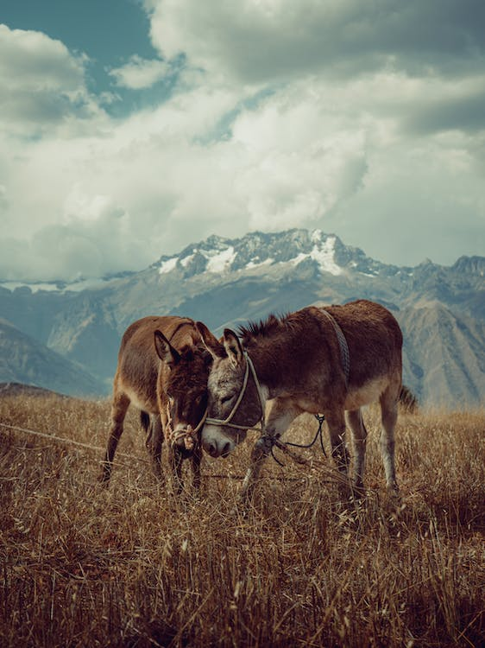
Goal and purpose
Build trust between client and counsellor and system
Bridge the gap between ideals and practice policy
To start building:
  Agency
  Self-efficacy
  Self-esteem

Slide 4
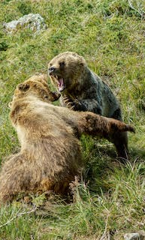
Method
Storytelling
  Savickas (crafting identities)
Strength cards
  VIA Character (24 character strenghts)
Individual/ group work
(Peterson & Seligman, 2004), (Savickas, 2015)

Slide 5
Link to social justice themes presented during summer school
Social justice /injustice
Establishing relationship
Participation
Alliance co-agency
Enabling
Education
Structural inequality
Gap ideals and practice policies
Trust!
Encouraging people to work together
Vulnerability
(Hooley et al, 2021), (Toivainen, 2021),
(Fraser & Honneth, 2003)

Slide 6
Session - prework
Collaborating → clients (I.e social services, migration aid)
1
Setting ground rules
2
Framework and expectations

Slide 7
Exercise in group - Strength cards
Questions:
1. Think of a person/character that You admire
(Placing cards on the table and short guide)
2. Look at the cards and pick 3 strengths that You like about your chosen person/character

Slide 8
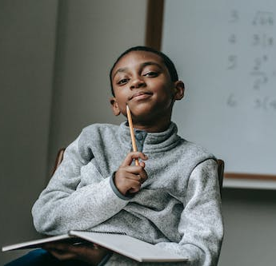
Whiteboard and discussion
3. Group share, counsellor writes (characters) on whiteboard
4. Group associate strenghts to the characters on the board
5. (We stop here) Further questions and discussion is recommended

Slide 9
6. Suggestions for Further work in the group
(I.e. Why did You choose them/What do You think about them etc. ?)

Slide 10
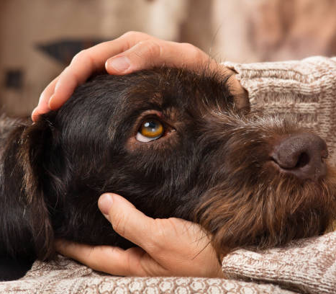
‘Conclusion’
This idea is addressing social justice by:
Enabling/ being recognized as an individual
Strengthen agency
Educate low threshold
Empowering each other in the group
Varied methods to participate (didactic) →establish relationship/trust

Slide 11

Tack
Graciás
Takk fyrir
Tak
Tänan
Thank you

