Slide 1
Critiquing and Combatting Inequality: Critical Consciousness & Career Outcomes among Marginalized Youth
Matthew A. Diemer, Ph.D

Slide 2
Defining CC
Critical reflection: understanding structural and historical root causes of group-based inequalities; migrant status or race (Diemer & Blustein, 2006)
Critical motivation: perceived ability or motivation to change inequitable social and political conditions (Watts et al., 2011)
Critical action: individual or collective action to disrupt & challenge oppressive systems (e.g., protest, marching, organizing) – Heberle et al., 2020
Example: “At a high school that disproportionately suspends youth of color, CC would look like: (a) recognition that school disciplinary policies are being applied disproportionately across racial/ethnic groups, (b) the agency to do something about it, and (c) behaviors such as joining a student diversity group, participating in a protest, or talking with school administrators. In contrast, a less critically conscious youth might fail to recognize the disproportionate suspensions, ignore or minimize the underlying racism, blame the students, lack interest or feel powerless to do anything about it, or avoid talking about or acknowledging the problem.” (p. 810, Diemer et al., 2015).
Rigorously validated measures & other empirical evidence has been important to advance CC theory (e.g., we now generally agree upon this three-part CC model).

Slide 3
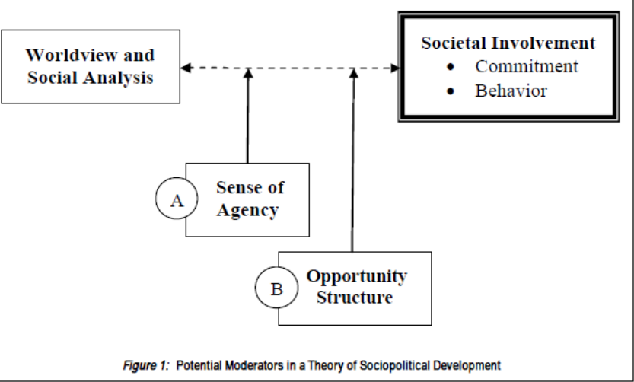
CC: Foundation
Key Freirean sequence: Reflection, motivation, then action
  People learn to critique and understand inequality as structural (reflection)
    then feel empowered (motivation) to act (action) to create change, applying their new understanding of inequality
    which then further grows their understanding of inequality (reflection) and efficacy (motivation) to produce change in the future
  Sociopolitical Development (SPD) theory (Watts et al., 1999; Watts & Flanagan, 2007) similar model:
  Note: CC well-studied in Europe
Portugal (Azevedo & Gonçalves, 2012)
Romania (Assante & Candel, 2022;
Assante & Momanu, 2021)
Spain (Miranda et al., 2021;
Luque-Ribelles & Portillo, 2009)
Switzerland (Udayar et al., 2021)
Germany (Schwarzenthal et al., 2022;
Schwarzenthal et al., in press)

Slide 4
Previous CC - Career Research
Among samples of youth classified as more marginalized, typically youth of color living at or near the poverty line (mostly in U.S.)
First study: Diemer and Blustein (2006): CC associated with higher levels of vocational identity and career commitment
Diemer and Hsieh (2008): CC predicted higher vocational expectations
  “effect size” equal to expecting to be a bank teller instead of a garbage collector
Trend replicated in a number of studies:
CC -> career development (e.g., Diemer et al., 2010; Olle & Fouad, 2015; Luginbuhl, McWhirter & McWhirter, 2014)
CC -> schooling (e.g., Cabrera et al., 2014; Cammarota, 2007; O’Connor, 1997; Seider & Graves, 2020; Ramos-Zayas, 2003)
CC: component of Psychology of Working Theory (Duffy, Blustein, Diemer & Autin, 2016)

Slide 5
Theoretical Explanation
CC believed to help people who are marginalized to negotiate and challenge structural constraints, fostering ability to achieve goals (Christens et al., 2016; Freire, 1973)
For urban-residing Puerto Rican youth, “a politicized understanding of power, inequality and historical processes…actually involves the most disengaged students in a process of critical consciousness that can serve as a catalyst for entry into more mainstream mobility routes” (p. 88-89, Ramos-Zayas 2003).

Slide 6
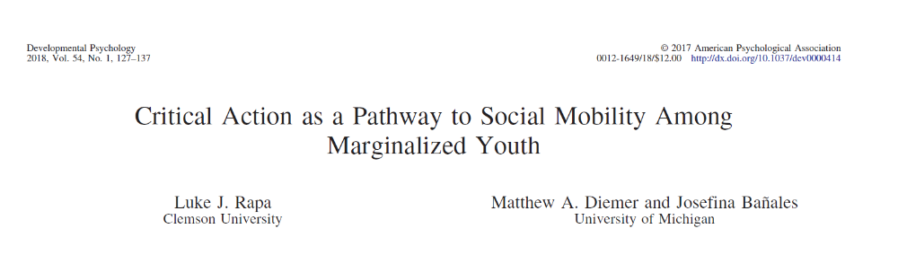
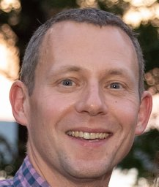
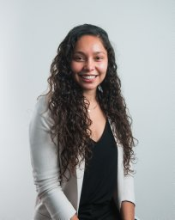
Empirical Example
Dr. Bañales now Asst Prof @ UIC

Slide 7
Study Motivation
Youths’ thinking about & planning for a future career is all well & good -> what role does CC play in adult occupational attainment?
  Diemer (2009): SEM applied to three-wave panel longitudinal study, 10 years
  CC in high school predicted attainment of higher-paying/higher-status occupations at age 24, among more marginalized youth (N = 1,052)
    Lagged GPA control variable; stronger effect size estimates for women
Need to replicate this important CC-> career outcomes linkage

Slide 8
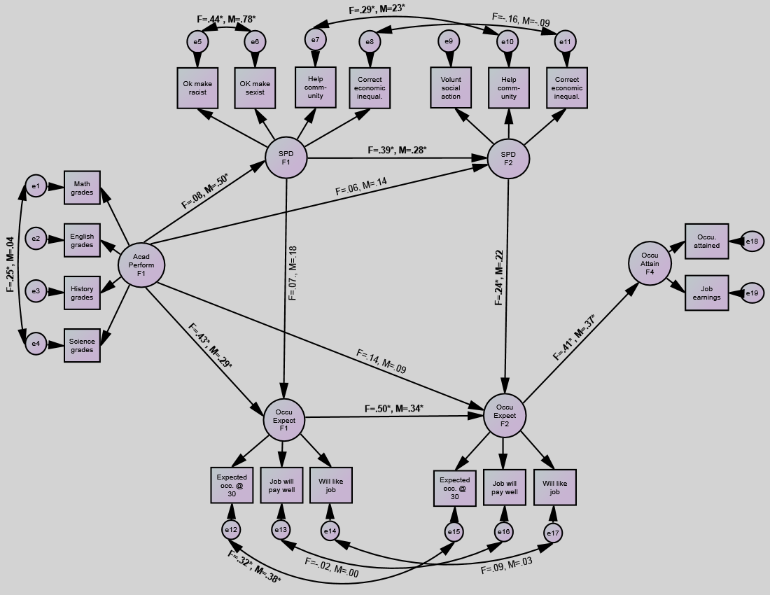
Prior work: Diemer (2009) full model

Slide 9
Sample
MADICS longitudinal data collection
  1,482 7th graders & 7 waves of measurement
  Designed to examine Black/African American and White families of comparable SES
Analytic sample of interest
  Self-identified Black/African American respondents
  Intentionally filtered to lower rungs of SES distribution (using parental education)
  N = 261
  Male: n = 150 (57.5%) / Female: n = 111 (42.5%)
    Non-binary categories not provided in MADICS

Slide 10
MADICS Overview
Wave 4
11th Grade
(~17 yrs old)
Wave 5
1 year post HS
(~19 yrs old)
Wave 6
3 years post HS
(~21 yrs old)
Wave 7
11 years post HS
(~29 yrs old)
Career Expectancies
Critical Action
Occupational Attainment

Slide 11
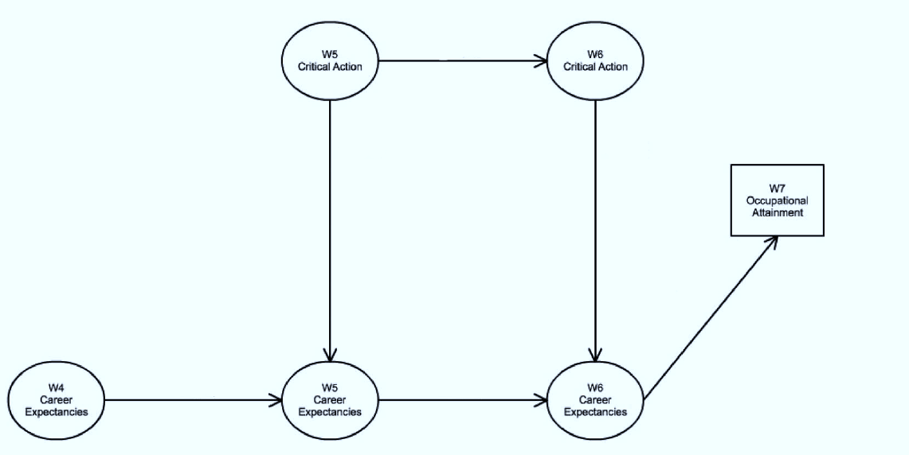

Conceptual Model
Wave 4
11th Grade
(~17 yrs old)
Wave 5
1 year post HS
(~19 yrs old)
Wave 6
3 years post HS
(~21 yrs old)
Wave 7
11 years post HS
(~29 yrs old)

Slide 12
Measures
Career Expectancies (2 items, repeated in waves 4, 5, and 6)
  “What kind of job would you most like to have when you are 25/30?”
  “What kind of job do you think you will really have when you are grown up?”
    280 nominal categories → socioeconomic index of occupational prestige (Nakao & Treas, 1994)

Slide 13
Measures
Critical Action (5 items; repeated in waves 5 & 6)
  In the last 2 years, how often have you:
    Joined in a protest march, meeting, or demonstration?
    Given money to social or political action groups?
    Participated in a civil rights group or activity?
    Participated in a women’s rights group or activity?
    Participated in a political party, club, or organization?

Slide 14
Measures
Occupational Attainment (wave 7)
  Occupation at age 29
    As with Career Expectancies, nominal categories → socioeconomic index of occupational prestige (Nakao & Treas, 1994)
Lagged controls: Gender; Lagged Academic Achievement (Wave 4 GPA); Lagged Career Expectancies (Wave 4)

Slide 15
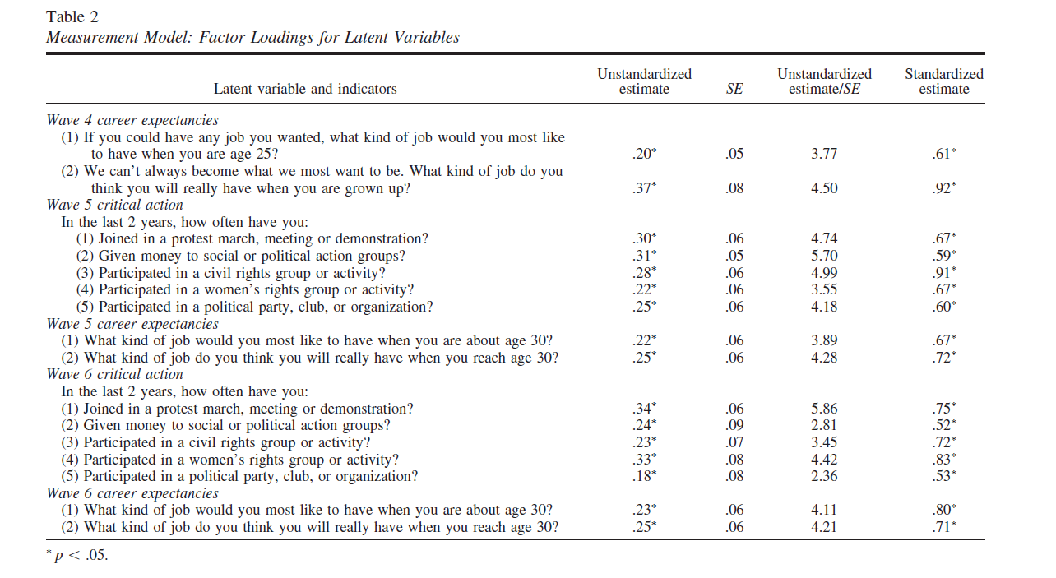
Measurement: Strong fit & item loadings
RMSEA: .04 (90% CI = [.01, .06]); CFI = .96; TLI = .94

Slide 16
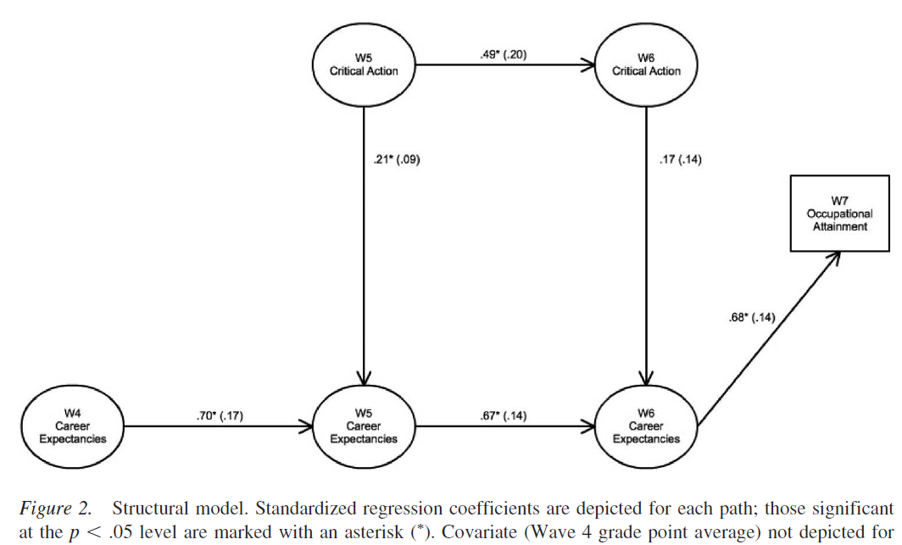
Results
RMSEA: .03 (90% CI = [.01, .05]);
CFI = .95; TLI = .94
Significant mediated or “indirect effects” from W5 critical action to W7 occupational attainment via W5 & W6 career expectancies (ß = .08, p = .03).

Slide 17
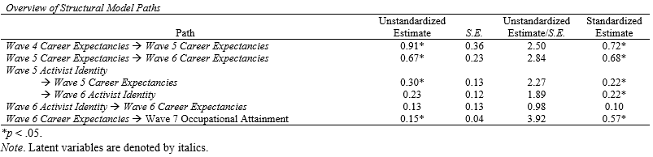
Results
Mediated or “indirect effects” from W5 activist identity to W7 occupational attainment were significant via W5 & W6 career expectancies (ß = .08, p = .03).

Slide 18
Discussion
Critical action during adolescence plays a significant role in fostering career expectancies, which in turn fosters occupational attainment among poor/working class Black youth
  Supports broader theoretical arguments that CC helps more marginalized people negotiate structural constraints
    Somewhat paradoxically, “achievement as resistance”
  Replicates only prior study linking critical consciousness in adolescence to career attainment in adulthood (Diemer, 2009)
“…many activities, including education, become difficult undertakings for students constrained by severe social injustices. When these injustices are engaged and critiqued, students begin to clear intellectual and emotional space for education. They become further engaged in learning when their education becomes a means by which to challenge oppressive forces within their social context.” (pg. 95, Cammarota, 2007)

Slide 19
Policy/Practice Implications
Young people who are marginalized benefit from discussion about inequalities in their lives, and how to challenge inequality
  Instead of avoiding inequality for fear of ‘discouraging’ students
  Not “telling” students how they are oppressed, but open-ended discussion
  McWhirter & Chronister (2006): RCT where survivors of DV benefited more from vocational interventions with CC elements
Critical schooling models, see Seider and Graves’ excellent book
  “Three Is” framework: Internalized, Interpersonal, Institutional
Supported opportunities to be civically engaged and to challenge inequalities in one’s school and/or community
  Youth-adult partnerships one such model
Ethnic studies curricula & opportunities to learn about ethnic/racial histories (see: CRT, yPAR, youth organizing)
  Note: U.S. states of California, Minnesota, others now require Ethnic Studies

Slide 20
Thank you
Collaborators, youth organizations, schools & youth who shared their time, energy, and ideas in partnership
Funding sources for this body of work:
  Institute for Educational Sciences, #R305A170639
  William T. Grant Foundation, #186645
  Spencer Foundation, #200000806
  Spencer Foundation/National Academy of Education Postdoctoral Fellowship
  Corporation for National & Community Service
  American Educational Research Association
  SPSSI ‘Grants in Aid’ program

