Slide 1

Reflecting on the use of critical theory in research and practice in career guidance
Rie Thomsen
Tristram Hooley

Slide 2
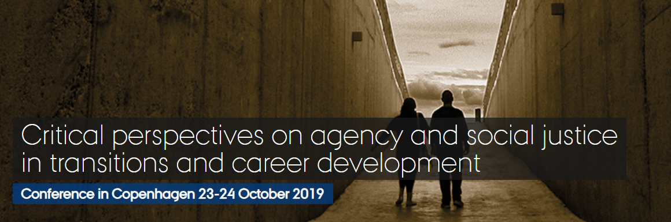
A long journey…

Slide 3
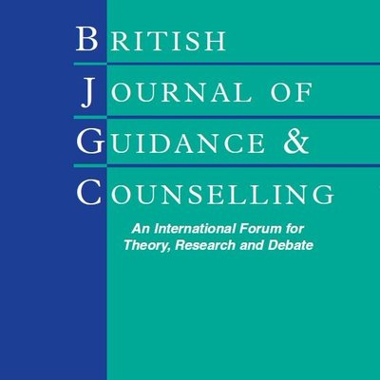
To a special issue of the BJGC
Critical Perspectives in Career Guidance Research
British Journal of Guidance & Counselling, 2022, 50(4).

Slide 4
13 papers address career and critical theory
Using critical psychology in analysis of career guidance and counselling
The hegemonic psychological discourse and its implications for career counselling and psychological intervention
A critical review of contemporary concepts of agency in the field of career guidance: life-design counselling and a systems theory framework
Co-agency: reconsidering agency in guidance practice
Navigating the matrix: career development and the responsibilisation of employability in Australia
Towards intersectional and anti-racist career guidance
Empowering newcomer workers by addressing racism and xenophobia: a promising pilot
On epistemic justice in career guidance
Examining career transition narratives through the lens of social justice: a critical study of the British Press
Problem representations of employability in higher education: using design thinking and critical analysis as tools for social justice in careers education
Using phenomenology in careers research: student experiences of unpaid work
Building a radical career imaginary: using Laclau and Mouffe and Hardt and Negri to reflexively re-read Ali and Graham’s counselling approach to career guidance
Critical psychologies
Relational sociologies
Postmodern discourse theories

Slide 5
We defined critical theory as work which is…
Creating a radical imaginary
Attending to power
Unmasking ideologies
Understanding individuals to be in a dialectical relationship with context
Viewing human beings as having a bounded but transformative agency

Slide 6
Today we will hear from
Anna Bilon
Marjorie McCrory
Sanna Toiviainen
Suzanne Rice
Rie Thomsen
Tristram Hooley

Slide 7
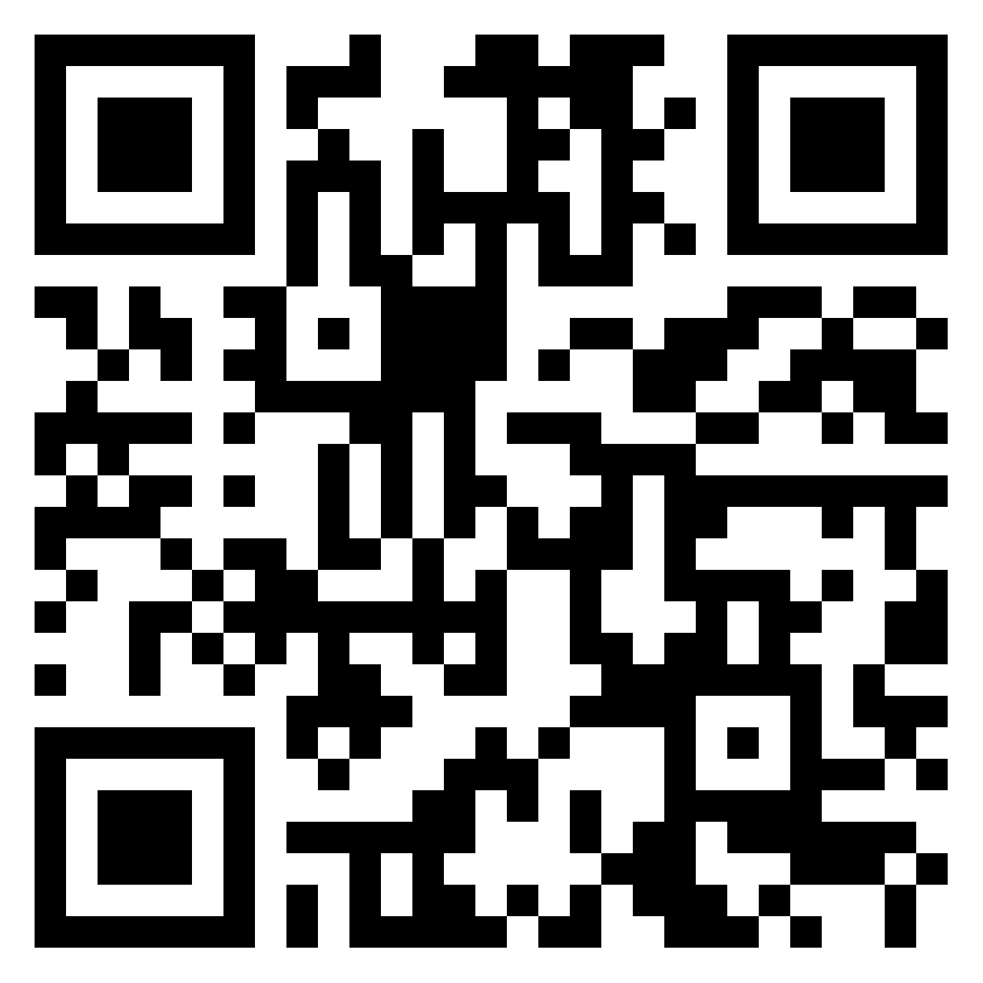
Discussion in 5 groups: How can critical theory inform what you do?
Creating a radical imaginary
Attending to power
Unmasking ideology
Understanding individuals to be in a dialectical relationship with context
Viewing human beings as having a bounded but transformative agency
For the theme that corresponds with your group answer the following questions.
Is this important?
Does it describe what you do?
Does it help you to understand yourself, your practice or your clients better?
How could it be used more in the future?
https://padlet.com/tristram_hooley/critical-theory-workshop-iaevg-4bqy79k36f9qnkjh

Slide 8
Thank you for participating
The blog post will be on https://careerguidancesocialjustice.wordpress.com/

Slide 9
Can traditional career guidance theories support the efforts to enhance the individuals’ bounded but transformative agency?
A critical review of contemporary concepts of agency in the field of career guidance: life-design counselling and a systems theory framework
Anna Bilon-Piórko, Rie Thomsen

Slide 10
Our points of departure
the purpose of career guidance includes the support of citizens’ agency
a social understanding of agency has been largely replaced by more individualised concepts
most studies related to agency in our field are based on quantitative approaches where agency needs to be reduced to particular traits and/or beliefs
the dominant position of individual psychology and individual constructs in the development of career guidance theories has been challenged
multi-disciplinary theoretical and methodological approaches are needed
self-efficacy, self-creation, self-regulation

Slide 11
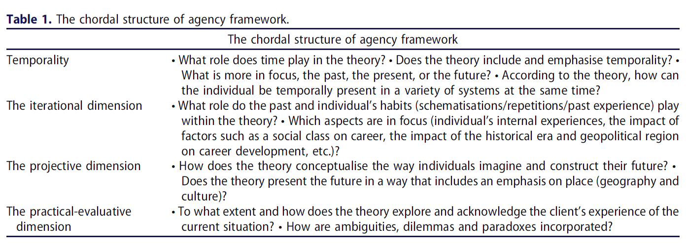
What have we done?
Our question: how do contemporary theories support career practitioners in building and exercising human agency with clients?
Theories analyzed: Life-design counseling and Systems Theory Framework for career development
Our analytical framework: relational sociology (Emirbayer & Mische)

Slide 12
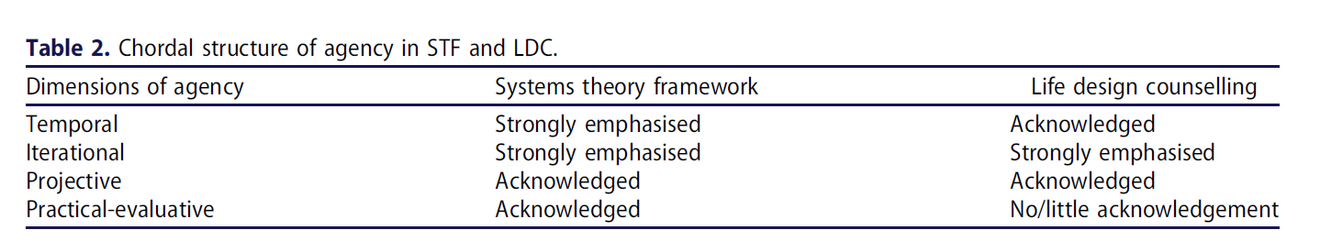
Results
The chordal structure of agency framework introduces a new and more detailed conceptualisation of agency
The analyses reveal both the specific priority and the general possibilities within LDC and STF, as well as their inherent limitations and challenges in relation to agency
there is an urgent need for further theoretical analyses and discussions of the strengths and weaknesses of various CGC theories and methods in relation to the expected development of human agency

Slide 13
References:
Bilon-Piórko A. D. ,Thomsen R. (2022). A critical review of contemporary concepts of agency in the field of career guidance: life-design counselling and a systems theory framework, British Journal of Guidance & Counselling, 50:4, 533-546, DOI: 10.1080/03069885.2022.2101614
Emirbayer, M., & Goodwin, J. (1994). Network analysis, culture, and the problem of agency. American Journal of Sociology, 99(6), 1411–1454. https://doi.org/10.1086/230450
Emirbayer, M., & Mische, A. (1998). What is agency? The American Journal of Sociology, 103(4), 962–1023. https://doi.org/10.1086/231294
Mcmahon, M., & Watson, M. (2007). The systems theory framework of career development: Expanding its research influence. Australian Journal of Career Development, 16(3), 47–54
Savickas, M. L. (2015b). Life-design counseling manual. www.vocopher.com

Slide 14

Theorising agency for socially just Careers work
Dr Marjorie McCrory
University of the West of Scotland
IAEVG June 2023

Slide 15

How we conceptualise agency matters
Careers work in all its forms (practice, scholarship, research) is fundamentally concerned with agency
Agency can be thought of as the capacity of persons, or subjects, to deliberate or reach decisions and to act upon those deliberations or decisions to effect intentional change
Career Development Theory as the basis for Careers work rarely explicitly addresses how agency can be theorised
An additional ‘problem’ in Careers work is that we draw upon theory from across a range of disciplines; we may be suffering from ‘paradigmatic confusion’

Slide 16

What’s the problem?
Psychological approaches to Career often focus on/privilege capacities to effect change at the level of the individual (sometimes based upon hypothesised mental structures/processes)
Sociological approaches to Career often focus on the extent to which individual agency is shaped/constrained by structures/social processes
‘Mid-level’ theories (as developed in Careership and elsewhere) are helpful in addressing the intersection of the individual and social ‘aspects’ of Career
A central problem remains: how do we adequately conceptualise agency in the context of Career without an underpinning assumption that ‘individual’ and ‘social’ are ontologically and epistemically separate- different ‘domains’ or fundamentally different (even if interacting) sets of processes?

Slide 17

Where to go for help?
I turned to a different ‘tradition’, one that hasn’t often found it’s way into our theoretical discussions about Career
Vygotskian and post-Vygotskian scholarship (and in particular the work of Anna Stetsenko) addresses the problematic of structure and agency head-on
Stetsenko's work expands Vygotsky’s critical project to posit that human consciousness and social structures arise from the same ‘stuff’; our collective efforts to make our world, in which conceptualisations of the future are always implicated (Vygotsky’s work on language is a basis for Stetsenko’s more expansive theorisations)
People are fundamentally ‘built from the outside’ but are always engaged in making creative sense of the raw material of their experiences (which are always meaningfully social)

Slide 18
Careers work/careers and social justice are inextricably linked
Stetsenko’s work leads us to an ethico-political position in which it is impossible to argue that individual thinking and acting, though meaningfully unique and creative, arises from anything other than engagement with the world and our ongoing attempts to re/create our world
Our thinking and acting (and our Careers work and actual careers) are literally bringing our world into being all the time
People have unequal access to the resources that are required to continually bring the world into being- and the world they may seek to make (always together) will be a certain kind of world in which inequalities are either exacerbated, or not (so our thinking-action is always ‘political’)

Slide 19

What does this mean for Careers work?
My attempts to make sense of agency in the context of Career lead me to make these assertions:
Careers work in all its forms must attend to meaningfully individual aspects of people’s thinking (deliberation) decision-making and action without ever conceptualising these processes as anything other than social: thinking and acting always have consequences for others
Our careers are literally making our world- as we are ‘careering’ so we make and remake our world anew every day- even when doing routine things, even when doing things that don’t always count as ‘work’
Careering is an ethico-political process- there’s just no getting away from that
Our theory, methodologies and practice need to be reoriented to these realities

Slide 20

References
This presentation summarises my contribution to a special edition of the British Journal of Guidance and Counselling. My key points are elaborated fully in my paper and refences to the work of Archer, Vygotsky and Stetsenko are contained therein
McCrory, M., 2022. Theorising agency for socially just career guidance and counselling scholarship and practice. British Journal of Guidance & Counselling, 50(4), pp.503-514 https://doi.org/10.1080/03069885.2022.2026881

Slide 21



Co-agency:
How could relational thinking about agency reframe career guidance practices?
Critical theories in career guidance
Workhop at the IAEVG 2023 conference
The Hague 27.6.2023
Sanna Toiviainen
Postdoctoral researcher
University of South-Eastern Norway
Notes:
Thank you for the NorNet Reearch Network and conference organisers for this opportunity to come and share this important moment with you. I am happy that the research community gives an opportunity to also us researchers who are still relatively in the beginning of their post-PhD academic career.
I feel very honoured to be representing that perspective in this seminar.

Slide 22

PROBLEMATISING THE HUMANISTIC NOTION OF THE FREE AGENT
In the humanistic-psychological tradition of career development theories human agency often becomes defined through qualities and abilities considered ´agentic´ such as autonomy, independence, self-determination, intentionality, goal-directedness, perseverance (Little et al., 2006; Chen et al., 2020; Cochran & Laub, 1994).
The humanistic idea(l) of a ´freely choosing´, reflexive and ´autonomous´ agent is dominating in Western career theory
This approach to agency is somewhat problematic as it does not adequately orient us epistemologically to explore agency as something continuously emerging in precarious and transformative relations to others
Notes:
A vast amount of career literature is based on the assumption that people always have some notion of choice to choose from, and this is the context of people with readily many resources and possibilities, the ideas of agency also in ways reflect this idea of a freely-choosing agent. At the background there is an idea of a self-contained individual looking for their own interests and survival. This neglects the idea that «choices» are complex social and societal processes, deeply contaminated by others and the collective social histories before us.
Focusing on reflective action does not adequately take into consideration how habitual and embodied ways of being-in-the-world are also constructing agency > that sense being ´out of place´ in some contexts while feeling at home in others
Relations to people, to communities, to systems, to institutions, to cultures, to power hierarchies
The universal charasteristics of agency also misperceive agency as a substanse and unchanging, in contrast to that it would be in continuous process and movement, changing and formulating accross time and accross the many social contexts we are embedded in
I borrow Anna Tsing´s thinking in defining precarity as a state of acknowledgment of our vulnerability to others. In order to survive, we need help, and help is always the service of another, with or without intent. If survival always involves others, it is also necessarily subject to the indeterminacy of self-and-other transformations.

Slide 23

AGENCY AS A RELATIONAL PHENOMENON
In this paper I argue for a relational turn in conceptualising agency in both guidance theories and practices.
Feminist scholarship has most explicitly argued for a more situational understanding of agency: actors and actions are tied to inter- subjective relations and structural hierarchies of power (McNay 2016)
Relational sociology repositions agency as profoundly embedded in interactive processes of co-construction and co-action (Burkitt, 2016; Emirbayer & Mische, 1998) within interactions, relations and networks (Dépelteau, 2018, p. 4).
Locating power from individuals/structures to social relations of interdependence with others (Burkitt 2018)
Agency is not pure consciousness, but also emerges out of embodied relations of being-in-the-world (Merleau-Ponty, 1945)
Agency as an intersubjective transformative process that draws simultaneously from several social and temporal contexts (Emirbayer & Mishce, 1998)
Photo by Omar Flores on Unsplash
Notes:
Relational thinking of agency shifts the location of power from individual actors to interaction (Burkitt 2016; Emirbayer & Mische, 1998)
Human agency as an inter-subjective engagement that draws simultaneously from several social and temporal contexts. People come to situations with their “embodied” past social interactions, and act jointly to construct meanings for the present and future (Emirbayer & Mische, 1998).
Understanding agency as relational affair invites reconceptualising agency as ‘relations’, ‘associations’, ‘assemblages’, ‘networks’, ‘figurations’, ‘interactions’ or ‘trans-actions’ (Depelteau 2018)
Agency is constituted in relations to others and hierarchies of power (McNay2016).
Social constructionism grounds a relational ontology to agency as it contends that understandings of the world, ourselves and others occurs through interactions and shared systems communication (Gergen 2009).
Agency is not pure consciousness, but also emerges out of embodied relations of being-in-the-world or our being-in-relation (Merleau-Ponty, 1945)

Slide 24

A CASE EXAMPLE
Ethnographic and narrative study on the construction of agency of young adults outside education and work (Toiviainen, 2019)
Context of the study:
Local youth and support guidance project that operated in Eastern Finland, North Carelia region, between 2010–2014
Data:
Participant observation in a guidance centre that offered guidance and preparatory training (2014, 3 months)
Interviews with 17 young people (18–25 years, 10 women, 7 men) participating in activities (2014)
Follow-up interviews with 12 young people (2015-2016)
Picture: Reima Hirvonen
Picture: Reima Hirvonen
Notes:
15–24-year-old young people without secondary level educational degree, not in education, employment or training
All were involved in both of the projects guidance contexts: individualp guidance and preparatory vocational training
Physical guidance centres (Fin. Ohjaamo) across the region
Interviews included life-historical themes and themes focusing especially on young people´s insights about the projects main activities. the individual guidance and the group-based activities of the preparatory vocational training.
In this presentation my focus will especially be in young people´s experiences at the guidance centre and the interactions that took place there among young people and the counsellors.

Slide 25
THREE CONTEXTS OF AGENCY EXPLORED
Agency as interaction between the career counsellors and young people at the guidance centre
Forms of agency emerging within the community (career centre of the project)
Agency as widened ways of participation and engagement with institutions and the broader society
Picture: Reima Hirvonen
Picture: Reima Hirvonen
Notes:
And now I will present try to higlight some of the key findings of my research in relation to agency, and what I have begun to re-conceptualise as co-agency
I will focus here especially interactions in the projects guidance centre the young people were all clients of

Slide 26
NOTION OF CO-AGENCY
Based on the results, I propose the concept of co-agency to draw attention to how career guidance practices can be rethought through a relational agency perspective.
Co-agency is situated in an emancipatory discourse within career guidance research and practice that gives primacy to situational knowledge and experience and pays critical attention to context and issues of power in peoples lives and careers (e.g. Duffy et al., 2016; Hagaseth-Haug et al., 2020; Hooley et al., 2019; Ribeiro, 2021).
Co-agency highlights interactions, relations, networks and alliances as the building blocks for agency in guidance practice.
Co-agency de-centralises agency from the self-contained individual to a joint and collective process
Relations refer to other people (e.g. family, friends, teachers, and career guidance practitioners) as well as discursive and power relations (McNay, 2016). In career guidance, these can be understood as discourses and social structures which inform our understanding of career, transitions, work and learning, and how these intersect with structures such as gender, race, ethnicity, age, health, and dis/ability.
Career theories and models are also discursive practices that produce and organise social reality and subjectivities in particular ways.
Notes:
I will now discuss how co-agency can inform career guidance practice by focusing on three contexts: the counsellor–counsellee dyad, the community context and the broader societal context. The framework is presented in Table 1.

Slide 27
ELABORATING CO-AGENCY IN CAREER GUIDANCE PRACTICE
Co-agency as a community-construction
Co-agency as a counsellor-counsellee relation
Co-agency as engaging with systems, culture and discource
  Giving authorship of the «what, when, who and how» of guidance to the community (Thomsen 2012)
  Reframing individual issues as shared, collective issues (Hooley, Sultana, Thomsen 2018)
  Using more of the community to recognition and validation of individuals expreriences (Ribeiro, 2019)
  Community-level activism, forming local alliances (Blustein et. al 2005)
  Challenging dominant neoliberal discourses by normalising counter-narratives such as the relational understanding of agency (Hooley et. al. 2018)
  Thinking about institutional, cultural societal power structures as a co-agentive effort
  Enhancing alliances between social groups and political actors in the name of co-agency
  Enhancing democratic participation and including political activism in co-agentive assemblages
  Co-agency is emerging in meaningful encounter, out of the social, cultural and institutional resources at hand
  Power is dispersed differently according to the actors´ social and societal positions. These are historically, socially and culturally shaped
  Joint narrative co-construction of past, present and future
  Joint production of embodied knowledge and experience
Notes:
This is an ongoing process and I will be happy to discuss and elaborate this framework together with you today, or after this conference
Very much inspired by Hooley and Sultana´s take on Young´s five faces of oppression

Slide 28

THANK YOU
SANNA.TOIVAINEN@USN.NO
+ 358 50 4321 381
+ 47 9188 2907
Notes:
I am sorry if I did not mention some of your research as my reference, sorry for missing references

Slide 29
REFERENCES
Aaltonen, S. & Määttä, M. (2016) Between rights and obligations – rethinking youth participation at the margins. International Journal of Sociology and Social Policy 36 (3/4), 157–172.
Ball, S. (2006). The Necessity and Violence of Theory. Discourse: Studies in the Cultural Politics of Education 27(1), 3–10.
Blustein, D. L. (2011) A relational theory of working. Journal of Vocational Behavior 79 (1), 1-17.
Blustein, D. L., McWhirter, E. H., & Perry, J. C. (2005). An emancipatory communitarian approach to vocational develop- ment theory, research, and practice. The Counseling Psychologist, 33, 141–179.
Brunila, K. (2012). Hooked on a feeling: Education, guidance and rehabilitation of youth at risk. Critical Studies in Education, 54(2), 215–228.
Brunila, K., & Lundahl, L. (2020). Introduction. In K. Brunila and L. Lundahl (Eds.), Youth on the move: Tendencies and tensions in youth policies and practices (pp. 1–14). Helsinki: Helsinki University Press. DOI: https://doi.org/10.33134/HUP-3-
Brunila, K., Toiviainen, S. & Vainio, S. (2021) Positivity Imperative in Youth Education as a Form of Cruel Optimism. Journal of Applied Youth Studies. Burkitt, I. (2016). Relational Agency: Relational Sociology, Agency and Interaction. European Journal of Social Theory 19 (3): 303–321.
Burkitt, I. (2018) Relational Agency. In F. Depelteau (Ed.) The Palgrave Handbook of Relational Sociology. (pp.523–529). Palgrave Macmillan.
Cuervo, Hernan & Wyn, Johanna (2014). Reflections on the use of spatial and relational metaphors in youth studies. Journal of Youth Studies 17, 901–915.
Dépelteau, F. (2018) Relational Thinking in Sociology: Relevance, Concurrence and Dissonance. In F. Depelteau (Ed.) The Palgrave Handbook of Relational Sociology. (pp.3–34). Palgrave Macmillan.
Emirbayer, Mustafa & Mische, Ann (1998) What is agency? American Journal of Sociology, 103(4), 962–1023.
Elias, N. 1978. What Is Sociology? London: Hutchinson.
France, A. (2007). Understanding youth in late modernity. Maidenhead: Open University Press.
Gergen, Kenneth J. (2009) Relational being: Beyond self and community. Oxford University Press. ProQuest Ebook Central.
Haikkola, L. (2019). Shaping activation policy at the street level: Governing inactivity in youth employment services. Acta Sociologica, 62(3), 334–348.
Hodkinson, P., &. Sparkes, A. C. (1997). Careership: a sociological theory of career decision making, British Journal of Sociology of Education, 18(1), 29-44.
Hooley, T., Sultana, R. G., & Thomsen, R. (2018). The neoliberal challenge to career guidance. Mobilising research, policy and practice around social justice. In T. Hooley, R. Sultana, & R. Thomsen (Eds.), Career guidance for social justice: Contesting neoliberalism (pp. 1–27). Routledge.

Slide 30
Hooley, T. & Sultana, R. G. (2016) Career guidance for social justice. Journal of the National Institute for Career Education and Counselling, 36, 2–12.
Kalalahti, M., Niemi, A-M., Varjo, J.& Jahnukainen, M. (2020) Diversified transitions and educational equality? Negotiating the transitions of young people with immigrant backgrounds and/or special educational needs. Nordic Studies in Education 41(1), 36–54
Kelly, Peter (2006) The entrepreneurial self and ‘youth at-risk’: Exploring the horizons of identity in the twenty-first century. Journal of Youth Studies 9 (1), 17–32.
Law, B. (1981). Community interaction: A ‘mid-range’ focus for theories of career development in young adults. British Journal of Guidance & Counseling, 9(X), 142–158.
Merleau-Ponty, M. 2012 [1945]. Phenomenology of Perception. Trans. Donald A. Landes. Routledge.
McNay, L. (2016). Agency. In L. Disch & M. Hawkesworth (Eds.), Oxford handbook of feminist theory. (pp. 39–56). Oxford University Press.
Mäkinen, S. & Vanhalakka-Ruoho, M. (2017). Guidance centers as sites for construction of agency among young people on the educational margins. In V. Cohen-Scali & J. Rossier & L. Nota (Eds.) International perspectives on current research in career counseling and guidance. Cham: Springer, 167–185.
Plant, Peter (2005) Guidance policies: The trojan horse. International Journal for Educational and Vocational Guidance 5 (2), 101–109.
Pless, Mette (2014) Stories from the margins of the educational system. Journal of Youth Studies 17 (2), 236–251.
Ribeiro, M. A. (2018). Towards diversified ways to promote decent working trajectories: A life and career design proposal for informal workers. In V. Cohen-Scali et al. (Eds.), Interventions in career design and education: Transformation for sustainable development and decent work (pp. 180-201). Springer.
Te Riele, Kitty (2004) Youth transitions in Australia: Challenging assumptions of linearity and choice. Journal of Youth Studies 7 (3), 243–257.
Thomsen, Rie (2017) Career Guidance in communities: A model for reflexive practice. Derby: International Centre for Guidance Studies, University of Derby.
Toiviainen, S., & Brunila, K. (2021). Emerging Multi-Professional Assemblages of Precision Guidance Producing the Resilient and Future-Oriented Citizen. Nordic Journal of Transitions, Careers and Guidance, 2(1), pp. 1–13.

Slide 31
Toiviainen, S. (2020). Ohjaus ja yhteistoimijuuden ulottuvuudet Ohjaamossa. Teoksessa M. Määttä ja A.-M. Souto (2020) (toim.) Tutkittu ja tulkittu Ohjaamo. Helsinki: Nuorisotutkimusseura. [Guidance and dimensions of co-agency in the One-Stop Guidance Centre. In M. Määttä & A.-M. Souto (2020) (Eds.) Researched and interpreted One-Stop Guidance Centers. Helsinki: Finnish Youth Research Network.
Toiviainen, S. (2019). Suhteisia elämänpolkuja – yksilöiden elämänhallintaa. Koulutuksen ja työn marginaalissa levien nuorten toimijuus ja ohjaus. Nuorisotutkimusseura/Nuorisotutkimusverkosto Julkaisuja 217. Tiede. Helsinki: Nuorisotutkimusseura.[Relational life paths – life management of individuals? Agency and guidance of young people on the margins of education and work. Finnish Youth Research Society and Network. Publications 217. Science. Helsinki: Youth Reseach Society.]
Vehviläinen, S. & Souto, A-M. (2021) How does career guidance at schools encounter migrant young people? Interactional practices that hinder socially just guidance. International Journal for Educational and Vocational Guidance, (2021).
Walther, Andreas (2006) Regimes of youth transitions. Choice, flexibility and security in young people’s experiences across different European contexts. Young. Nordic Journal of Youth Research 14 (2), 119–139.
Wierenga, Ani (2009) Young people making a life. New York: Palgrave Macmillan.
Wong, V., & Yip, T. (2018). The ‘Expanded Notion of Work’ as a Proactive Response to the Social Justice Issues in Career Development Practice. In T. Hooley, R. G. Sultana & R. Thomsen (Eds.), Career Guidance for Emancipation: Reclaiming Justice for the Multitude. Routledge. Ebook
Wyn, J. (2009) Educating for late modernity. In A. Furlong (ed.) Handbook of youth and young adulthood. New perspectives and agendas. (pp. 97–104). Routledge.

Slide 32
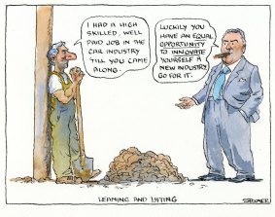
Responsibilisation and career development
Associate Professor Suzanne Rice,
Dr Mary Leahy
Associate Professor Gosia Klatt
University of Melbourne
Notes:
Creates a radical imaginery
Attends to power
Unmasks ideology
Understands the individual to be in a dialectic relationship with context
Humans have bounded but transformative agency

Slide 33

Responsibilisation
“The process by which responsibility for outcomes is transferred from the state to the individual, through a combination of policy actions and the framing of public discourse”

Slide 34
Documenting responsibilisation
probation practices (Kemshall, 2002)
domestic violence (Coy & Kelly, 2019)
child welfare (Liebenberg et al., 2015).
homelessness (Whiteford, 2010)
In education, a “disciplinary process of normalisation”
in which “the causes of educational ‘failure’ and social inequality are located within the family as cultural and moral deficiencies rather than as outcomes of structural and economic inequalities”
(Ball, 2017, pp. 201–202).

Slide 35
Australian policy discourse
I believe in a fair go for those who have a go, and what that means is part of the promise that we all keep as Australians is that we make a contribution and don’t seek to take one…So under our policies, if you’re having a go, you’ll get a go. Scott Morrison, Prime Minister, 2018
“We are a nation of lifters, not leaners” Joe Hockey, treasurer, 2014
“Being an adult means taking responsibility for the choices you make and making the best possible choices in the circumstances you face. Only after six months will young job seekers receive income support and then there will be a requirement to participate in at least 25 hours a week of work for the dole,” Tony Abbott, Prime Minister, 2014

Slide 36
1. How are individual choice and agency constructed in selected career development websites?
2. Are the constraints and enabling factors that impact on individuals identified and acknowledged in the selected career development websites, and if so, how?

Slide 37
Aboriginal and Torres Strait Islanders compared to non-ATSI
40% children developmentally vulnerable
67% NMS reading Yr 9
3% Bachelor’s degree (20-24)
2,000 per 100,000 incarcerated
50% employed
$550 equivalized gross household income
20% children developmentally vulnerable
91% NMS reading Yr 9
15% bachelor’s degree (20-24)
100 per 100,000 incarcerated
70% employed
$830 equivalized gross family income

Slide 38
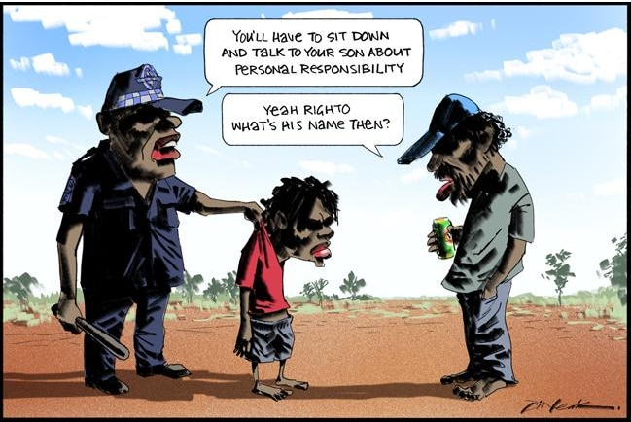
ATSI people in Australia
Discrimination
Few economic resources
Ongoing impact of colonization
Racism, verbal abuse, avoidance
Notes:
2016

Slide 39

5 career tips for Aboriginal and Torres Strait Islander students (MyFuture)
1. Develop your emotional intelligence
2. Build your networks
3. Get that internship/work experience
4. Find mentors
5. Lifelong learning
Notes:
You can have all the skills in the world and put in the hard yards. But if you never get an opportunity, then all
your talent, potential and hard work is lost.
Also, note the deficit perspective – there is no positioning of Indigenous people as having skills, knowledge etc. because of their Indigeneity.

Slide 40
Power, ideology, agency
Artefacts | Our critique
Limitless agency | External forces shape and constrain agency
State invisible | State actively shapes opportunities
Apparent equality | Disadvantage impacts capacity to transform opportunities into capabilities
Individuals as entrepreneurs | Risk management not solely individual
Notes:
External forces include legislative frameworks, geographical location, social attitudes, family social capital,
Examples of state include using unemployment policies to manage the economy (as opposed to buffer stock of jobs) and discrimination (30% schools, 40% aged care religious afflilation), also the privatization of education means young people are unequally prepared to navigate websites, interview well, write a CV and application etc. before they even enter the job market. Privatisation of schools, 83.9% of Indigenous students in government schools (compared to 66% of non-Indigenous).

Slide 41
Implications for career development
Practitioners
Raised personal awareness among CD practitioners – own and others’ thinking (Howard et al., 2018)
Support clients to understand limits
The field:
Be aware and shape discourse
Notes:
discursive practices were used to dehumanise and bind the unemployed in a paradox as both victim and perpetrator of their own circumstances were thorough and normalized
underpinned by a mix of ideas of choice, blame, status, and difference

Slide 42
References:
Ball, S. (2017). The education debate (3rd ed). Bristol University Press.
Coy, M., & Kelly, L. (2019). The responsibilisation of women who experience domestic violence: A case study from England and Wales. In C. Hageman-White, L. Kelly, & T. Meysen (Eds.), Interventions against child abuse and violence against women: Ethics and culture in practice and policy (pp. 155–163). Verlag Barbara Budrich.
Kemshall, H. (2002). Effective practice in probation: An example of ‘advanced liberal’ responsibilisation? The Howard Journal of Criminal Justice, 41(1), 41–58. https://doi.org/10.1111/1468-2311.00224
Liebenberg, L., Ungar, M., & Ikeda, J. (2015). Neo-liberalism and responsibilisation in the discourse of social service workers. British Journal of Social Work, 45(3), 1006–1021. https://doi.org/10.1093/bjsw/bct172
Whiteford, M. (2010). Hot tea, dry toast and the responsibilisation of homeless people. Social Policy and Society, 9(2),
193–205. https://doi.org/10.1017/S1474746409990340

Slide 43
Responsibilisation
“The process by which responsibility for outcomes is transferred from the state to the individual, through a combination of policy actions and the framing of public discourse”

Slide 44
Documenting responsibilisation
probation practices (Kemshall, 2002)
domestic violence (Coy & Kelly, 2019)
child welfare (Liebenberg et al., 2015)
homelessness (Whiteford, 2010)
education (Ball, 2017)

Slide 45
Australian policy discourse on careers & employment
“I believe in a fair go for those who have a go, and what that means is part of the promise that we all keep as Australians is that we make a contribution and don’t seek to take one…So under our policies, if you’re having a go, you’ll get a go.” Scott Morrison, Prime Minister, 2018
“We are a nation of lifters, not leaners” Joe Hockey, treasurer, 2014
“Being an adult means taking responsibility for the choices you make and making the best possible choices in the circumstances you face. Tony Abbott, Prime Minister, 2014

Slide 46
1. How are individual choice and agency constructed in selected career development websites?
2. Are the constraints and enabling factors that impact on individuals identified and acknowledged in the selected career development websites?

Slide 47
Aboriginal and Torres Strait Islanders
Non-ATSI
40% preschool children developmentally vulnerable
67% meet national minimum standard reading Year 9
3% Bachelor’s degree (20-24)
2,000 per 100,000 incarcerated
50% employed
$550 equivalized gross household income
20% preschool children developmentally vulnerable
91% meet national minimum standard for reading Yr 9
15% bachelor’s degree (20-24)
100 per 100,000 incarcerated
70% employed
$830 equivalized gross family income

Slide 48
ATSI people in Australia
Discrimination
Ongoing impact of colonization & actions of the state
Racism, verbal abuse, avoidance
Notes:
2016

Slide 49
5 career tips for Aboriginal and Torres Strait Islander students (MyFuture)
1. Develop your emotional intelligence
2. Build your networks
3. Get that internship/work experience
4. Find mentors
5. Commit to lifelong learning
Notes:
You can have all the skills in the world and put in the hard yards. But if you never get an opportunity, then all
your talent, potential and hard work is lost.
First, focus is on the individual
Second, state and the context is invisible
Third note the deficit perspective – there is no positioning of Indigenous people as having skills, knowledge etc. because of their Indigeneity.

Slide 50
Power, ideology, agency
Artefacts | Our critique
Limitless agency | External forces shape and constrain agency
State invisible | State actively shapes opportunities
Apparent equality | Disadvantage impacts capacity to transform opportunities into capabilities
Individuals as entrepreneurs | Risk management not solely individual
Notes:
External forces include legislative frameworks, geographical location, social attitudes, family social capital,
Examples of state include using unemployment policies to manage the economy (as opposed to buffer stock of jobs) and discrimination (30% schools, 40% aged care religious afflilation), also the privatization of education means young people are unequally prepared to navigate websites, interview well, write a CV and application etc. before they even enter the job market. Privatisation of schools, 83.9% of Indigenous students in government schools (compared to 66% of non-Indigenous).

Slide 51
Implications for career development
Practitioners
Need personal awareness among CD practitioners – own and others’ thinking (Howard et al., 2018)
Support clients to understand limits
The field:
Be aware and shape discourse
Notes:
discursive practices were used to dehumanise and bind the unemployed in a paradox as both victim and perpetrator of their own circumstances were thorough and normalized
underpinned by a mix of ideas of choice, blame, status, and difference

Slide 52
References:
Ball, S. (2017). The education debate (3rd ed). Bristol University Press.
Coy, M., & Kelly, L. (2019). The responsibilisation of women who experience domestic violence: A case study from England and Wales. In C. Hageman-White, L. Kelly, & T. Meysen (Eds.), Interventions against child abuse and violence against women: Ethics and culture in practice and policy (pp. 155–163). Verlag Barbara Budrich.
Kemshall, H. (2002). Effective practice in probation: An example of ‘advanced liberal’ responsibilisation? The Howard Journal of Criminal Justice, 41(1), 41–58. https://doi.org/10.1111/1468-2311.00224
Liebenberg, L., Ungar, M., & Ikeda, J. (2015). Neo-liberalism and responsibilisation in the discourse of social service workers. British Journal of Social Work, 45(3), 1006–1021. https://doi.org/10.1093/bjsw/bct172
Whiteford, M. (2010). Hot tea, dry toast and the responsibilisation of homeless people. Social Policy and Society, 9(2),
193–205. https://doi.org/10.1017/S1474746409990340

Slide 55

Using critical psychology in analysis of career guidance and counselling
Randi Skovhus & Rie Thomsen

Slide 56

Within the broader field of psychology, critical psychology is characterised by its focus on central themes such as “pursuing social justice, promoting the welfare of communities in general and oppressed groups in particular, and transforming the status quo of both society and psychology”
(Fox et al., 2009, p. 5).
Notes:
Tæl til fire, det er din gruppe på internatet

Slide 57
Meet Thomas
The case will particularly consider critical psychological analyses in relation to:
Attending to power
Understanding individuals to be in a dialectical relationship with context
Viewing human beings as having a bounded but transformative agency

Slide 58

Thomas
Thomas lives with his parents and younger siblings in a village some distance from his school, resulting in a lengthy commute. Thomas’s father is an unskilled worker with a job in Norway, meaning that he spends a lot of time away from the family home. Thomas’s mother has no qualifications and receives an early retirement pension.
In Year 9, Thomas tells the guidance counsellor that, inspired by his cousins, he would like to attend a general academic upper secondary programme as such qualifications ‘open a lot of doors’, adding that ‘he would like to study at the tertiary level’.
Thomas also tells the guidance counsellor that if it does not work out with the assessment of educational readiness required for entry, he is considering vocational training as a carpenter. Thomas’s teacher does not feel that he will be ready for general upper secondary education after Year 9. Both teacher and guidance counsellor believe that the optional Year 10 could help Thomas in developing certain academic competences and discuss how it would give him more time to think things over; perhaps he will discover that becoming a carpenter is a better option for him than general upper secondary education.

Slide 59
Thomas
At a follow-up meeting, the guidance counsellor says to Thomas that it would be interesting to figure out how he intends to use the general upper secondary exam: “It’s important not to do it just for the sake of doing it”.
Thomas explains that he has visited the national online guidance portal in search of more information about the different possibilities, but that he would need some help because: “I haven’t got a clue [about the various options at the tertiary level]. I want to be presented with the things you can actually use a general upper secondary education for…I’m not at all familiar with all that stuff”. The guidance counsellor replies that there are so many possibilities in terms of what you can study that it is virtually impossible to mention them all. “What’s important when it comes to upper secondary education is whether you can imagine using three years of your life on it and then, after those three years, you have to imagine that you’ll need to spend anywhere between two and seven years more on further studies”. “Yeah, you’re right”, Thomas replies. The guidance counsellor continues: “and if you can’t imagine doing that and think the path is too long and it just doesn’t make sense, then you should maybe consider not enrolling in general upper secondary education and then take another route and get a vocational education…there’s no point getting general upper secondary qualifications just to get general upper secondary qualifications. You should be able to use them for something”.

Slide 60
First person perspective
We must look around the individual to really see it. And […] we must start with and talk to the individual participants to see workings of the broader organized conditions and structures they take part in. A situated approach to the structural aspects of social practice – based on these curious observations – might constitute the building blocks of a critical position. (Busch-Jensen, 2013, p. 18)
Notes:
Det moderne – vejledningens raison d’être
det grundlæggende i praksisformen

Slide 61
Two first person perspectives
Thomas
Pursue tertiary education
Assesed not ready – not meeting the requirements – take optional 10th grade
Get information on tertiary programmes (expand agency)
Career guidance practitioner
Requires Thomas to explain his purpose of enrolling in an academic general upper secondary
Relates the missing answer on which tertiary programme he will pursue to the conclusion ‘consider other options
Explain that it is another career guidance unit that should provide Thomas with the desired information

Slide 62
The analyses helps ud to discuss
Which questions are asked to which students and why?
How the answers to questions asked by the career practitioner influence the practitioner’s evaluation of relevant next steps and the advice given
The analysis also draws attention to the practice of career guidance itself and shows how career guidance becomes a condition for students in their process of developing career possibilities, self-understanding and subjective standpoints in life.
AND WE SEE HOW A CRITICAL ANALYSES HELPS US; Understand HOW individuals are in a dialectical relationship with context, View human beings as having a bounded but transformative agency and Attend to power in career guidance

Slide 63
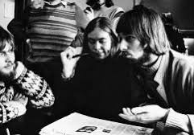

Randi Boelskifte Skovhus & Rie Thomsen (2022) Using critical psychology
in analysis of career guidance and counselling, British Journal of Guidance & Counselling, 50:4, 491-502, DOI: 10.1080/03069885.2022.2050672

