Slide 1
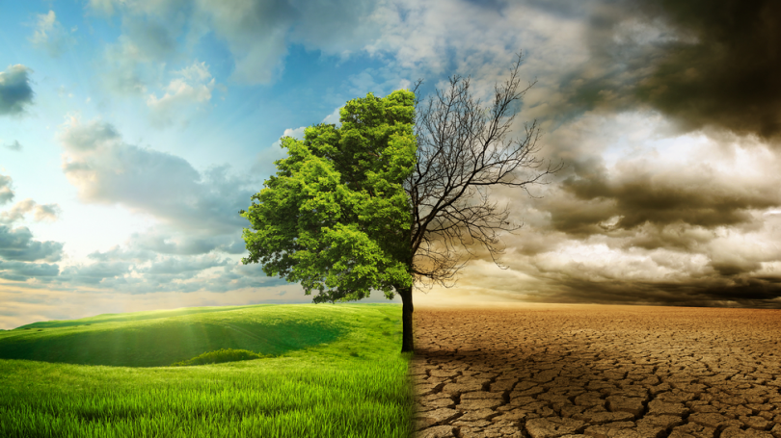
Green guidance
Why career development needs to pay attention to environmental change
Tristram Hooley

Slide 2
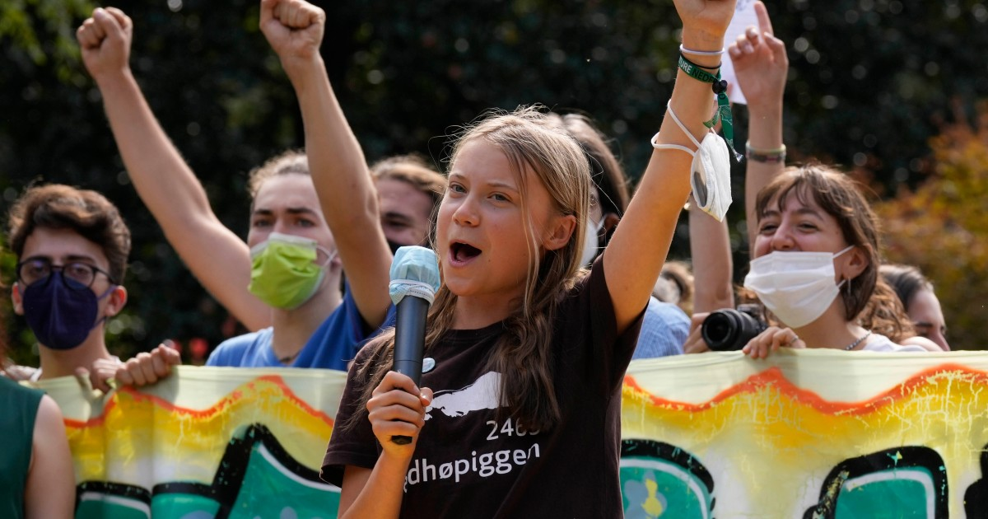
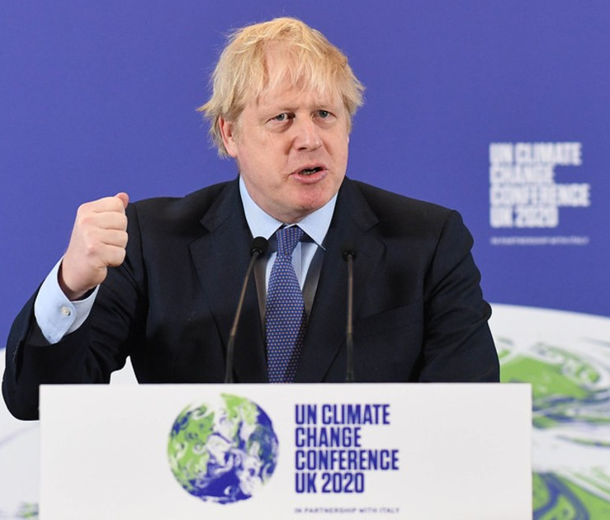
Last Year we had COP26…

Slide 3
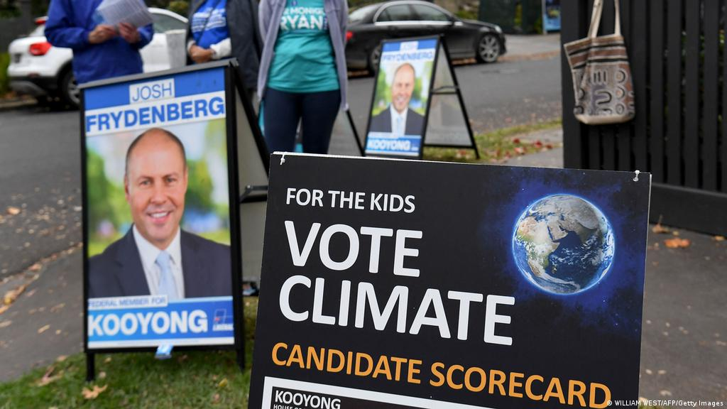
Earlier this year you had an election where climate change was a major issue

Slide 4


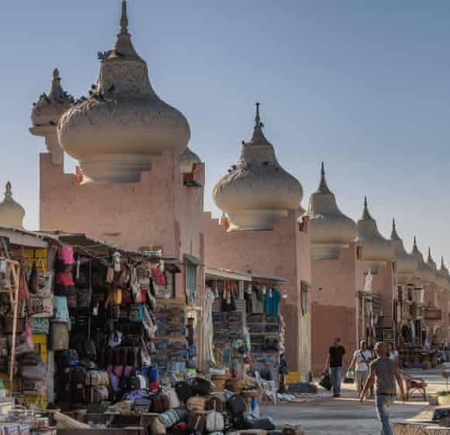
COP27 will be happening in November 2022

Slide 5
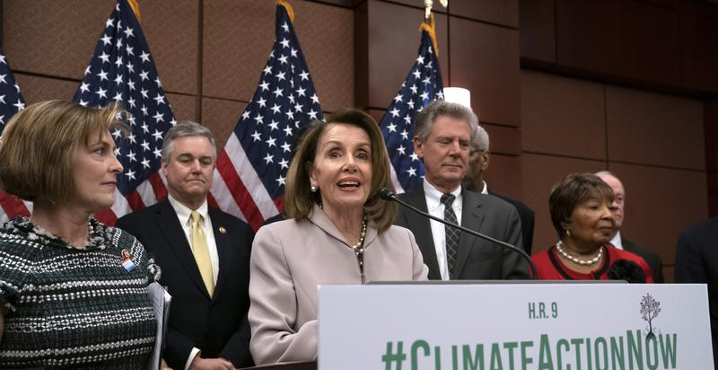
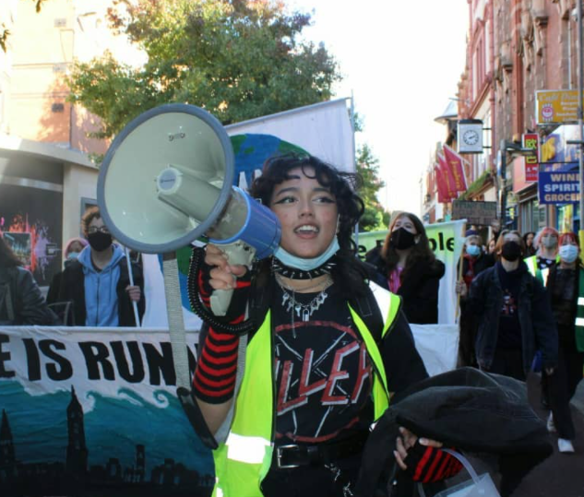
Climate change is the defining political issue of our times

Slide 6
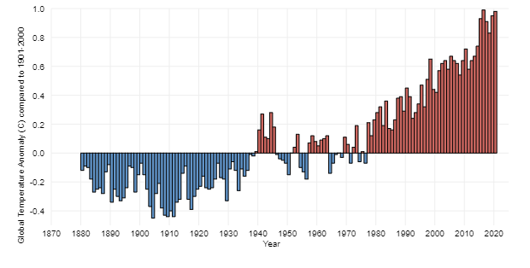
global surface temperature since 1880 (Compared to average 1901-2000)

Slide 7
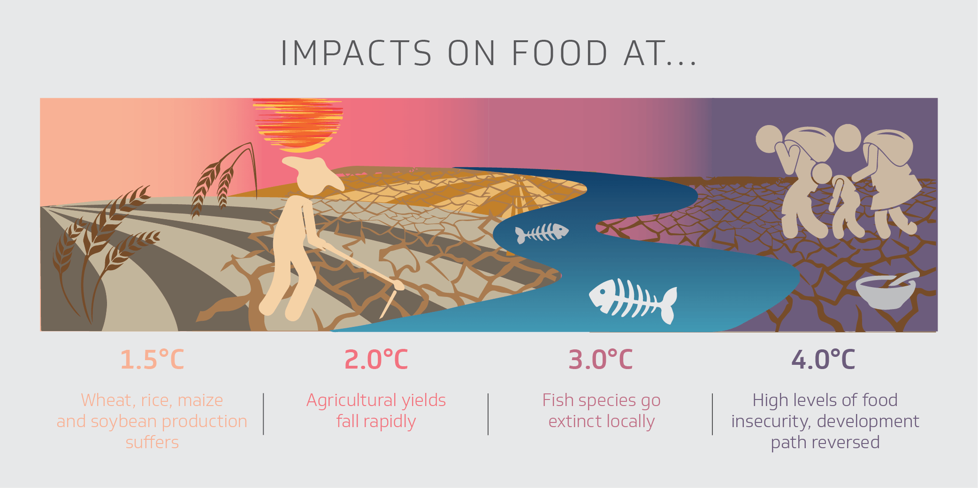

Slide 8
So what does this mean?
Rising prices
Shortages of goods
Growing inequality
Health issues
Increasing volumes of migration
And critically for us, shifts in the skills needed, the jobs available and the nature of those jobs.

Slide 9
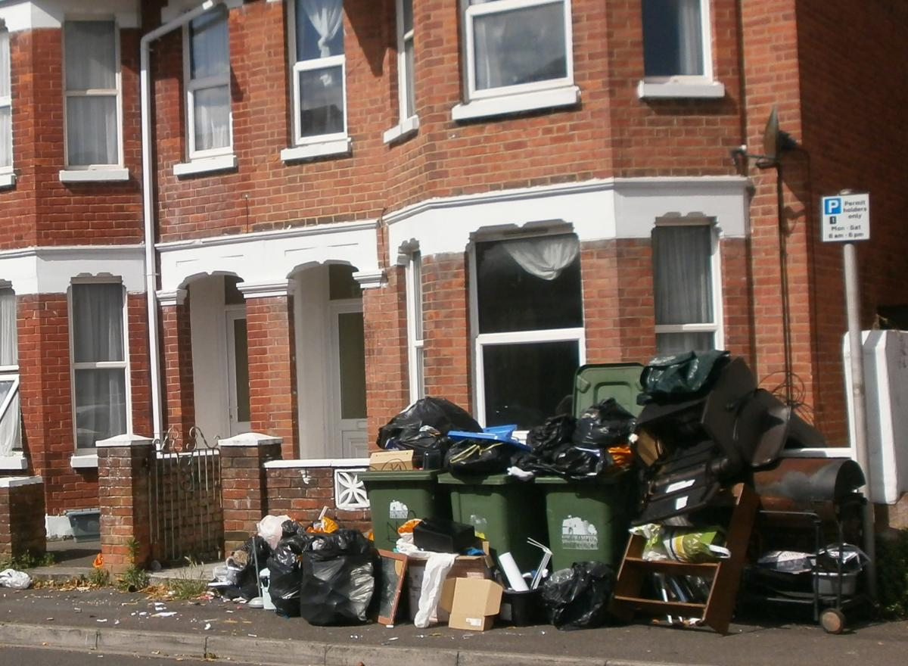
The environment is where we live
Climate change is critical, but it isn’t the only environmental issue.
The big picture matters because it impacts on the conditions in which people live and work.
But, our environment is also shaped by numerous small decisions and policies around us.
These can have big impacts on our health, wellbeing and standard of living. They can also influence how we work and what jobs are available.

Slide 10
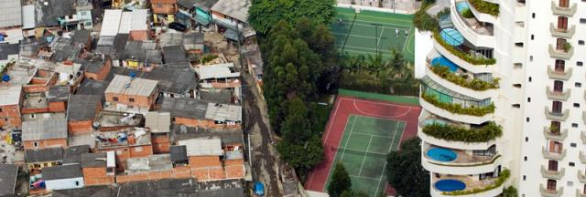
We are all in it together, but…
Image from São Paulo Brazil

Slide 11

Corporate influence

Slide 12
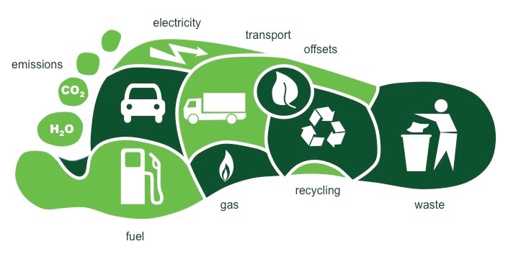
A focus on individuals making different choices (including career choices) is important, but insufficient

Slide 13
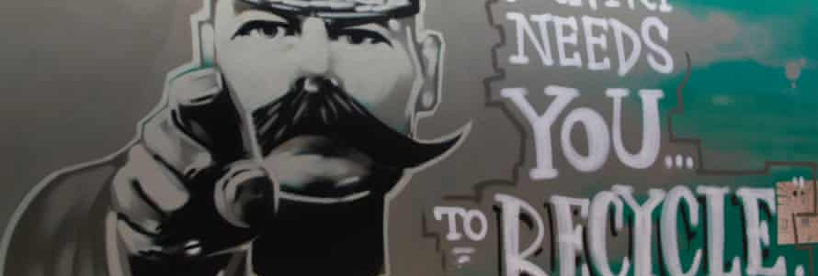
Responsibilisation to the individual

Slide 14
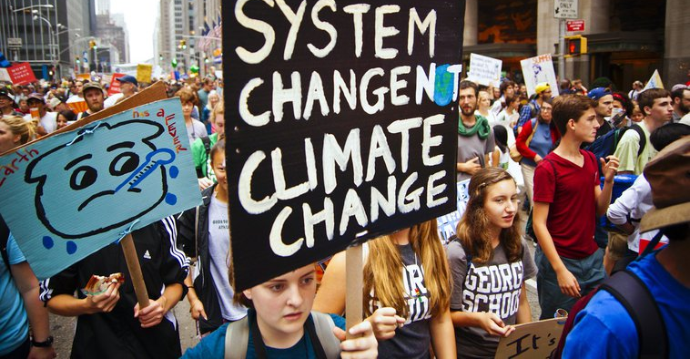

Slide 15
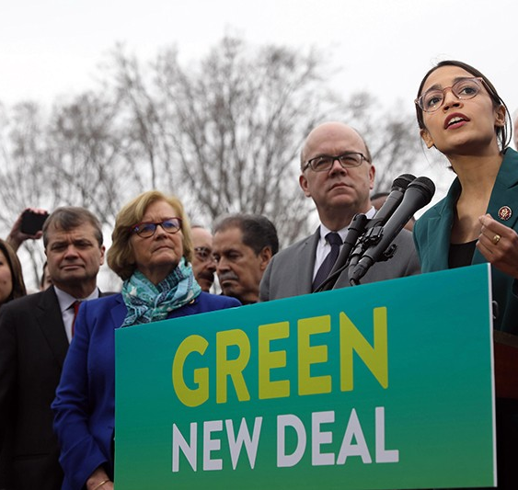
What does this look like?
The Green New Deal (or similar initiatives in different countries)
A political approach
Which foregrounds a system approach.
But also the politics of production, employment and work
This (re)engages us with ideas around work and career

Slide 16
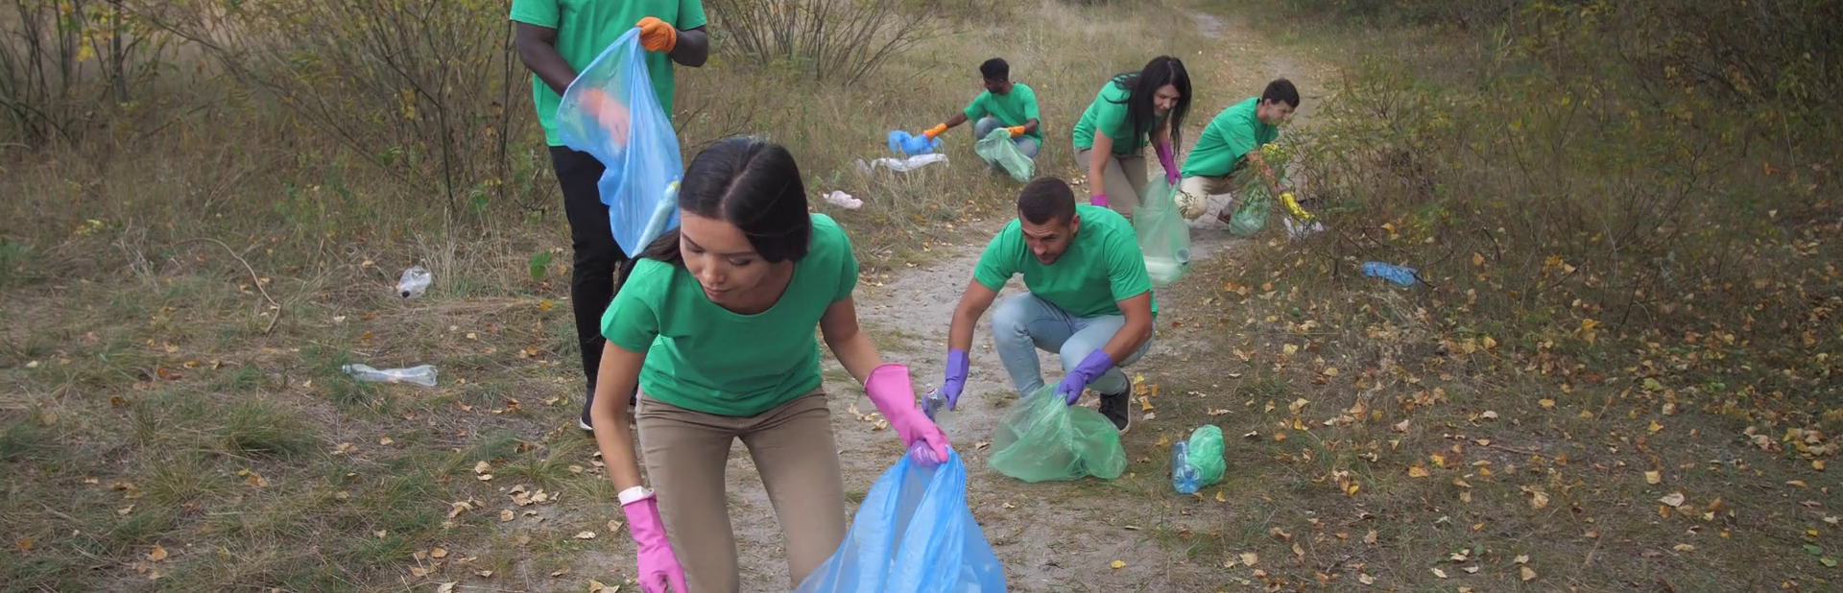
Career is how we relate to the world arouNd us

Slide 17
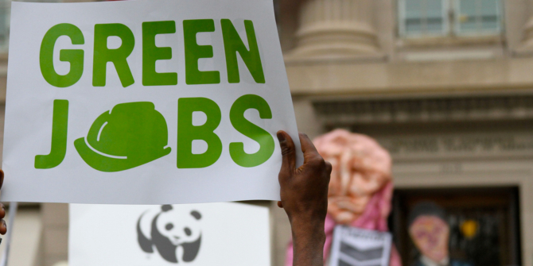
This is not (just) about choosing a green job

Slide 18

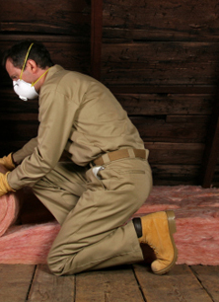
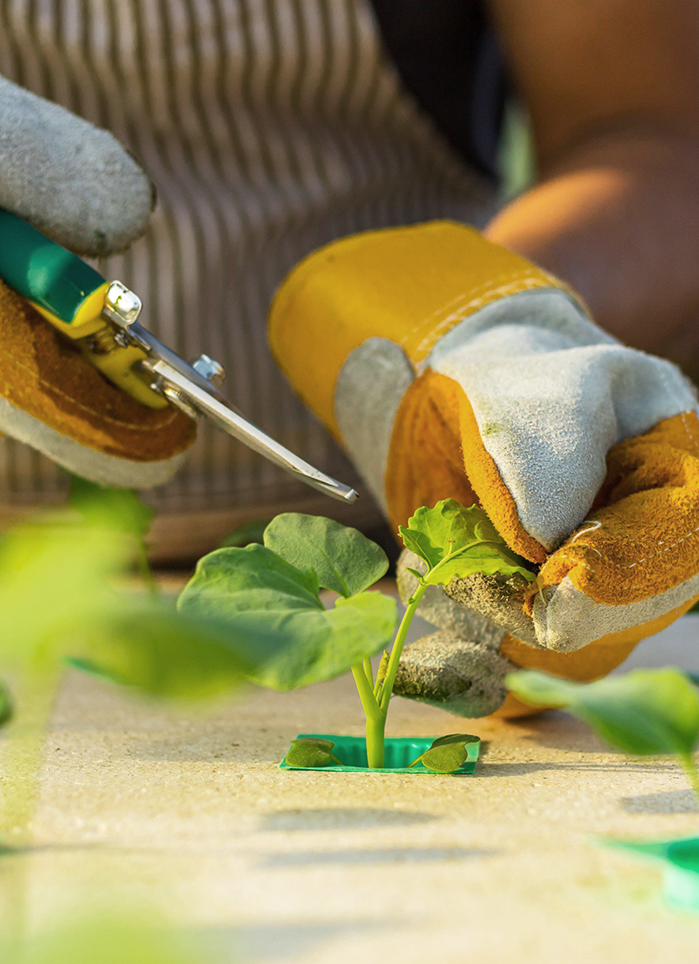
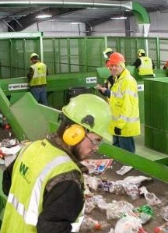
What is a green job?

Slide 19
Recent research from LinkedIn says that in Australia
Sectors hiring the most green talent
Construction
Fastest growing green jobs
Sustainability manager
Fastest ‘greening’ jobs
Engineering
Corporate services
Energy and mining
Public administration
Manufacturing
Ecologist
Geologist
HR
Risk management

Slide 20
Most in demand green skills in Australia
Sustainability
Environmental awareness
Environmental science
Environmental management systems
Environmental impact assessment

Slide 21
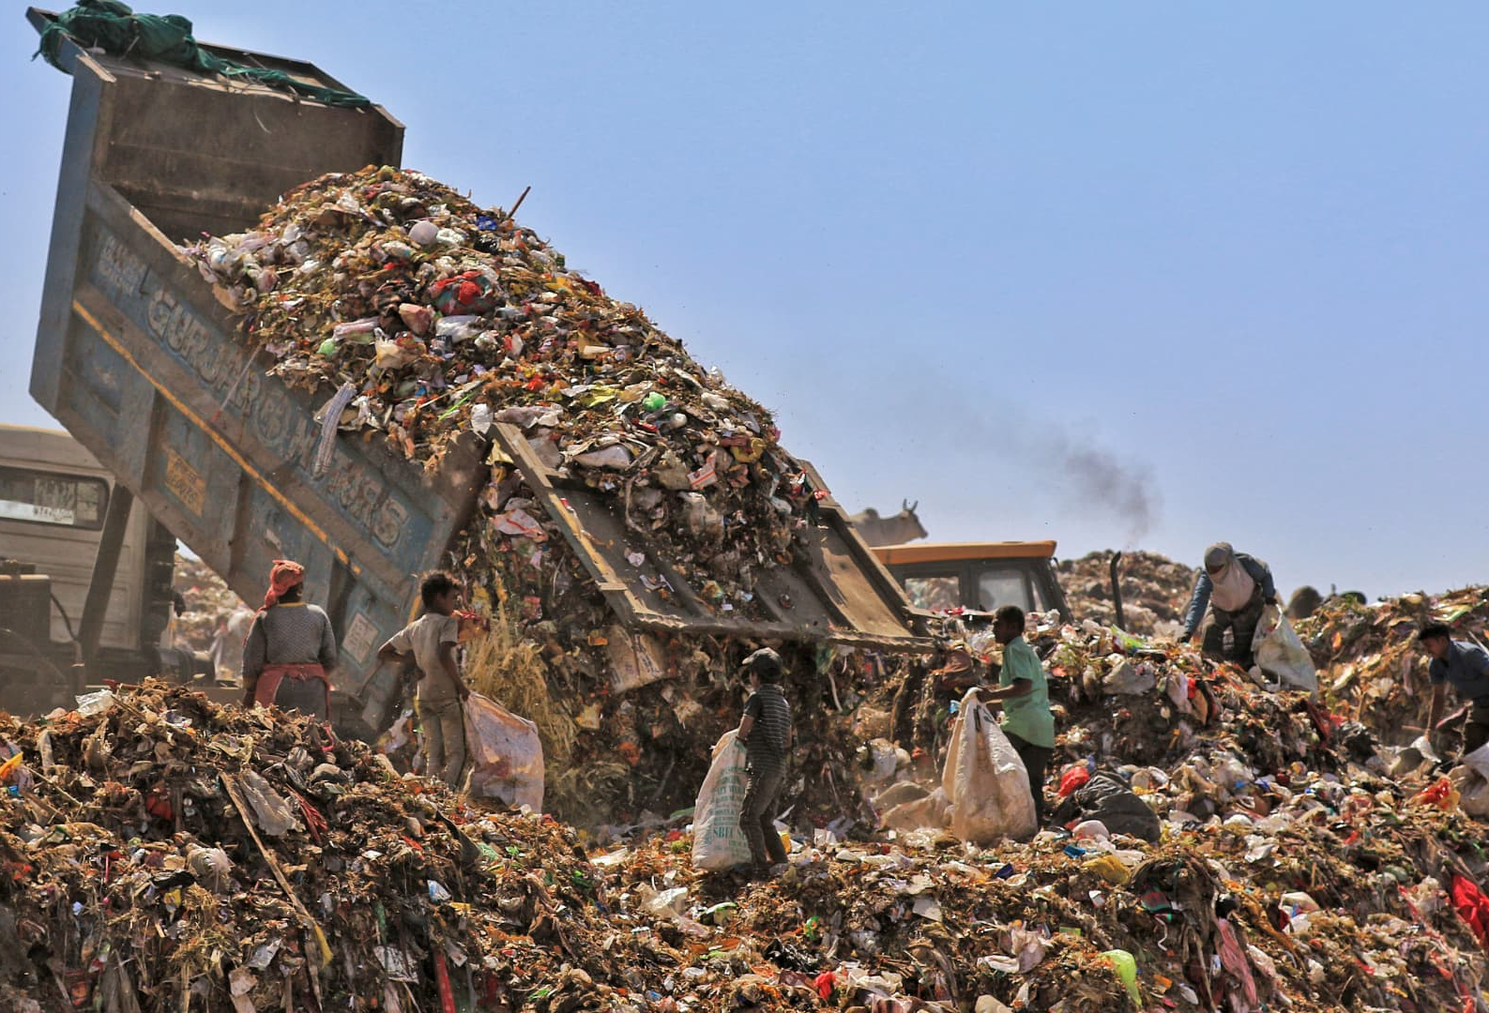
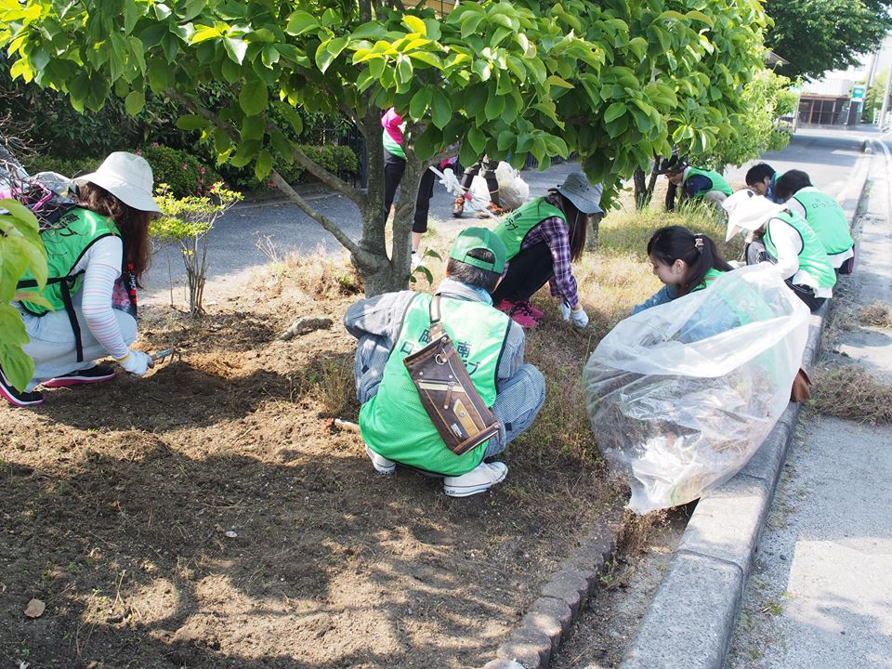
All work has an environmental impact

Slide 22

Organisations of all types are under pressure to change

Slide 23
This raises a range of questions that career development needs to address
Moral questions
What kind of work should I do (and not do)?
Do I understand the environmental implications of my work?
Do I have a responsibility to try and change the environmental impact of my work and my organisation?
Skills questions
Do I have the skills to make a positive contribution to the environment?
How are my skills going to have to change as my organisation and work changes?
Do I have the skills to influence environmental change within my organisation?

Slide 24
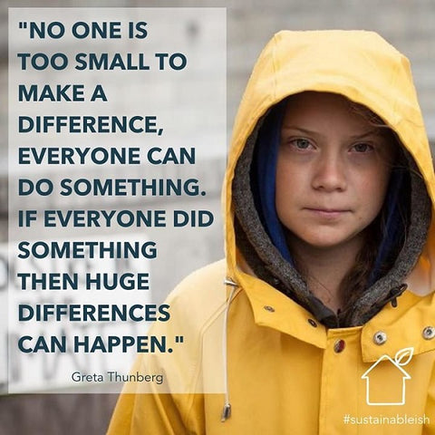
So how can career development professionals address these issues?

Slide 25

(Re)defining career guidance (career development)
“Career guidance supports individuals and groups to discover more about work, leisure and learning and to consider their place in the world and plan for their futures… Career guidance can take a wide range of forms and draws on diverse theoretical traditions. But at its heart it is a purposeful learning opportunity which supports individuals and groups to consider and reconsider work, leisure and learning in the light of new information and experiences and to take both individual and collective action as a result of this.”

Slide 26
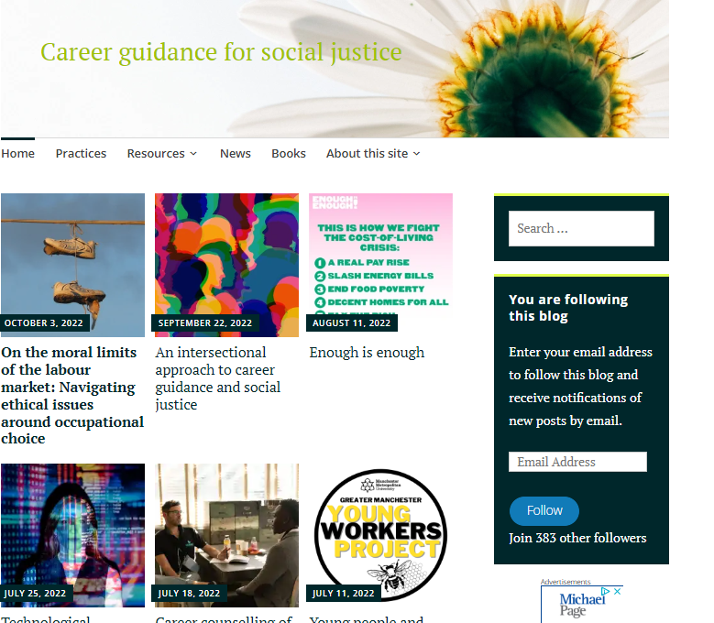
But we haven’t said enough about green issues
See the Career Guidance and Social Justice website at https://careerguidancesocialjustice.wordpress.com/tag/green-guidance/

Slide 27
The 5 signposts to a socially just career guidance
Build critical consciousness
Help people to understand the situation, not just to react to it on a personal level.
Name
oppression
Help people see injustice and organise in solidarity to access a decent career.
Question what is normal
Spend time discussing what normal means and whether it is something desirable.
Encourage people to work together
Facilitate social interaction and collaboration
Work at a
range of levels
Intervene into individual, group, organisational, social and political systems.

Slide 28
So if we put our green glasses on
Build critical consciousness
Help people to understand the what is happening to the environment, what it means for their career and the career of others and think about how they might react to it.
Name
oppression
Help people see where climate injustice exists and to notice where it is shaping their career. Support them to organise in solidarity with others experiencing similar issues.
Question what is normal
The idea of ‘normal life’ and ‘normal politics’ have become very challenging. Career guidance should include talking to people about how the concept of normal life and career is changing under pressure from the climate crisis.
Encourage people to work together
Help people to recognise the limits to individual action. Support them to consider how they can come together with others to access support and enact change.
Work at a
range of levels
As a professional you should raise these issues at an individual, group, organisational, social and political level.
Also encourage your clients to recognise that they also need to act on various levels as they drive their careers forward.

Slide 29
In counselling
Clarifying
Exploring
Evaluating
Action planning
Listen to what the client wants, build rapport, and set out the contract.
Ask them about whether they are concerned about the environment and whether this is part of their story or future?
Exploring possibilities and what they want to achieve.
Consider how this interacts with environmental change and policies. What influence can they exert?
Challenge inconsistencies, weigh up pros and cons and prioritise.
How does environmental change shape this? What additional challenges and opportunities does it present?
Strategising, planning and moving on.
What can you do to make a difference in relation to the environment?
An increasing number of clients are likely to proactively raise concerns about the environment.
We need to address this rather than externalise it.
We also need to introduce it as a key contextual issue that is shaping career development.
If they have not considered it, they are likely to be missing something important.

Slide 30

In education

Slide 31
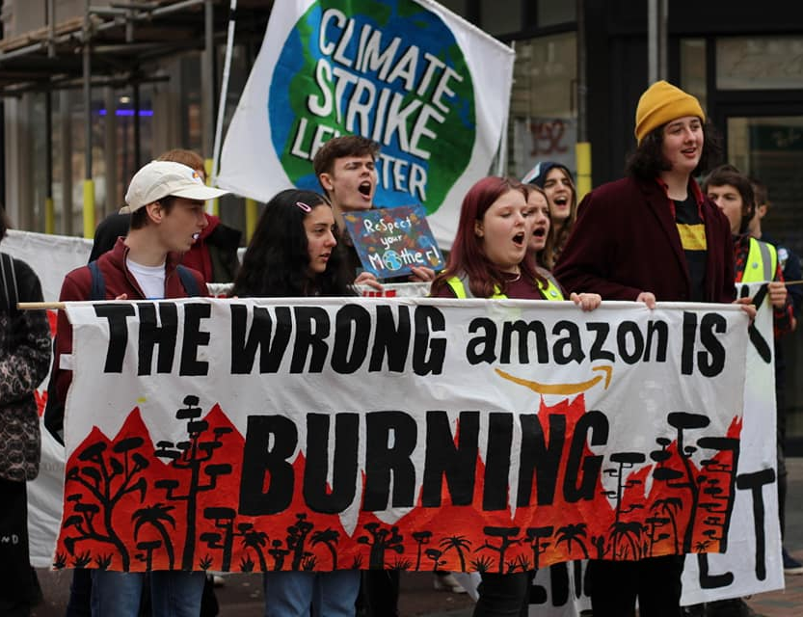
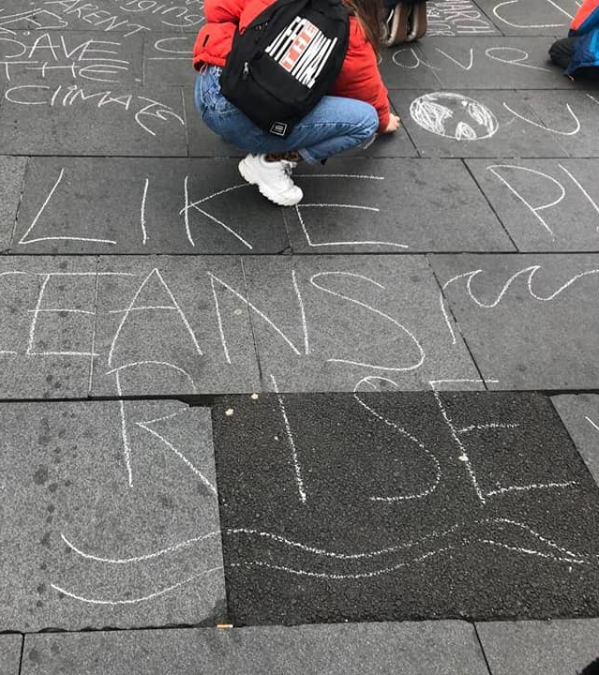
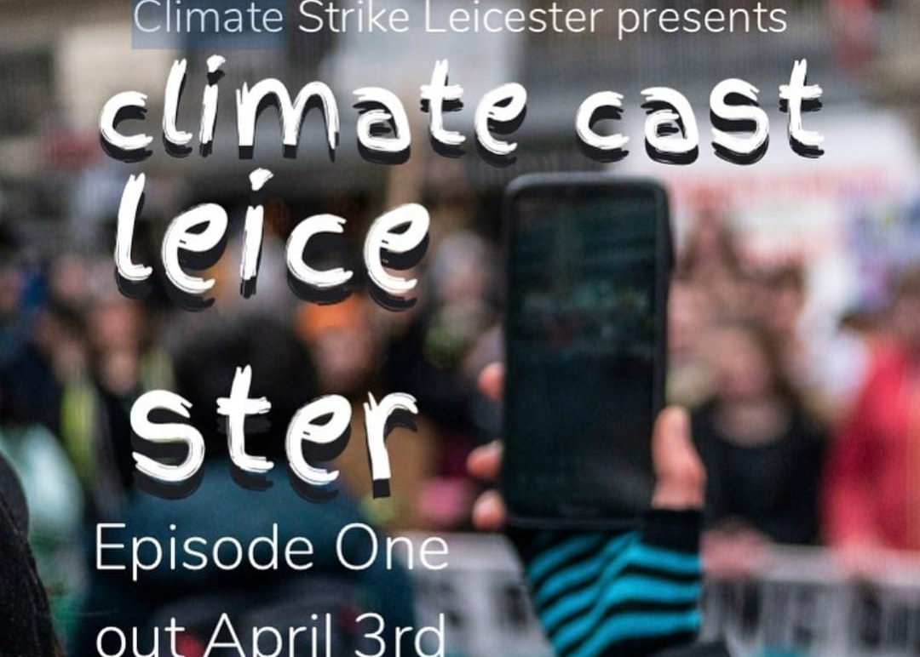
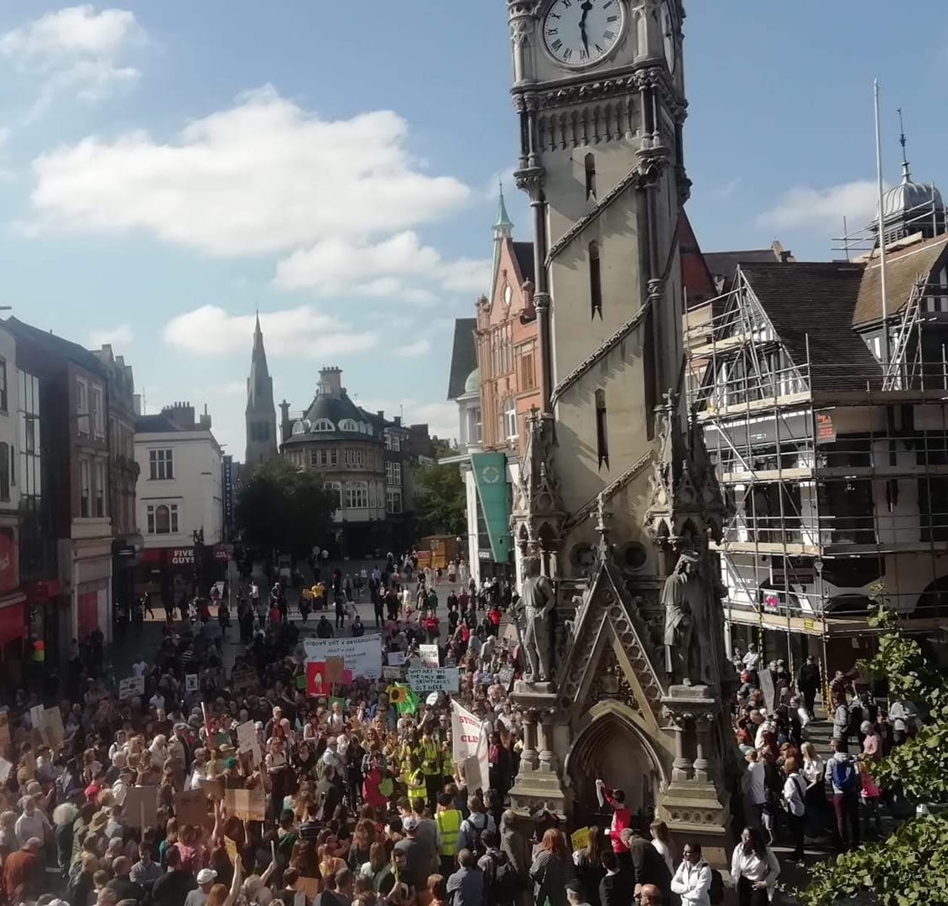
Climate Strike movement in schools
Young people are already engaging with these issues.
We cannot meaningfully talk about careers in schools without recognising this context.
So, how can we bring this into the careers curriculum?

Slide 32
Australian work studies curriculum
Skills for learning and work
Learning to learn
Work skills
Career and life design
Career development and management
The nature of work
Entrepreneurial behaviours
Gaining and keeping work
What new learning does the climate crisis require?
What skills will be necessary to take Australia to Net Zero?
Learning about green entrepreneurship and sustainable business.
Considering how career choices interact with environemental change both responding to it and shaping it.
Considering how the nature of work is changing to meet the demands of the climate crisis
Asking what key workplace competencies might be in a green business. Also discussing how to change and influence without endangering your employment.

Slide 33
An example activity
Divide students into small groups and encourage them to investigate different sectors of the economy.
Resources might include:
All your usual LMI sources plus others like…
Corporate Watch https://corporatewatch.org/ / How Climate Change Impacts the Economy https://news.climate.columbia.edu/2019/06/20/climate-change-economy-impacts/ / Emissions by sector https://ourworldindata.org/emissions-by-sector / CNBC https://www.cnbc.com/2014/10/22/7-industries-at-greatest-risk-from-climate-change.html / Newspapers
Sector | Key companies | Typical jobs | How does this sector impact the climate? | How will climate change impact on this sector?

Slide 34
Follow up questions and discussion
How is climate change changing business?
Are businesses doing enough? Is this businesses responsibility?
How is climate change impacting on the jobs that are likely to be available?
Where can you work if you want to be green?
What can you do if you work for a polluting company?

Slide 35
Useful resources for addressing climate change in Australia
Australia’s environment from ANU https://www.wenfo.org/aer/
Climate action tracker https://climateactiontracker.org/countries/australia/
Climate change education network https://climatechangeeducation.net.au/
Curious climate schools https://curiousclimate.org.au/schools/
Environmental statististic from ABS https://www.abs.gov.au/statistics/environment
Ethical jobs https://www.ethicaljobs.com.au/
Green career http://www.greencareer.net.au/

Slide 36
References and resources
Aronoff, K. (2021). Overheated: How capitalism broke the planet - And how we fight back. Public Affairs US.
Career Development Institute. (2021). Career Development Framework. Stourbridge: Career Development Institute.
Coppola, M., Krick, T., Blohmke, J. (2019). Feeling the heat? Companies are under pressure on climate change and need to do more. https://www2.deloitte.com/us/en/insights/topics/strategy/impact-and-opportunities-of-climate-change-on-business.html
Hooley, T. (2022). Building a radical career imaginary: using Laclau and Mouffe and Hardt and Negri to reflexively re-read Ali and Graham’s counselling approach to career guidance. British Journal of Guidance and Counselling. https://doi.org/10.1080/03069885.2022.2058697
Hooley, T., Sultana, R. and Thomsen, R. (2018). Career guidance for social justice: Contesting neoliberalism. London: Routledge.
Linkedin. (2022). Global green skills report 2022. https://economicgraph.linkedin.com/content/dam/me/economicgraph/en-us/global-green-skills-report/global-green-skills-report-pdf/li-green-economy-report-2022-annex.pdf
Linsey, R. & Dahlman, L. (2021). Climate change: Global temperature. https://www.climate.gov/news-features/understanding-climate/climate-change-global-temperature
Lukacs, M. (2017). Neoliberalism has conned us into fighting climate change as individuals. The Guardian. https://www.theguardian.com/environment/true-north/2017/jul/17/neoliberalism-has-conned-us-into-fighting-climate-change-as-individuals
Puiu, T. (2019). Major oil corporations spent $1 billion on climate lobbying against Paris Agreement-related regulations. ZME Science. https://www.zmescience.com/science/news-science/oil-corporations-lobbying-04235/
Red-Green Study Group. (1995). What On Earth is To Be Done? Manchester: Red-Green Study Group.

Slide 37
About me
Tristram Hooley, Professor of Career Education, Inland Norway University of Applied Sciences and University of Derby
Email: tristram.hooley@inn.no
Blog: http://adventuresincareerdevelopment.wordpress.com
Twitter: @pigironjoe

Slide 38
Summary
Climate change and wider environmental issues are becoming increasingly important for our careers.
It is not meaningful to talk to people about their careers without recognizing the changing context of environmental change.
A critical approach, linked to wider consideration of social justice, provides us with the best framework for considering these issue as part of career management.
Career education provides an important space within which we can get individuals thinking about environmental issues.

