Slide 1
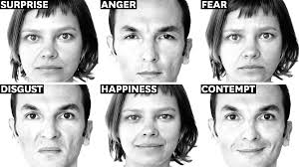
‘Reading’ a job application
Andrea Cox, Careers Consultant for SLLF
Queen Mary University of London
Notes:
https://hbr.org/2018/09/how-to-get-better-at-reading-people-from-different-cultures

Slide 2


Symbolises a writing exercise
Symbolises a discussion using microphone or chatbox
Feel free to write comments/questions in the chatbox as we go along
You will need a pen and paper

Slide 3
What are the kinds of feelings you can have when reading a job description?
Write a word or an emoji into the chatbox
Notes:
Link to mental imagery work done in week 2 teaching
Elicit if there are:
Embodied responses (heart rate, feelings of excitement/stress)
Thoughts / Mental narrative
Explain rationale for the question – We start to generate responses to texts like this in the first few seconds of reading. Our psychosomatic experiences may affect our response to the text – whether we apply or not, mindset for writing an application, reinforce positive/negative beliefs

Slide 4
I’m going to show you two job descriptions – on a piece of paper write down honestly how you are feeling when you read them
Notes:
Initially give students 30 seconds for each job description

Slide 5
INTERNSHIP A - Do you have a keen attention to detail, an enthusiasm for publishing, and a hunger for learning? Then apply now to join this academic publisher for a 6-month internship…
Liverpool University Press is the UK’s third oldest university press, with a distinguished history of publishing exceptional research since 1899. LUP is looking for a Marketing Assistant to join them for a 6-month paid internship. The successful candidate will learn the fundamentals of marketing books, along with a set of skills that can be applied across the spectrum of the publishing industry. You will likely be working in a hybrid home/in office environment, with a line manager and mentoring provided by experienced managers with regular opportunities for discussion and feedback over the course of six months.
Knowledge, skills, experience
Keen attention to detail
Great interpersonal skills
An enthusiasm for publishing
A hunger for learning and a can-do attitude
Previous experience organising events
Ideally you will have written copy for a website or a blog or you have created marketing materials
Academic requirements
A degree would be an advantage, but all candidates are welcomed who have performed strongly at A-level and can demonstrate excellent attention to detail

Slide 6
INTERNSHIP B - TPP’s aim is to improve access to healthcare data, making sure it is available whenever and wherever it is needed. TPP’s Communications & Marketing team are the voice of the company. The team manage all aspects of the company’s image, develop our product marketing strategies, foster important relationships and grow the company’s global brand.
The is 6 month marketing internship will see you working on projects such as a complete marketing campaign for a smartphone app in China, speech-writing for an international TED conference, coordinating a government trade mission to India, and preparing digital content for events in Africa. During a typical week you might write a summary document for a health minister, promote our Artificial Intelligence technology to doctors, and work on the branding for smartphone apps used by millions of people. Skills and experience:
We’re looking for someone who is ready to take on an exciting challenge. You’ll have a self-confident attitude and be detail-oriented. You’ll have an interest in current affairs and healthcare. You’ll be able to write easy-to-understand narrative on complex topics. You will enjoy running our social operations. You’ll work with all our teams, from the clinical advisors to the software developers. You’ll have the drive and ambition to push our brand around the world.
TPP has been consistently recognised as an outstanding graduate employer. In both 2018 and 2019 we were awarded the “Top Company for Graduates to Work For”. We will give you an excellent starting salary of £35,000, this will be reviewed annually. You will also receive a range of benefits, including: Fantastic holiday entitlement, Regular social events, Opportunities to travel internationally, Pub Fridays
Requirements
Predicted 2:1 or above at degree level
Minimum BBB/BBC at A-level, International equivalents are accepted, see below for details.

Slide 7
In breakout groups of three discuss your responses to the two job descriptions (write these questions down!)
1. How did you feel reading them and why?
2. Would your feelings affect whether or not you would apply?
Make a note of these three questions. We will have a group discussion about your responses after 7 minutes. Please can one person from each group be ready to share one point about either of the internships
Notes:
In group discussion:
Get students to vote (anonymously) if they would apply to A, B, both or neither
For internship A what is appealing / off-putting – idea of ‘learning’, mentoring, lack of salary information (what does this mean?), degree being an advantage but not necessary, response?
For internship B what is appealing / off-putting – explore salary, international travel, concepts of ‘data’, how to assess showing ‘interest in current affairs + healthcare’ (what does interest mean? Can we develop interest? Would we want to?). Does Comparative Literature qualify you to do this job?

Slide 8
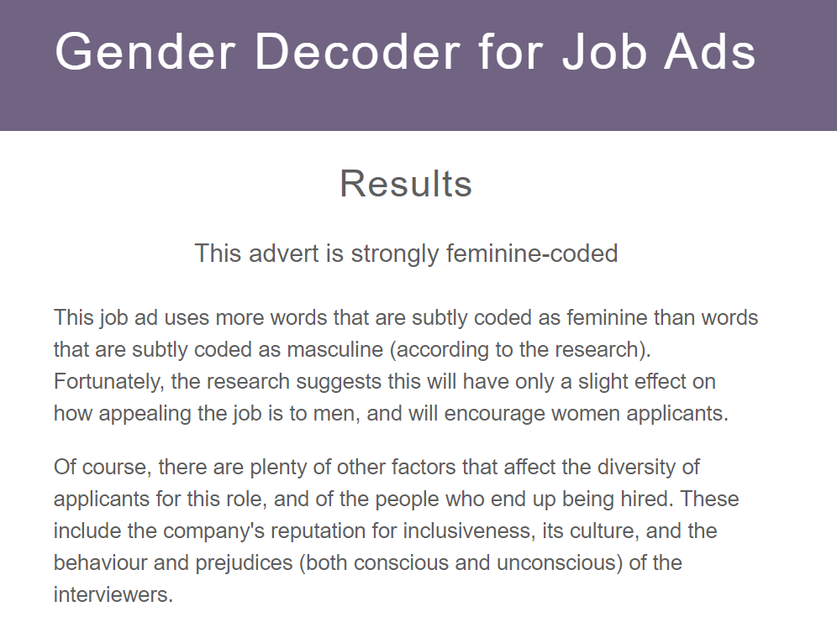
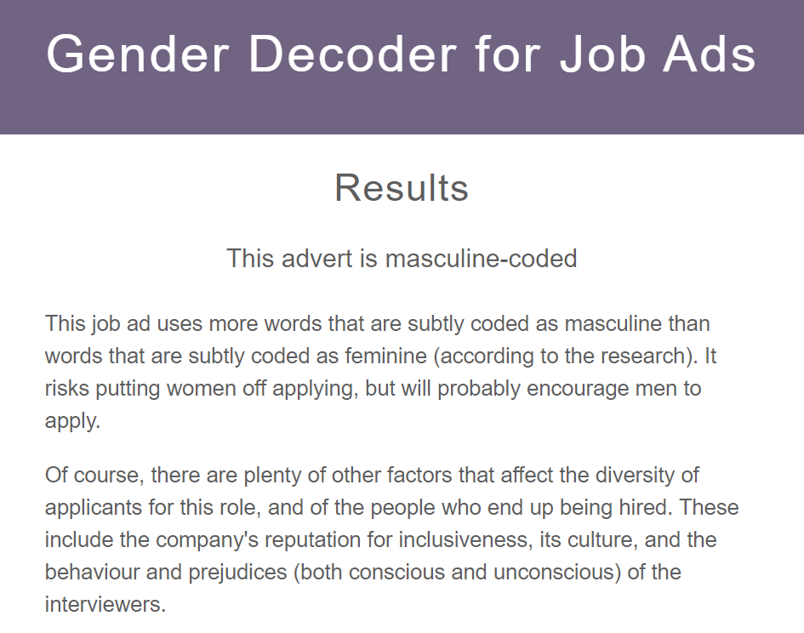
Gender decoder tool
http://gender-decoder.katmatfield.com/about
Internship A – publishing, LUP
Internship B – marketing, TPP
Evidence That Gendered Wording in Job Advertisements Exists and Sustains Gender Inequality (Journal of Personality and Social Psychology, July 2011, Vol 101(1), p109-28).
Notes:
The paper on which the tool is based demonstrates that men and women find different types of language appealing but that masculine-coded language affected influenced how much women they felt they 'belonged' in that occupation. Non-binary people were not included in the study.
Danielle Gaucher, Justin Friesen, and Aaron C. Kay, Evidence That Gendered Wording in Job Advertisements Exists and Sustains Gender Inequality (Journal of Personality and Social Psychology, July 2011, Vol 101(1), p109-28).

Slide 9
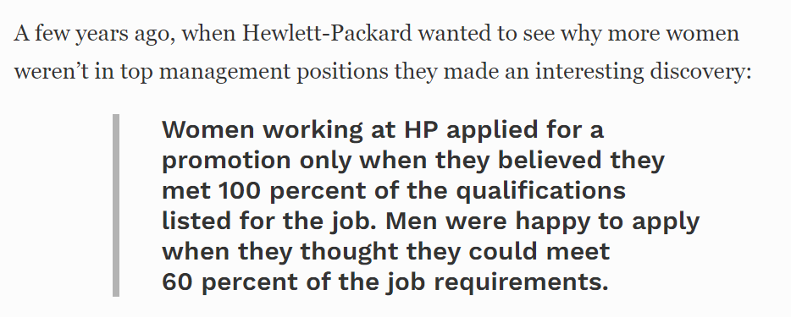
What questions do you have about this statistic?
This statement is widely quoted but is based on a senior HP manager’s perception and not based on fact! BUT it is very widely shared amongst women – why?
Are there ‘unwritten rules’ about how many skills you need to have before you apply for a job?
Notes:
Journalists revealed that this claim was only based on a speculative comment made by a senior executive at Hewlett Packard in an interview – no quantitative data was used to generate this “fact”. https://www.forbes.com/sites/womensmedia/2014/04/28/act-now-to-shrink-the-confidence-gap/.
Additional research by Tara Mohr: Survey of 1,000 American professionals, and asked them, “If you decided not to apply for a job because you didn’t meet all the qualifications, why didn’t you apply?” Men and women also gave the same most common reason for not applying, and it was by far the most popular, twice as common as any of the others, with 41% of women and 46% of men indicating it was their top reason: “I didn’t think they would hire me since I didn’t meet the qualifications, and I didn’t want to waste my time and energy.” In other words, people who weren’t applying believed they needed the qualifications not to do the job well, but to be hired in the first place. They thought that the required qualifications were…well, required qualifications. They didn’t see the hiring process as one where advocacy, relationships, or a creative approach to framing one’s expertise could overcome not having the skills and experiences outlined in the job qualifications. What held them back from applying was not a mistaken perception about themselves, but a mistaken perception about the hiring process. This is critical, because it suggests that if the HP finding speaks to a larger trend, women don’t need to try and find that elusive quality, “confidence,” they just need better information about how hiring processes really work.
https://hbr.org/2014/08/why-women-dont-apply-for-jobs-unless-theyre-100-qualified.

Slide 10


Summarising
In the chatbox:
What have you learned from your experience of ‘reading’ the two job descriptions?
Is this experience of reading different to the types of reading you have been doing on your course?

