Slide 1


What is a career anyway?
Tristram Hooley
Presentation to the Key tips for surviving work event at Oxford Brookes University 13/10/2021

Slide 2

Choices
Planning

Slide 3
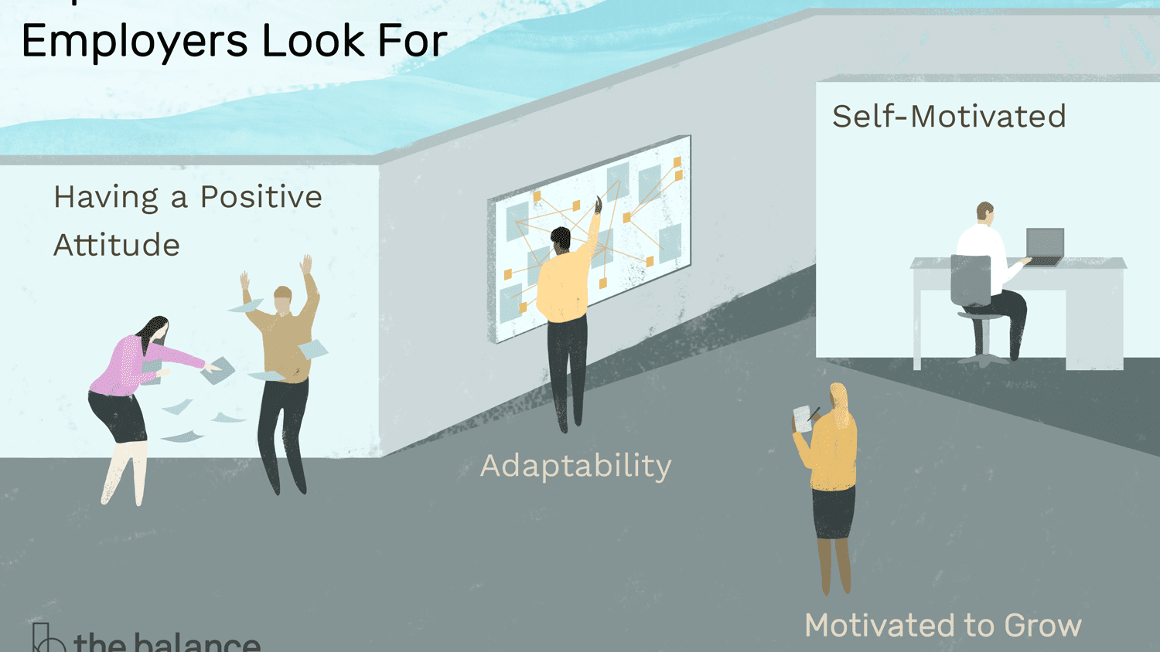

Slide 4


Slide 5

University rankings
Universities push the idea of ‘employability’
Telling students that they have to fit into the labour market, do it quickly and earn as much as possible
Student employment rates then influence university rankings
Whose interest in this ‘employabilty agenda’ in?

Slide 6


Slide 7


Slide 8
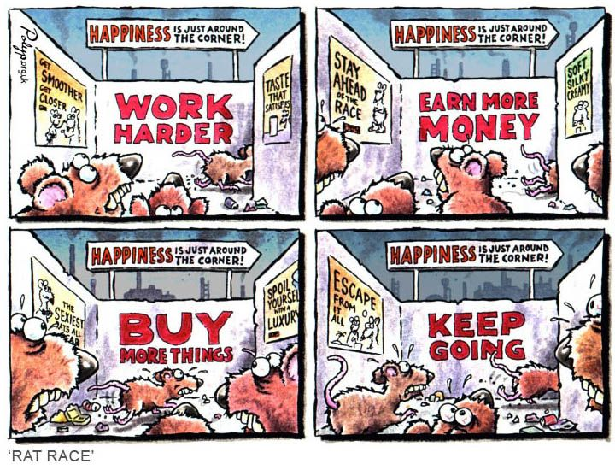

Slide 9

But what is the alternative?

Slide 10

There is no space outside of capitalism

Slide 11
(Paid) Work also offers us
Survival and power
Creativity and growth
Socialisation and connections with others

Slide 12
So how can we reframe ‘career’?

Slide 13
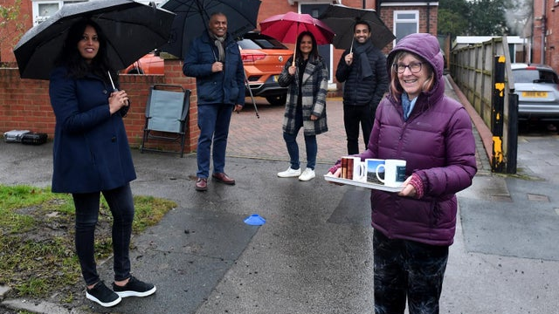
Career is our journey(s) through life, learning and work

Slide 14
Careers matter
In our careers we try and make our lives, and the lives of those around us, better.
We also exert control (within limits) over the direction that our careers progress.

Slide 15


Career is lifewide and lifelong
Lifewide
Lifelong

Slide 16

Real careers are twisted and complex

Slide 17

They are a journey not a race

Slide 18

They are where we negotiate with power, institutions and structures

Slide 19

They are social, not individual

Slide 20


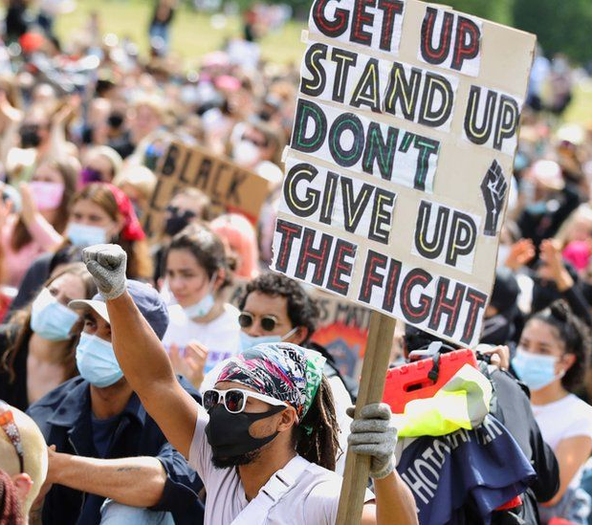

They are not just about paid work
Career is where we balance all aspects of our lives

Slide 21

So what do alternative career development strategies look like?

Slide 22

Build your understanding of the world and your place in it
Think about the structures that you are part of
Who benefits from them?
How do they connect to politics and the economy?
What is your role and your place?
Discuss this with others
Think about what you have the power to influence and change

Slide 23
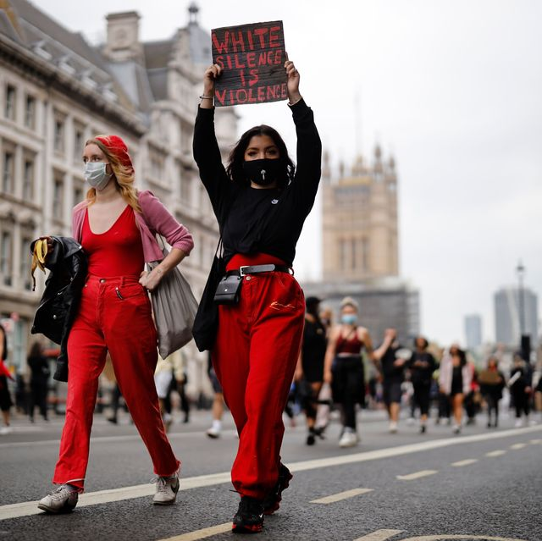
Name oppression when you experience it and see it elsewhere
Notice patterns in the way that you and other people are treated in your Workplaces and careers
Resist the urge to internaliSe oppression
Call it out and organiSe against it

Slide 24

Question what is normal
Ask what is considered normal and why
Consider how far you want to conform
Ask who is forcibly left out of ‘normal’
Challenge norming and celebrate diversity

Slide 25

Come together
We can’t career alone
A problem shared is a problem halved
Building a network of reciprocity is a key resources
Be willing to solve career problems through collective action as well as individual action
Join a trade union!

Slide 26
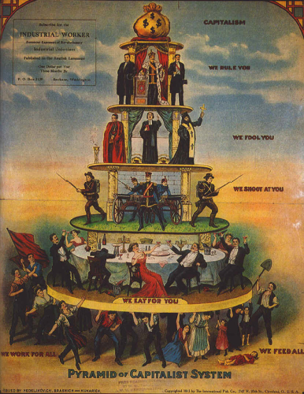
Work at a range of levels
Career is not just conducted in the workplace
You need to engage in career development at every level from your own psychology to global political action

Slide 27
About me
Tristram Hooley
Professor, Inland Norway University of Applied Sciences
Tristram.hooley@inn.no
Twitter: @pigironjoe
Blog: https://adventuresincareerdevelopment.wordpress.com/

Slide 28
Develop your career by…
Building your understanding of the world and your place in it
Naming oppression when you experience it and see it elsewhere
Questioning what is normal
Coming together with others
Working at a range of levels

