Slide 1

Social justice and social mobility
Implications for careers education and guidance
Tristram Hooley
Thursday 10th February, 2021
CDI – East of England

Slide 2


Career guidance
“Career guidance supports individuals and groups to discover more about work, leisure and learning and to consider their place in the world and plan for their futures… Career guidance can take a wide range of forms and draws on diverse theoretical traditions. But at its heart it is a purposeful learning opportunity which supports individuals and groups to consider and reconsider work, leisure and learning in the light of new information and experiences and to take both individual and collective action as a result of this.”
Notes:
Rie

Slide 3
Career guidance and
Public policy goals
Economic
Health and well-being
Environmental
Peace and justice
Educational
Social

Slide 4
Overview
Social mobility
Career guidance
Problems
Social justice
5 signposts

Slide 5
overview
Social mobility
Career guidance
Problems
Social justice
5 signposts

Slide 6


Slide 7
But, it isn’t as simple as that…
In the UK people from working class backgrounds…
Are more likely to be unemployed
Are more likely to be paid below the living wage
Earn 24% less on average than more advantaged peers
Are less likely to be in a professional job

Slide 8
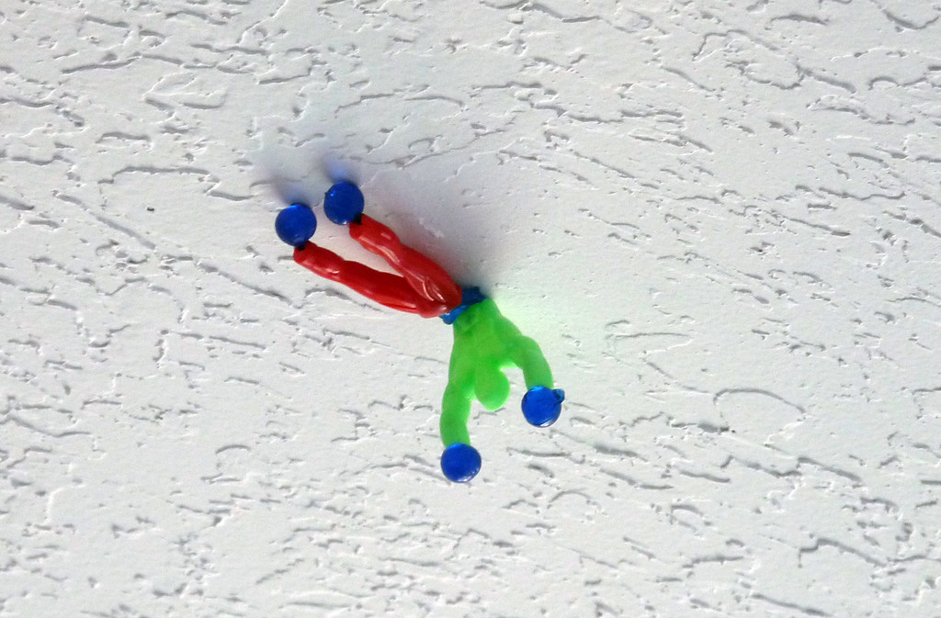

Problems
Sticky floors and sticky ceilings
There is social mobility at both ends.
But, people at the top aren’t complaining about this.

Slide 9

But All politicians want to increase social mobility

Slide 10

From the right
When we knock on people’s doors, I want people to know we are on their side… We are the party of the ladder, it was Churchill who first said that. The ladder symbolises everything we’re about.
If you're in poverty we'll get you into work, if you're in work we'll cut your taxes. If you want to own your home, we'll help you do that too.
Robert Halfon, Conservative

Slide 11
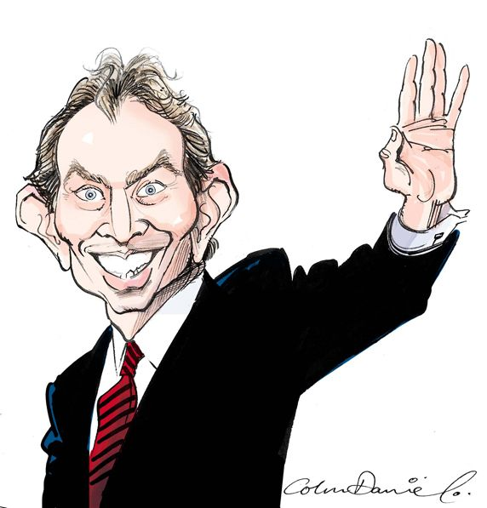
From the left
“And we must not only lift people out of poverty. We must transform their horizons, aspirations and hopes as well - through helping people get the skills they need for better jobs, and through giving them chance to save and build up a nest egg.
Only in this way will we drive up social mobility, the great force for equality in dynamic market economies.”
Tony Blair, Labour

Slide 12
Putting it simply
Government should try and make sure that where you come from does not determine where you can go in life.

Slide 13
overview
Social mobility
Career guidance
Problems
Social justice
5 signposts

Slide 14




Career guidance
Shows us new horizons
It gives us a map
It provides help, mentoring and support
And bridges us to our next step
All of this can contribute to social mobility.

Slide 15
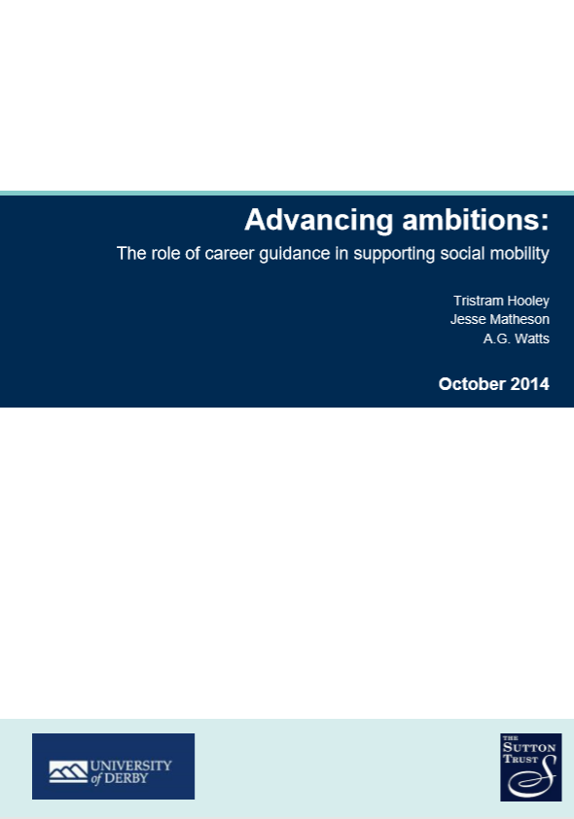
Career guidance can…
Provide access to information and intelligence about the labour and learning markets in ways that transcend existing social networks.
Demystify labour and learning market systems and support individuals to understand progression pathways and manage transition processes.
Engage with individuals’ assumptions about themselves and the world around them, informing and challenging them.
Listen to individuals’ aspirations and help them to operationalise these as well as considering alternatives.
Build the skills that people need to make decisions and transitions and to progress in their career (career management skills).
Broker access to networks beyond the ones that individuals normally have access to.
Provide mentoring and support to encourage persistence and remaining resilient in the face of setbacks.

Slide 16
Increasing evidence for this impact
That while career guidance (in the broadest sense) is good for everyone.
It is even better for those who do not have other forms of support.
See the work of Chris Percy, Elnaz Kashefpakdel and Anthony Mann for more evidence (included in the references).

Slide 17
overview
Social mobility
Career guidance
Problems
Social justice
5 signposts

Slide 18
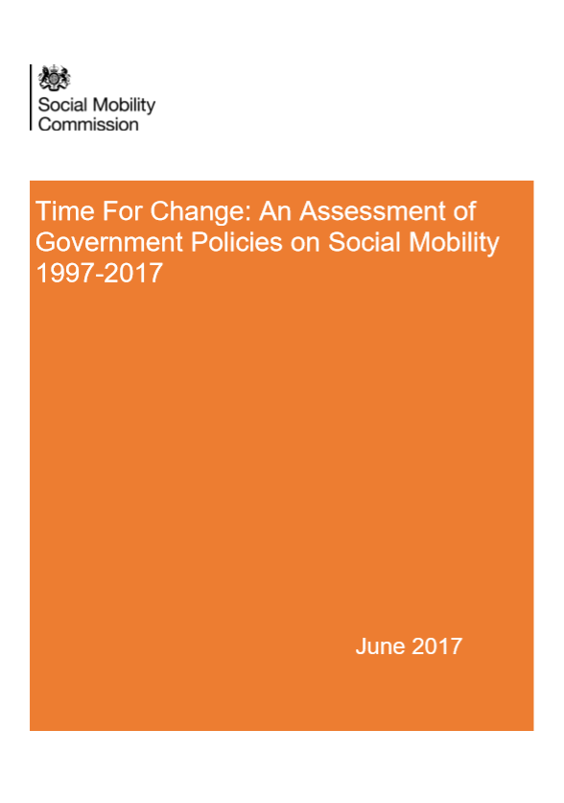
No real progress
After two decades of policy focus on social mobility very little progress has been made.

Slide 19


Slide 20
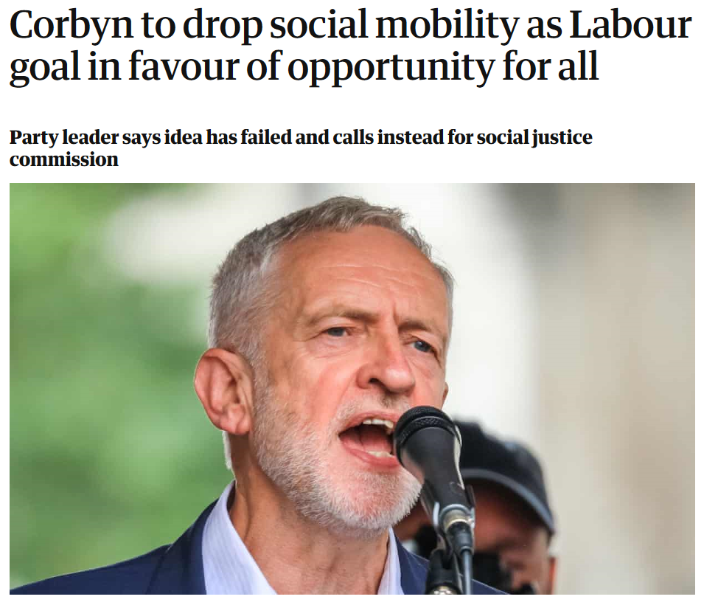

Slide 21

Theories of justice
Equality of opportunity
Equality of
outcome

Slide 22
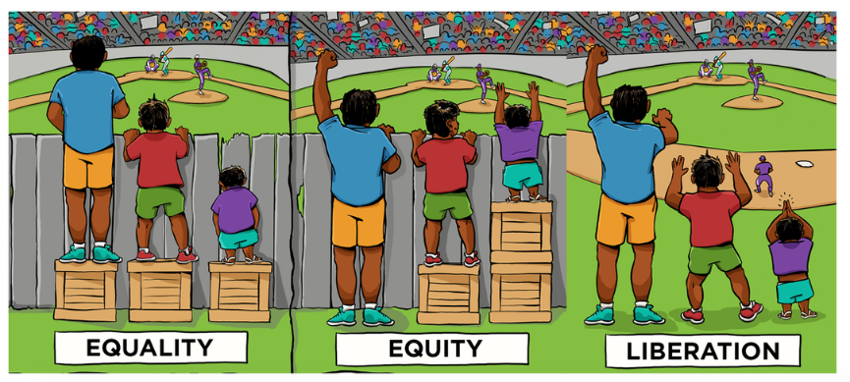

Slide 23
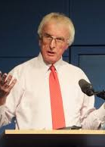
The politics of career guidance
Careers education and guidance is a profoundly political process. It operates at the interface between the individual and society, between self and opportunity, between aspiration and realism. It facilitates the allocation of life chances. Within a society in which such life chances are unequally distributed, it faces the issue of whether it serves to reinforce such inequalities or to reduce them.
Tony Watts
Notes:
Tristram

Slide 24
Socio-political ideologies of guidance
Conservative (social control)
Radical (social change)
Liberal (non-directive)
Progressive (individual change)
Focus on change
Focus on society
Focus on the individual
Focus on stability

Slide 25
overview
Social mobility
Career guidance
Problems
Social justice
5 signposts

Slide 26



There is a long tradition of thinking about career guidance and social justice…

Slide 27


The two volumes
2018
Career guidance for social justice – Explores context, critique and theory.
2019
Career guidance for emancipation – Explores diverse experiences of neoliberalism and possibilities for challenging and changing things.
Notes:
Rie

Slide 28

Career guidance for social justice website
https://careerguidancesocialjustice.wordpress.com
Notes:
Tristram

Slide 29
Social justice
Social justice is a contested concept with a long history.
We have adopted it because it brings together a concern with the collective good and a recognition that there are injustices to be righted.
Social justice is not an ideology, which offers a clear set of rules. Rather is a conversation that people can approach from a range of different perspectives.
The fact that it is ambiguous and open to debate, whilst also seeking to focus our attention on creating a better world is one of the reasons why it appeals to us.

Slide 30
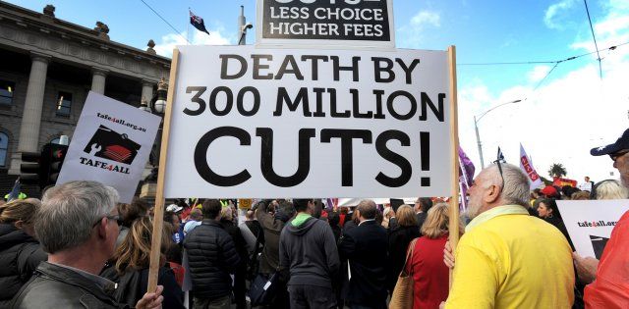
Neoliberalism
A description of a global political system.
This is not a finished and stable system, but is rather a tendency or project which is trying to move things in certain political direction.
It can be found in all countries and has influenced the parties of the left and right.
From 2008 many people have been contesting and arguing against it.
Covid-19 may be hastening its demise.
Or maybe not…
Notes:
Ronald

Slide 31

Ensuring opportunities for all means tackling those who are hoarding them
“For every oppressed group there is a group that benefits from that oppression and is privileged in relation to that group.”
Iris Marion Young (2004)

Slide 32
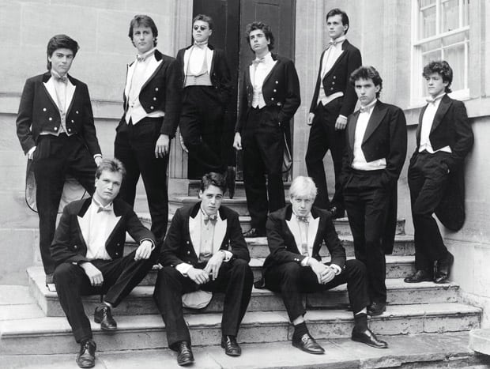
So how serious are they about social mobility…?

Slide 33
Overview
Social mobility
Career guidance
Problems
Social justice
5 signposts

Slide 34
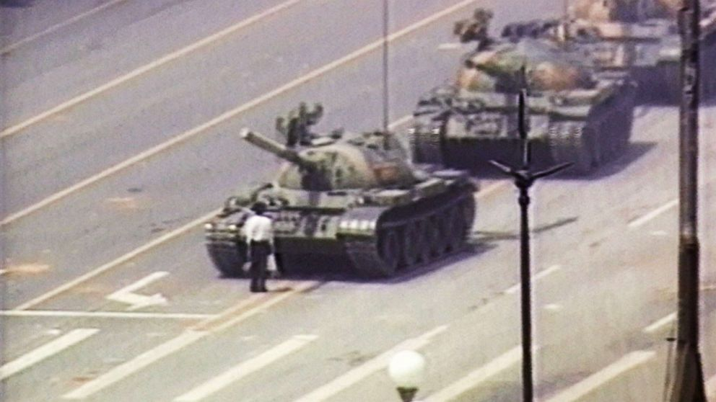
But what can career guidance really do to change things?

Slide 35
The five signposts towards socially justice career guidance
Build critical consciousness
01
Name oppression
02
Question what is normal
03
Encourage people to work together
04
Work at a range of levels
05
Notes:
Tristram

Slide 36
Critical consciousness
Build critical consciousness
01
Name oppression
02
Question what is normal
03
Encourage people to work together
04
Work at a range of levels
05
Helping people to understand the world as it is.
Thinking about why things are organised in the way that they are. E.g. asking who benefits from the current order.
Considering what can be changed and how we might go about changing it.

Slide 37

Naming oppression
Build critical consciousness
01
Name oppression
02
Question what is normal
03
Encourage people to work together
04
Work at a range of levels
05

Slide 38

Question what is normal
Build critical consciousness
01
Name oppression
02
Question what is normal
03
Encourage people to work together
04
Work at a range of levels
05

Slide 39

Encourage people to work together
Build critical consciousness
01
Name oppression
02
Question what is normal
03
Encourage people to work together
04
Work at a range of levels
05

Slide 40

Working at a range of levels
Build critical consciousness
01
Name oppression
02
Question what is normal
03
Encourage people to work together
04
Work at a range of levels
05

Slide 41
References I
Blair, T. (2002). Speech on welfare reform. The Guardian. https://www.theguardian.com/society/2002/jun/10/socialexclusion.politics1.
Dodds Staff. (2017). Robert Halfon and the long-running quest for a Tory ladder logo. Total Politics. https://www.totalpolitics.com/articles/diary/robert-halfon-and-long-running-quest-tory-ladder-logo.
Harvey, D. (2005). A brief history of neoliberalism. Oxford: Oxford University Press.
Hooley, T., Sultana, R.G. & Thomsen, R. (2018). Career guidance for social justice: Contesting neoliberalism. London: Routledge.
Hooley, T. Sultana, R.G. & Thomsen, R. (2019). Career guidance for emancipation: Reclaiming justice for the multitude. London: Routledge.
Mann, A., Kashefpakdel, E., & Percy, C. (2018). Socialised social capital?: The capacity of schools to use careers provision to compensate for social capital deficiencies among teenagers. In Essays on Employer Engagement in Education (pp. 68-83). London: Routledge.
Percy, C., & Kashefpakdel, E. (2019). Social advantage, access to employers and the role of schools in modern British education. In Career guidance for emancipation. London: Routledge.

Slide 42
References II
Robertson, P. (2020). Public policy for career guidance: Imagining a more ambitious agenda. Career guidance for social justice. https://careerguidancesocialjustice.wordpress.com/2020/11/24/public-policy-for-career-guidance-imagining-a-more-ambitious-agenda/
Social Mobility Commission. (2017). Time For change: An assessment of government policies on social mobility 1997-2017. London: Social Mobility Commission.
Social Mobility Commission. (2019). State of the nation 2018-19: Social mobility in Great Britain. London: Social Mobility Commission.
Stewart, H. (2019). Corbyn to drop social mobility as Labour goal in favour of opportunity for all . The Guardian. https://www.theguardian.com/politics/2019/jun/08/jeremy-corbyn-to-drop-social-mobility-as-labour-goal.
Watts, A.G. (2015). Socio-political ideologies of guidance. In Hooley, T. and Barham, L. (Eds.). Career Development Policy and Practice: The Tony Watts Reader. Stafford: Highflyers.
Young, I.M. (2004). Five Faces of Oppression. In Heldke, L. & O’Connor, P. (Eds.). Oppression, privilege, & resistance. Boston: McGraw Hill.

Slide 43
In summary
Social mobility is a powerful and influential policy ideas which career guidance can convincingly connect to.
But, there are also problems with it. ‘It’s a nice idea, but is it really practical’.
A broader more structural approach to social justice provides one way forwards.
We are beginning to explore what this looks like in practice.

Slide 44
About me
Tristram Hooley
Professor of Career Education,
University of Derby/ Inland Norway University of Applied Sciences/ Institute of Student Employers / Adviza
Email: tristram.hooley@gmail.com
Twitter: @pigironjoe
Blog: https://adventuresincareerdevelopment.wordpress.com/

