Slide 1

Career guidance and social justice
Developing emancipatory practice
Tristram Hooley
Sunday 26th January, Cannexus, OttAWA

Slide 2

By the end of this workshop you will be able to:
Explain what social justice is and demystify key concepts like opportunity structure, neoliberalism, oppression and responsibilisation
Discuss the ethical issues involved in engaging (and not engaging) in social justice as a careers practitioner
Identify the five signposts towards socially just career development (build critical consciousness; name oppression; question what is normal; encourage people to work together; and work at a range of levels) and explain their relevance to your practice
Make use of a range of resources, models and tools for delivering socially just career development

Slide 3

Career guidance
“Career guidance supports individuals and groups to discover more about work, leisure and learning and to consider their place in the world and plan for their futures… Career guidance can take a wide range of forms and draws on diverse theoretical traditions. But at its heart it is a purposeful learning opportunity which supports individuals and groups to consider and reconsider work, leisure and learning in the light of new information and experiences and to take both individual and collective action as a result of this.”
In other words it is a broad definition similar to how you would use the term ‘career development’.
Notes:
Rie

Slide 4
Who are you and why are you here?
Introduce yourself
Where do you work and in what role?
What are the main concerns that your students/clients have about their futures?
What are you hoping for from today?

Slide 5
Structure of today
Definitions and key concepts
Ethical dilemmas
The five signposts towards socially just career development
Background
Conclusions and next steps

Slide 6
Structure of today
Definitions and key concepts
Ethical dilemmas
The five signposts towards socially just career development
Background
Conclusions and next steps

Slide 7

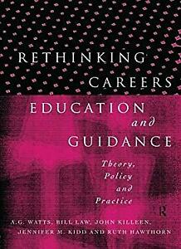

There is a long tradition of thinking about career guidance and social justice…

Slide 8
Career guidance, social justice and neoliberalism
2 book project to create space for a different kind of discussion about career guidance.
It builds on and extends a long tradition of thinking about career guidance and social justice.
Includes contributions from a wider range of countries including those in the global south.
Notes:
Rie

Slide 9


The two volumes
2018
Career guidance for social justice – Explores context, critique and theory.
2019
Career guidance for emancipation – Explores diverse experiences of neoliberalism and possibilities for challenging and changing things.
Notes:
Rie

Slide 10

Career guidance for social justice website
https://careerguidancesocialjustice.wordpress.com
Notes:
Tristram

Slide 11
Structure of today
Definitions and key concepts
Ethical dilemmas
The five signposts towards socially just career development
Background
Conclusions and next steps

Slide 12
Go to www.menti.com
I’m going to ask you for your definitions of some key concepts.
For each of them you can just enter the first three words that pop into your head.
We’ll then move on to look at how I’m defining them.
www.menti.com

Slide 13

Career is the individual’s journey through life, learning and work
Career is where the individual interacts with organisations, structures and wider society.
We pursue our careers in relation to others rather than alone.
Career is not just about paid work or hierarchical progression.
Everyone has a career. But, not everyone knows this.
Career is often constructed as a problem which needs to be solved by the individual, by career guidance and by public policy.
Notes:
Tristram

Slide 14
Social justice
Social justice is a contested concept with a long history.
We have adopted it because it brings together a concern with the collective good and a recognition that there are injustices to be righted.
Social justice is not an ideology, which offers a clear set of rules. Rather is a conversation that people can approach from a range of different perspectives.
The fact that it is ambiguous and open to debate, whilst also seeking to focus our attention on creating a better world is one of the reasons why it appeals to us.

Slide 15

The faces of oppression
Exploitation
Marginalisation
Powerlessness
Cultural imperialism
Violence
Unfair compensation and coercion
Loss of work, power and respect
Always being on the receiving end of orders
Imposing ‘norms’ on people
Random, unprovoked attacks
For every oppressed group there is a group that benefits from that oppression and is privileged in relation to that group (Iris Marion Young, 2004)
Notes:
Ronald

Slide 16
Neoliberalism
A description of a global political system.
This is not a finished and stable system, but is rather a tendency or project which is trying to move things in certain political direction.
It can be found in all countries and has influenced the parties of the left and right.
From 2008 many people have been contesting and arguing against it.
Notes:
Ronald

Slide 17
Neoliberal policies
Reducing the ability of states to conduct social and economic policy on their own terms.
Placing the state in the service of wealth and power.
Eroding democracy: ‘virtual senate’ of investors and lenders
‘Rolling back’ the welfare state
Increasing the concentration of wealth and monopolisation of profits
Deepening national and global inequality
Individualising structurally-induced problems and advocating that solutions must be the responsibility of the individual.

Slide 18
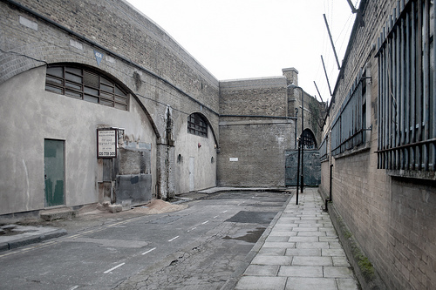

Ken Roberts and ‘opportunity structure’
Notes:
Tristram

Slide 19


Responsibilisation?
Career guidance typically locates both the problem and the solution in the individual. It helps to buy us into accepting the logic of the career ladder.

Slide 20
Structure of today
Definitions and key concepts
Ethical dilemmas
The five signposts towards socially just career development
Background
Conclusions and next steps

Slide 21
This is all very well…
But what has it got to do with career guidance/career development?

Slide 22
How do you deal with life being unfair?
Discuss how you deal with when your clients/students raising concerns that life isn’t fair?
Have you ever had a student who has…
concerns about doing a job that doesn’t pay well or that won’t give them a good standard of living?
been being marginalised? E.g. feeling that they aren’t respected.
been fed up with being told what to do all the time by their teachers/parents/employer?
been forced to conform to ‘norms’ by others? e.g. being told how to dress, act or behave in a way that makes them uncomfortable.
experienced aggression that makes them uncomfortable or actual physical violence?

Slide 23

The politics of career guidance
Careers education and guidance is a profoundly political process. It operates at the interface between the individual and society, between self and opportunity, between aspiration and realism. It facilitates the allocation of life chances. Within a society in which such life chances are unequally distributed, it faces the issue of whether it serves to reinforce such inequalities or to reduce them.
Tony Watts
Notes:
Tristram

Slide 24
Socio-political ideologies of guidance
Conservative (social control)
Radical (social change)
Liberal (non-directive)
Progressive (individual change)
Focus on change
So where are you?
Where would you like to be?
What are the ethical problems with each position?
Focus on society
Focus on the individual
Focus on stability

Slide 25
Key ethical issues
How do you know that you are right?
Consciousness raising vs. respecting difference of views
Undermining assumptions can be difficult
Your aims vs. the clients aims vs. the funders/government aims
Practicing safely within neoliberalism

Slide 26
Structure of today
Definitions and key concepts
Ethical dilemmas
The five signposts towards socially just career development
Background
Conclusions and next steps

Slide 27
The five signposts towards socially justice career guidance
Build critical consciousness
01
Name oppression
02
Question what is normal
03
Encourage people to work together
04
Work at a range of levels
05
Notes:
Tristram

Slide 28
Critical consciousness
Build critical consciousness
01
Name oppression
02
Question what is normal
03
Encourage people to work together
04
Work at a range of levels
05
Helping people to understand the world as it is.
Thinking about why things are organised in the way that they are. E.g. asking who benefits from the current order.
Considering what can be changed and how we might go about changing it.

Slide 29
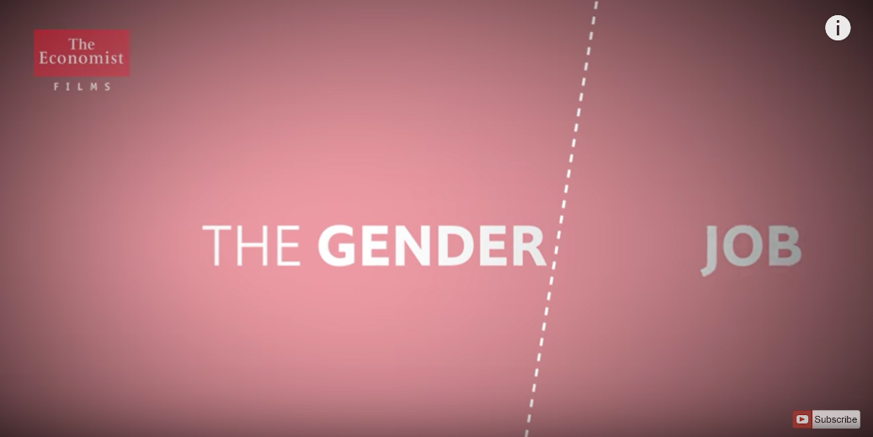
Example: I want to make a difference?
From Anne Delazon at the University of Reading
Full workshop at https://careerguidancesocialjustice.wordpress.com/2019/06/14/i-want-to-make-a-difference-social-justice-and-your-career/

Slide 30
Naming oppression
Build critical consciousness
01
Name oppression
02
Question what is normal
03
Encourage people to work together
04
Work at a range of levels
05
Exploitation
Marginalisation
Powerlessness
Cultural imperialism
Violence
Unfair compensation and coercion
Loss of work, power and respect
Always being on the receiving end of orders
Imposing ‘norms’ on people
Random, unprovoked attacks

Slide 31
Example: In career counselling
Help your clients to understand where their experiences are examples of oppression.
Challenge self-blaming behaviours.
Suggest possible names for what they have experienced and see how they feel about that.
Use this to help them recognise that others may have experienced similar things.

Slide 32

How the naming of oppression works…

Slide 33
Question what is normal
Build critical consciousness
01
Name oppression
02
Question what is normal
03
Encourage people to work together
04
Work at a range of levels
05
Our societies define what we assume is normal and natural.
This includes what constitutes a career, career success, a ‘good education’, a fulfilled life and so on.
What is seen as normal also varies for different kinds of people.
This doesn’t mean that what is normal is always bad.
But, by questioning what is normal and asking why it is normal we open up possibilities for people.

Slide 34



How do we deal with these different challenges to the norm?

Slide 35
Example: Norm criticism in Sweden
Look for (and reduce/challenge) examples of stereotypes and bias in labour market information.
Challenge assumed pathways (e.g. certain people go to university and others into vocational education).
Encourage students and clients to reflect on what they see as normal and consider whether they are happy with this. E.g. do they aspire to have a heterosexual nuclear family, is this the only way to live your life?
Encourage practitioners to be reflexive about their own use of norms.
See Frida Wikstand talking at https://careerguidancesocialjustice.wordpress.com/2019/02/14/frida-wikstrand-norm-criticism/

Slide 36
Encourage people to work together
Build critical consciousness
01
Name oppression
02
Question what is normal
03
Encourage people to work together
04
Work at a range of levels
05
Career is not an individual activity.
We pursue our career alongside others – sometimes co-operating, sometimes competing.
Strategies for improving your career can be collective as well as individual.
Recognising the importance of co-operation and collective struggle opens up a lot of new opportunities for career development.

Slide 37
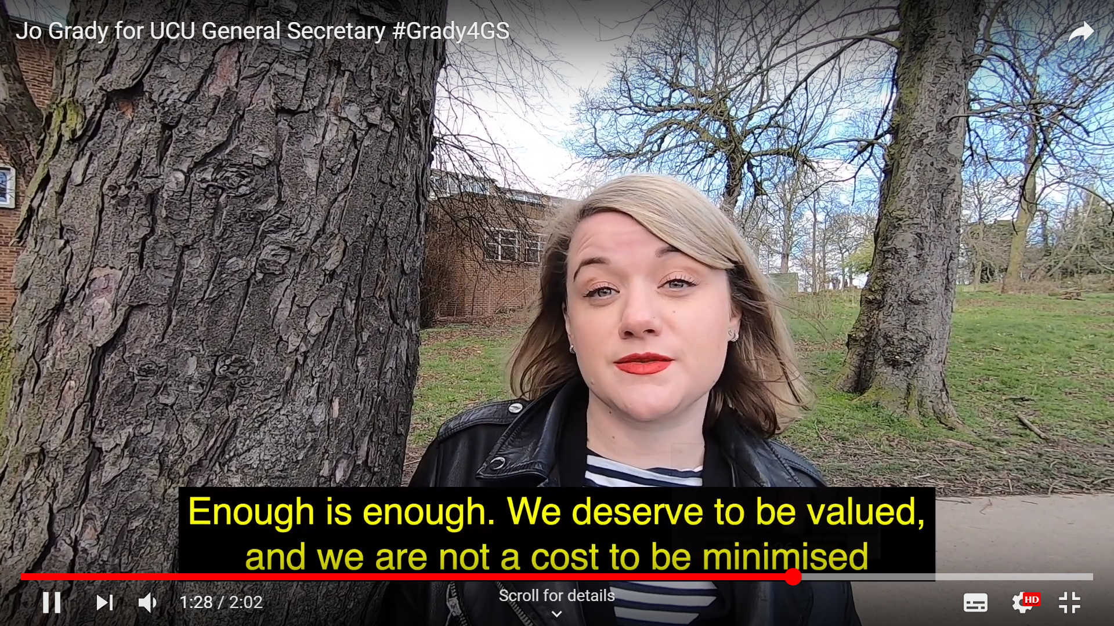
Example: Writing an open letter
Work together to write an open letter
What makes academic employment unjust?
What evidence do you have for this?
What could be done about this?
What evidence do you have that this would be a good thing?
What are your demands? Make them clear?
What power do you have? Why should your employers listen?
Slides are available at: https://careerguidancesocialjustice.wordpress.com/2019/06/14/what-kind-of-researcher-academic-do-you-want-to-be/

Slide 38
Working at a range of levels
Build critical consciousness
01
Name oppression
02
Question what is normal
03
Encourage people to work together
04
Work at a range of levels
05
Our careers take place at the level of:
  Our own psychology
  In our families
  In our workplaces
  In our communities
  In national politics
As a career counsellor you should feel free to intervene at any of these levels.
Sometimes people will be best helped by individual support, other times by system change (often by both at the same time).

Slide 39
Example: Subject choices
Career counsellors often help young people to make subject choices.
One told me that in his school he was regularly hearing about timetable clashes meaning that students couldn’t take the subjects that they wanted.
He continued to help students to manage the system, but started to campaign with the school leadership and administration to deal with the problem.
This is an example of feedback and system change within one institution. Often there is a need to work across even more levels e.g. engaging in political campaigning about benefit changes whilst helping individuals to deal with them.

Slide 40
Putting it into practice
Build critical consciousness
01
Name oppression
02
Question what is normal
03
Encourage people to work together
04
Work at a range of levels
05
Consider your own practice
Is this relevant as a way of thinking?
What are the challenges?
What opportunities would it offer?
How would you engage with the five signposts in your practice.

Slide 41
References
Harvey, D. (2005). A brief history of neoliberalism. Oxford: Oxford University Press.
Hooley, T., Sultana, R.G. & Thomsen, R. (2018). Career guidance for social justice: Contesting neoliberalism. London: Routledge.
Hooley, T. Sultana, R.G. & Thomsen, R. (2019). Career guidance for emancipation: Reclaiming justice for the multitude. London: Routledge.
Roberts, K. (1977). The social conditions, consequences and limitations of career guidance’, British Journal of Guidance and Counselling, 5, 1-9.
Watts, A.G. (2015). Socio-political ideologies of guidance. In Hooley, T. and Barham, L. (Eds.). Career Development Policy and Practice: The Tony Watts Reader. Stafford: Highflyers.
Young, I.M. (2004). Five Faces of Oppression. In Heldke, L. & O’Connor, P. (Eds.). Oppression, privilege, & resistance. Boston: McGraw Hill.
Wikstrand, F. (2019). Norm criticism: A method for social justice in career guidance. In Hooley, T. Sultana, R.G. & Thomsen, R. (2019). Career guidance for emancipation: Reclaiming justice for the multitude (pp.216-231). London: Routledge.

Slide 42
In summary
Our careers are not just an expression of our psychology or personal will, they are embedded in social structures.
The kind of (neoliberal) society in which we currently live means that many of us experience our careers through injustice and oppression.
Career guidance can play a variety of roles variously supporting or challenging the way that things are.
There is a growing literature which provides us with resources to think about career guidance differently.
The five signposts provide a basic framework within which we can develop more socially just forms of practice.
There are a growing number of examples that we can lend and borrow to help us to develop our practice in socially just ways.

Slide 43
About me
Tristram Hooley
Professor of Career Education, University of Derby/ Professor II, Inland Norway University of Applied Sciences/ Chief Research Officer, Institute of Student Employers
Email: tristram.hooley@gmail.com
Twitter: @pigironjoe
Blog: https://adventuresincareerdevelopment.wordpress.com/

