Slide 1
Social justice / spatial justice
Rosie Alexander
Twitter: @rosie148
rosie@rosiealexander.co.uk

Slide 2
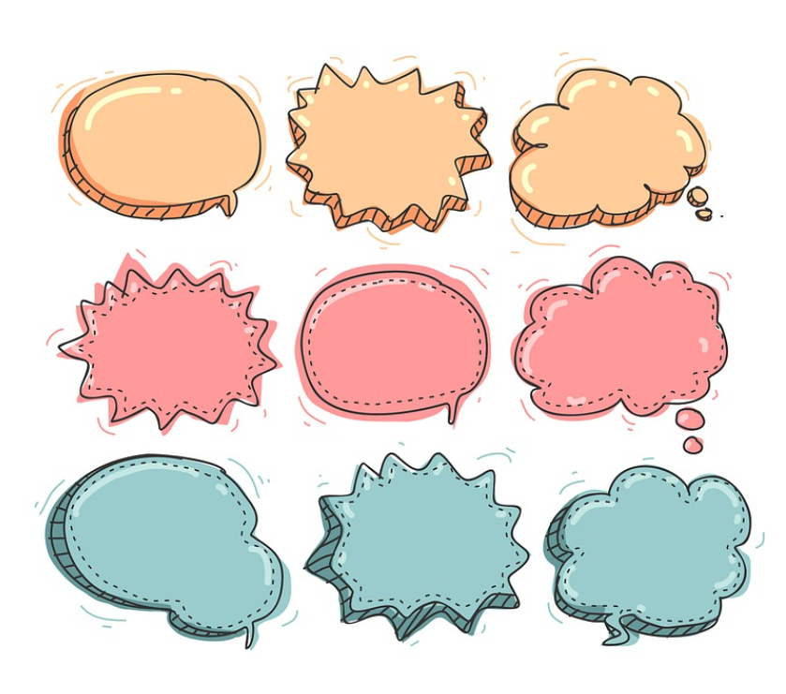
Structure of today’s session
Introduce the concept of spatial justice
Explore spatial justice in our own lives
Reflect on spatial justice in careers work.

Slide 3
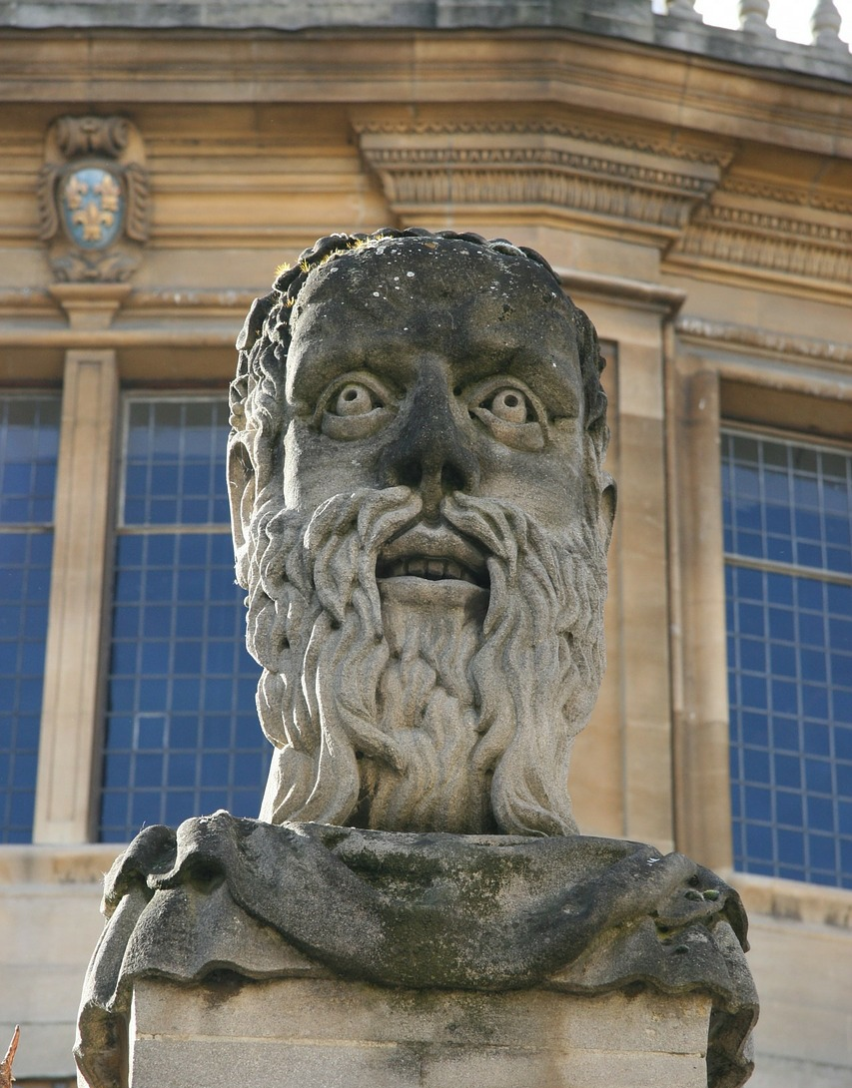

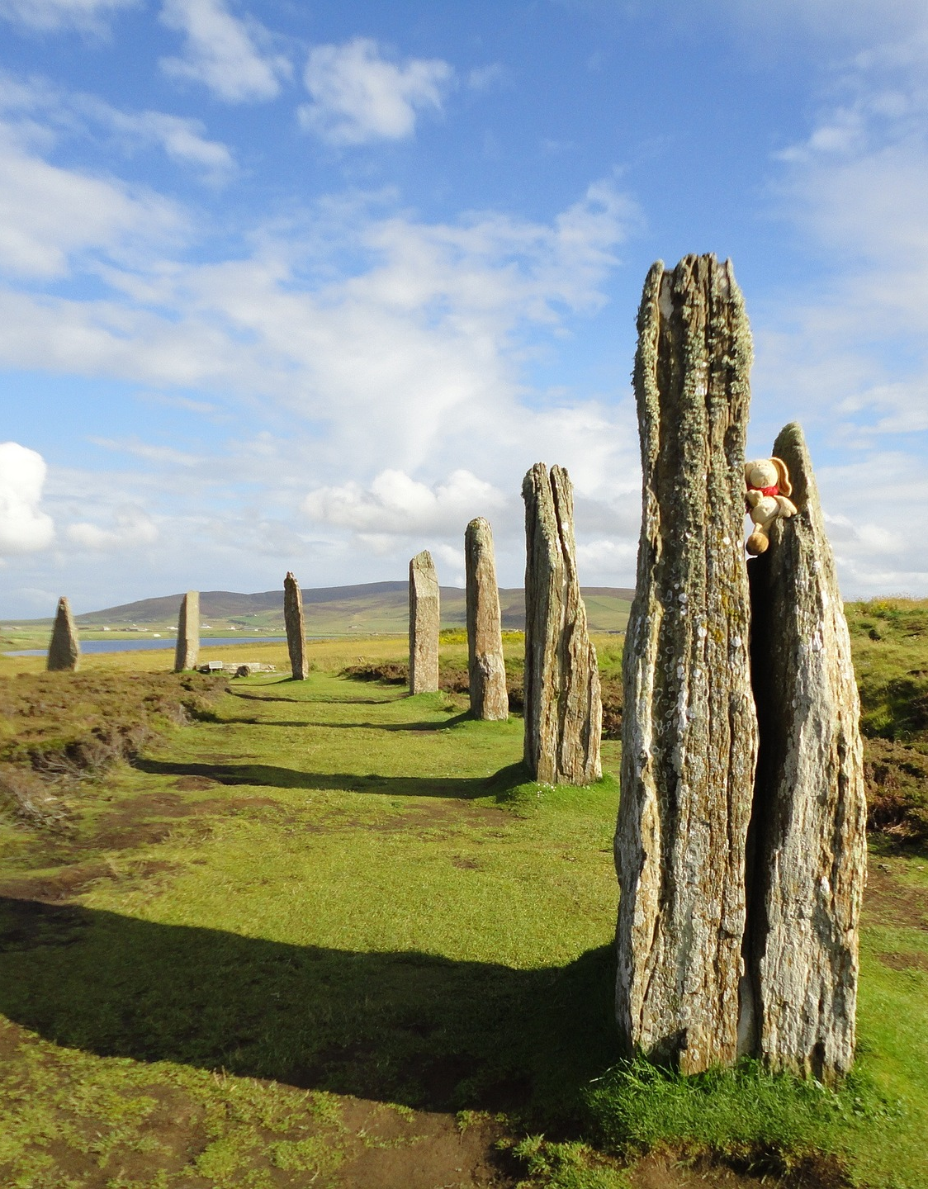
The importance of space
How many of these within 1 hour travel time of your house?
Universities
Theatres
Neolithic sites….

Slide 4
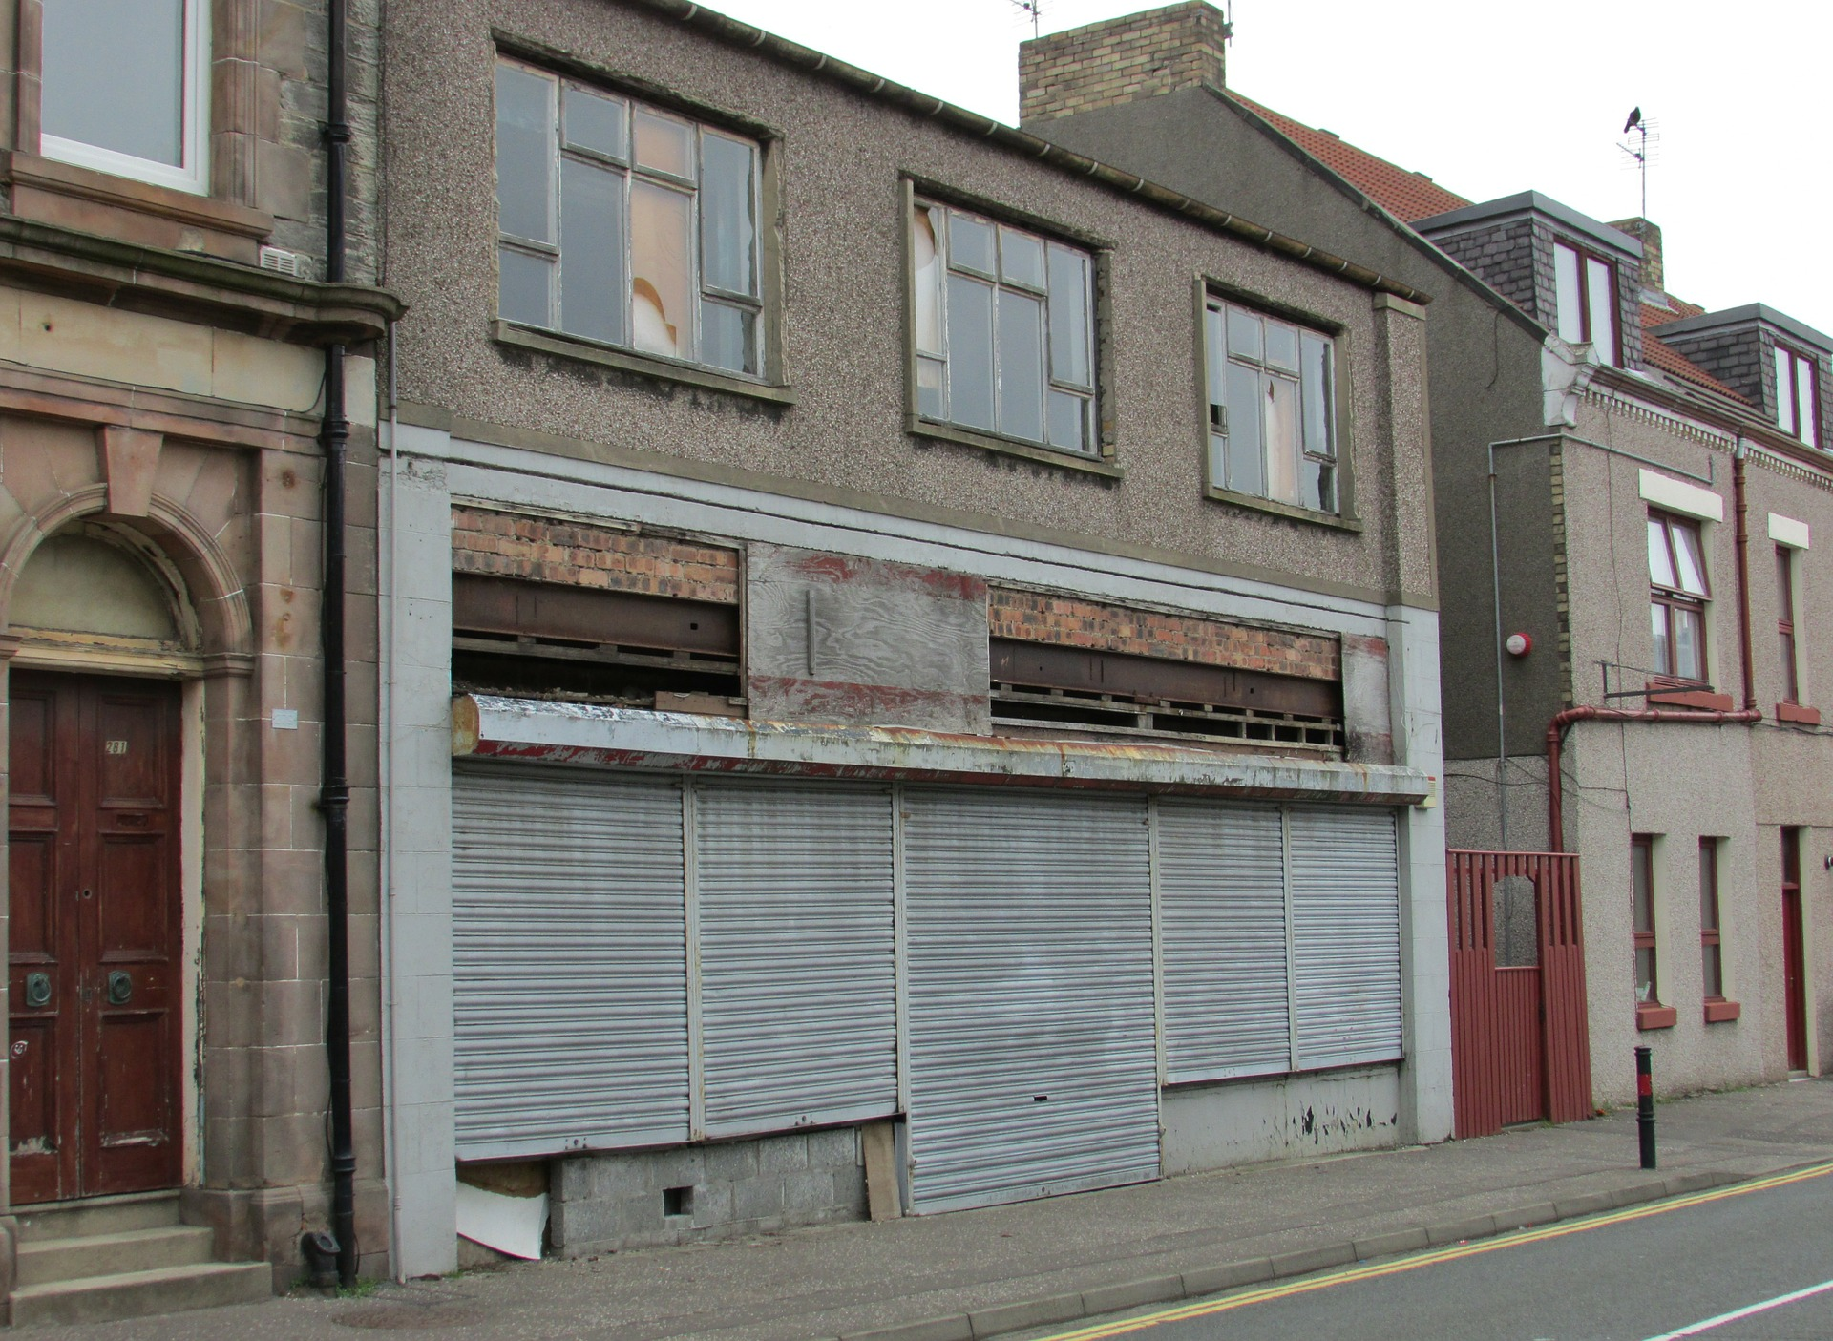
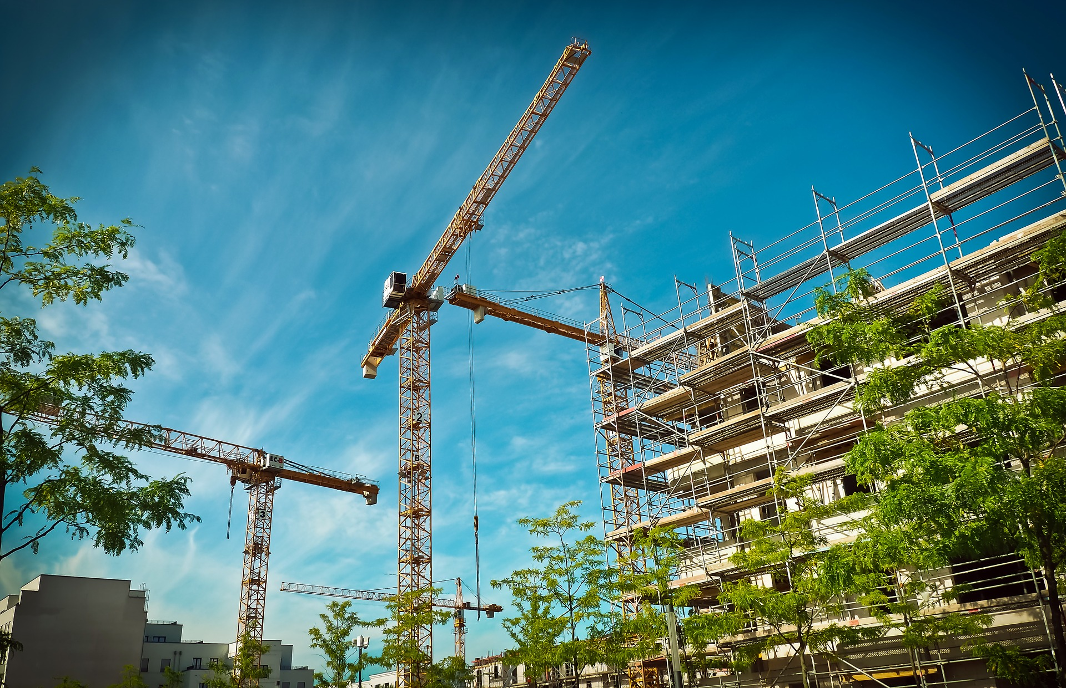
Socio-spatial dialectic

Slide 5
Spatial Justice
Spatial justice as such is not a substitute or alternative to social, economic, or other forms of justice but rather a way of looking at justice from a critical spatial perspective. From this viewpoint, there is always a relevant spatial dimension to justice while at the same time all geographies have expressions of justice and injustice built into them. (Soja, 2009, p. 2)

Slide 6

Mobility: a solution or a justice issue?
Social mobility often assumes geographic mobility

Slide 7
Implications for our work

Slide 8

Exercise
Draw a map
Mark on it where you live and the places that feel familiar.
Notes:
Familiarity in recognition that places aren’t static – we move around, may have moved locations, may have different relationships to place.

Slide 9
Exercise 1 cont.
Work with a partner – look at each others’ maps
What do you notice compared to your partner?
How would it feel to move to a place which is ‘familiar’? How would it feel to move to a place which is ‘unfamiliar’?
With the places that are ‘familiar’ – why are they familiar to you?
What impact might your immediate space and your ‘familiar’ spaces have on your choices?
How have your experiences of space changed through time?

Slide 10
Uneven experiences of space
People have different accessibility to different places and opportunities
It is easier to move to or engage with opportunities in ‘familiar’ places
People have different experiences of mobility shaped by a range of factors:
  Physical
  Economic
  Social
  Biographical

Slide 11
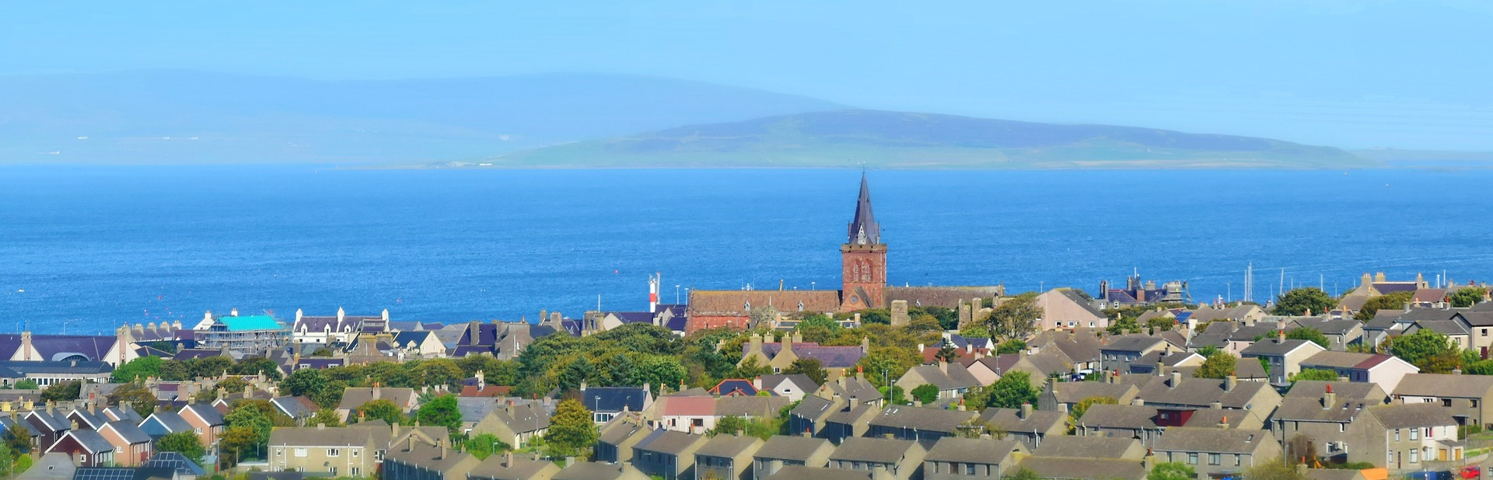
Scenarios: How can we work in practice?
Jo, 14, still at school, unsure what she would like to pursue as a career.
Marie, 35, wants to get back to work after having a family, but doesn’t want to move.
Stuart 24, unhappy in his job, wondering if he should move to a bigger city for his career.

Slide 12
Practical approaches
Raise awareness of geography
  Where do you see yourself in the future?
Identify and address barriers
  What can you access locally?
  Where might you move to? How can you move?
Question what is ‘normal’
  What appeals to you about staying / leaving?

Slide 13
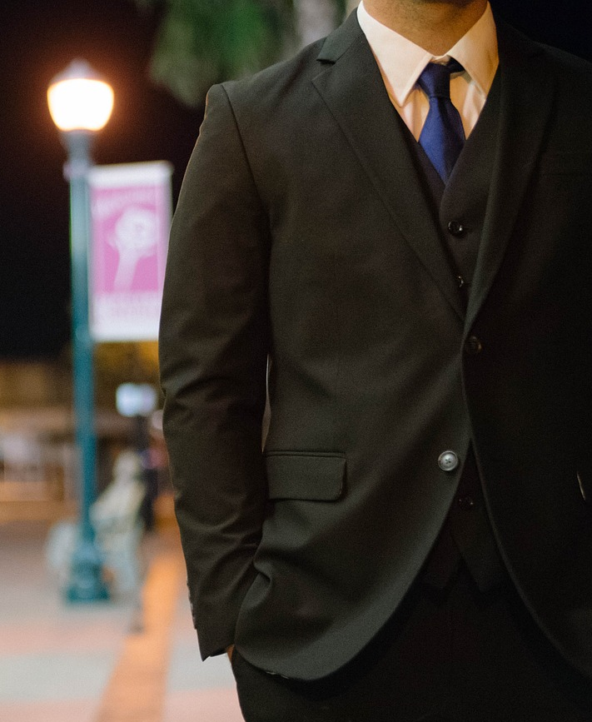
More radical approaches?
Group exercises and careers education
Advocacy on behalf of clients for mobility resources or geographical inclusivity
Changing the models / the narrative we work with.

Slide 14
Further reading
Alexander, R. (2018). Social Justice and Geographical Location in Career Guidance. In Hooley, Sultana, & Thomsen, Career Guidance for Social Justice: Contesting Neoliberalism (pp. 77–91). New York ; London: Routledge/Taylor & Francis Group.
Soja, E. W. (2010). Seeking spatial justice. Minneapolis: University of Minnesota Press.

