Slide 1

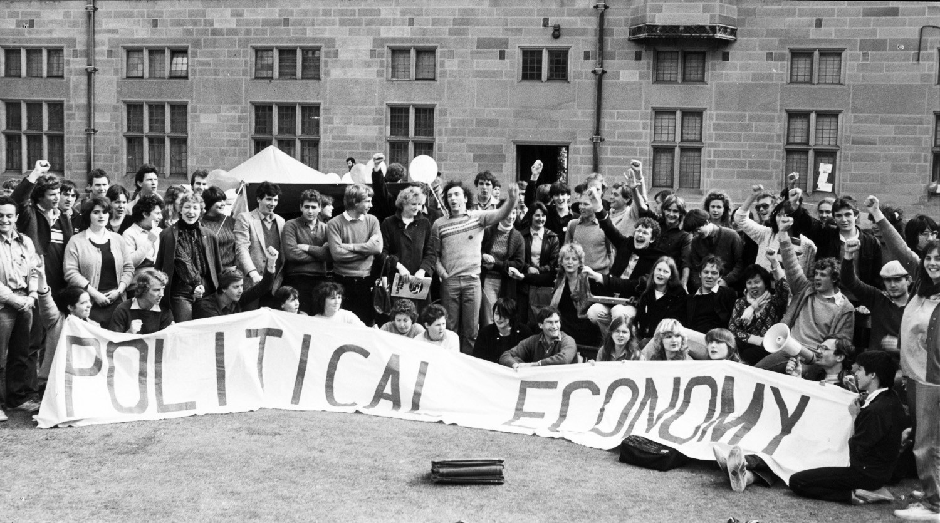
Learning from political economy:
Using laclau & MouffeT and Hardt & Negri in Career guidance practice
Presentation by Tristram Hooley to the Critical perspectives on agency and social justice in transitions and career development conference, Copenhagen, 23-24 October 2019.

Slide 2

Something better change
The current political economy limits individuals’ ability to achieve the outcomes that career guidance promises them.
If we are going to allow people to self-actualise, exercise autonomy and access decent work we need to act on the structures alongside the individuals.
But, what does this look like?

Slide 3

Yesterday…
I made the case that we were riding the social justice wave.
I proposed the five signposts as offering us a useful starting point.
I called for more theoretical and practical work and argued that it needed to be connected to wider struggles.
So, where next?

Slide 4
The five signposts towards socially justice career guidance
Build critical consciousness
01
Name oppression
02
Question what is normal
03
Encourage people to work together
04
Work at a range of levels
05
The five signposts are inductive and represent an attempt to theorise the materials that emerged through the two-volume project.
They draw on wider theories, but don’t have a clear theoretical basis.
Moving the agenda forwards requires more theoretical, empirical and practical work.
Notes:
Tristram

Slide 5

Evidence-informed practice
Existing (individualistic) practices can be built on an extensive body of research and evidence, largely informed by psychology.
Yates’ new book provides an excellent example of a book that allows for a read through from discipline (psychology), to theory (e.g. gestalt theory), to intervention studies and then to tools and techniques.
This epistemology has been built up over decades and provides a powerful account of how people’s careers work and how we can help them.
The movement for social justice in career guidance does not have an equivalent depth.

Slide 6
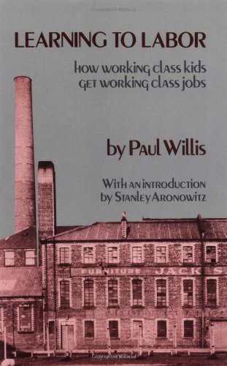

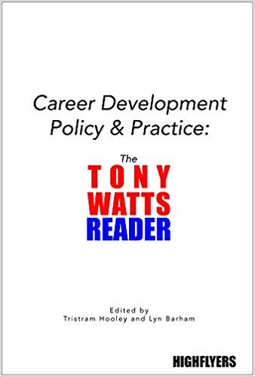
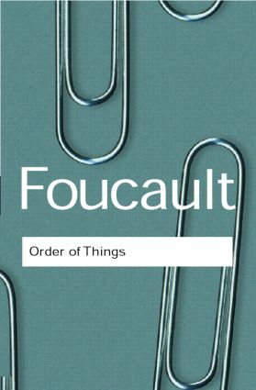
Alternative Epistemologies

Slide 7

Where do we go for new ideas?
Particularly ones that are focused on changing the world rather than just adapting to it?
The philosophers have only interpreted the world in various ways; the point, however, is to change it.

Slide 8
This takes us to political economy
Particularly to the study of social movements and political change.
How do things like economic systems change?
What actions and forces can bring such changes about?
How far can change be purposeful and deliberate?

Slide 9
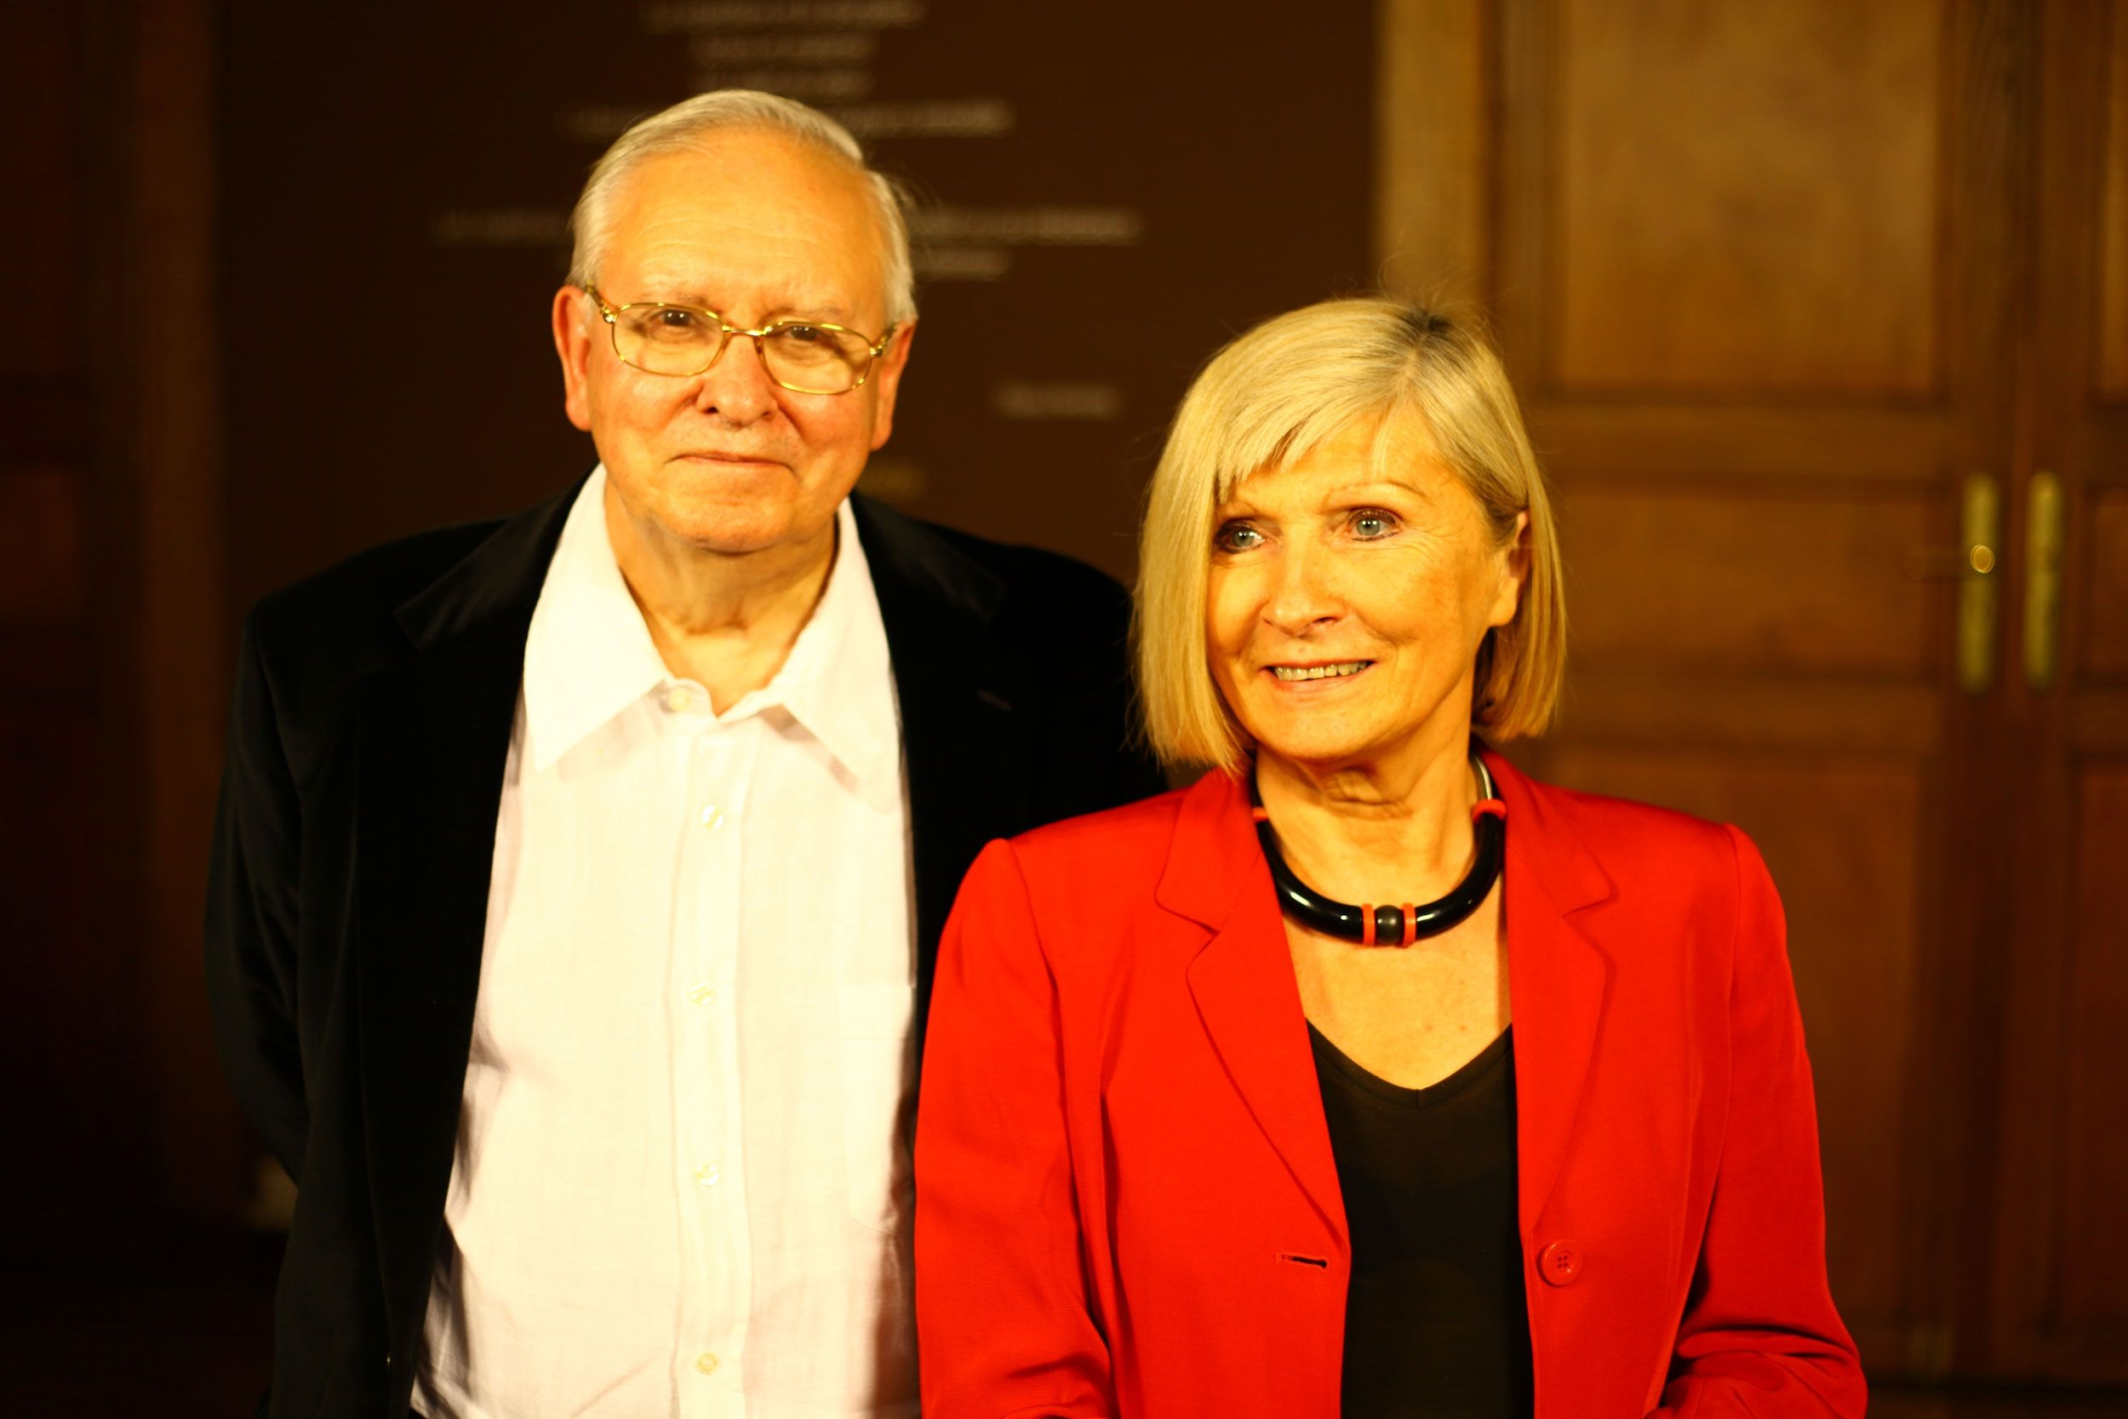
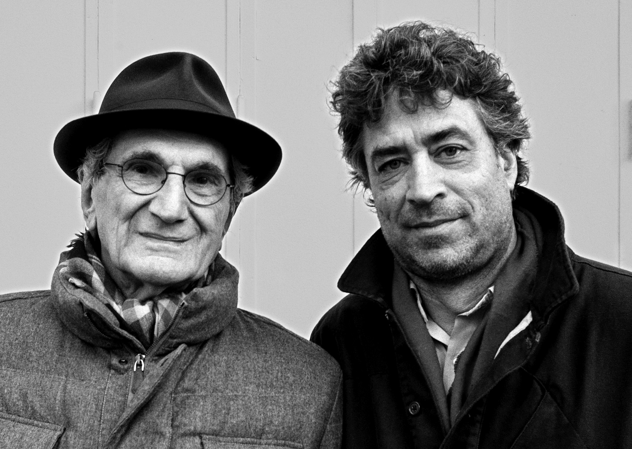
Laclau & Mouffe + HardT & Negri
Both are post-Marxist theorists of social change. Both draw on Marx and Gramsci. H&N are seen as revolutionaries, while L&M are radical reformists. As far as I know they have never talked about career guidance.

Slide 10

Laclau & Mouffe: Key ideas
Celebrate struggle. Agonism/antagonism/struggle is central to societies. It is to be celebrated as a positive force. We have to disagree and challenge as a way to resolve differences. We will never arrive at the harmonious society.
Link struggles to the hegemony. Understanding inequalities (subordination) and injustice (oppression) is not enough. We also need to link it to a larger pre-existing narrative (hegemony).
Recognise pluralism. Truth and justice are plural and not owned by any individual or group (e.g. white people, the working class, women). Successful political movements are those that establish ‘chains of equivalence’ between various struggles.
Create a democratic imaginary. Offer viable alternatives and create an imaginary of what an alternative society looks like

Slide 11

Hardt and Negri: Key ideas
Empire. The system of power and privilege is complex, diffuse and dynamic. It cannot be encompassed by a particular ideology (neoliberalism) or a particular institution (the state). Despite its complexity, it has built mechanisms for coordination.
Singularities. We are all plural and unique. We all encompass multiple identities and inter-sectionalities.
The multitude. The global population is comprised of multiple singularities. Yet, we can still conceive it as a political actor.
The common. The wealth that is shared by the multitude. It can be geographical, material, intellectual, institutional and symbolic (e.g. the environment, open source code, the idea of social justice).
Assembly. The process of bringing the multitude together to act to expand the common.

Slide 12
Grammar
The system of underlying structures that govern a system.
But it shapes what it is possible to say (or think or do).
It does not determine what is said (or thought or done)

Slide 13
Folk grammar
Career guidance is dependent on a folk grammar of concepts and approaches. These draw from a range of places e.g. Parsons (alignment of the individual with the labour market), Holland (vocational fit and types), Rogers (person-centred counselling, self-actualization), Savickas (life design, narrative).
Folk grammars are what we fall back on when we don’t know what to say. E.g. ‘what interests you’, ‘how does that make you feel’. They are the unconscious manifestation of epistemology.
Professional training is about inducting new people into an epistemology and helping people to transform it into an (unconscious) folk grammar.

Slide 14
Changing the grammar
This folk grammar is arbitrary.
Its dominance for career development has been established historically and epistemologically.
It carries with it a lot of assumptions and constructions of what sorts of problems and answers are legitimate.
The work of Laclau & Mouffe and Hardt & Negri offers us an alternative grammar.
This does not mean that they offer a script that should never be deviated from.

Slide 15
How do we integrate this into career guidance
Understanding the individual in context
We are all individuals (singularities)
But we are also part of the multitude
Develop chains of equivalence
Building transformative career strategies
Recognise and celebrate antagonisms
Link to the hegemony
Create a future imaginary based around an expanded common.
Understand and deconstruct Empire
Analysing the situation that they find themselves in
Assemble
Exploring the resources offered by the common

Slide 16
There are many ways to
‘do’ career guidance
“Career guidance supports individuals and groups to discover more about work, leisure and learning and to consider their place in the world and plan for their futures… Career guidance can take a wide range of forms and draws on diverse theoretical traditions. But at its heart it is a purposeful learning opportunity which supports individuals and groups to consider and reconsider work, leisure and learning in the light of new information and experiences and to take both individual and collective action as a result of this.” (Hooley, Sultana & Thomsen, 2018)
Some approaches are likely to be more conductive to making use of these theories and doing social justice.
I’ll illustrate with the example of a counselling conversation.

Slide 17
Framed as a counselling/coaching intervention
Exploring the individual’s career issues in context
Who are you? What is your identity? What do you want? (singularities)
Who else is important to you? How are you linked to others? (multitude)
Analysing the situation that they find themselves in
How do you see the world working? Where is it fair or unfair? How powerful are you? Who has power over you? (Empire)
Where are your interests in conflict with other people’s? Where are they aligned? (Antagonisms)
Building transformative career strategies
Who are your allies? Who else is struggling? (Developing chains of equivalence)
What is possible? How does connect with the current world? (Linking to the hegemony)
How can you bring people together? What can unite them? (Assembling)
What would be the ideal environment for your future career (imaginary)
Contracting: Explain what this conversation is for.
The session is about thinking about who you are and how you want to spend your time (singularities).
It is also about thinking about what kind of world you want to live in (imaginary)
We will be linking these imagined futures to the possibilities that exist (linking to hegemony)
How do you fit into the world? What are you concerned about? (Empire)
What resources are available to you? And to everyone? (the common)

Slide 18
What does this achieve?
It constructs the problems and possibilities differently.
It helps to focus discussions and thinking around the social but also keeps in view the possibility of social change.
It encourages counsellors to give time and energy to the idea of changing the political economy.

Slide 19
So…
Does this make any sense?
Would it be useful to individuals?
Can these concepts be helpful?

Slide 20

Career guidance for social justice website
https://careerguidancesocialjustice.wordpress.com
Notes:
Tristram

Slide 21
References
Freire, P. (1996). Pedagogy of the oppressed (revised). New York: Continuum.
Foucault, M. (2005). The order of things. London: Routledge.
Hardt, M. & Negri, A. (2001). Empire. Cambridge, MA: Harvard University Press.
Hardt, M. & Negri, A. (2004). Multitude: War and democracy in the age of Empire. London: Penguin.
Hardt, M. & Negri, A. (2017). Assembly. Oxford: Oxford University Press.
Holland, J.L. (1997). Making vocational choices.
Hooley, T. and Barham, L. (Eds.). (2015). Career Development Policy and Practice: The Tony Watts Reader. Stafford: Highflyers.
Hooley, T., Sultana, R. and Thomsen, R. (2018). Career cuidance for social justice: Contesting neoliberalism. London: Routledge.
Hooley, T., Sultana, R. and Thomsen, R. (2019). Career guidance for emancipation: Reclaiming justice for the multitude. London: Routledge.
Laclau, E., & Mouffe, C. (2014). Hegemony and socialist strategy: Towards a radical democratic politics. Verso Trade.
Marx, K. (1888). Theses on Feuerbach. Retrieved from https://www.marxists.org/archive/marx/works/1845/theses/theses.htm.
Mouffe, C. (2018). For a left populism. Verso Books.
Parsons, F. (1909). Choosing a Vocation.
Savickas, M.L. (2015). Life Design Counseling Manual. Available at http://vocopher.com/LifeDesign/LifeDesign.pdf [Accessed 11th January 2017]
Willis, P. (1977). Learning to labour. Farnborough: Saxon House.
Yates, J. (2019). The career coaching toolkit. London: Routledge.

Slide 22
About me
Tristram Hooley
Professor of Career Education, University of Derby/ Professor II, Inland Norway University of Applied Sciences/ Chief Research Officer, Institute of Student Employers
Email: tristram.hooley@gmail.com
Twitter: @pigironjoe
Blog: https://adventuresincareerdevelopment.wordpress.com/

