Slide 1
Decolonising careers education?
NICEC
September 20th 2019.
Charlotte Chadderton, School of Education, Bath Spa University

Slide 2
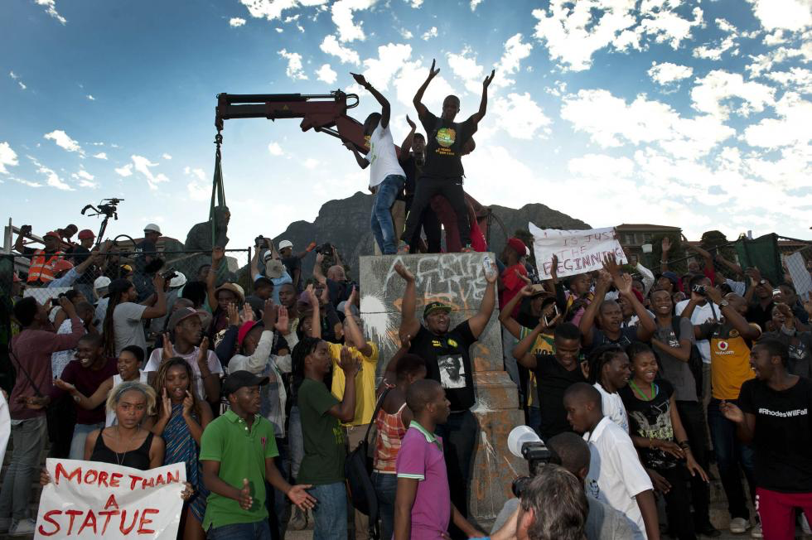

Slide 3
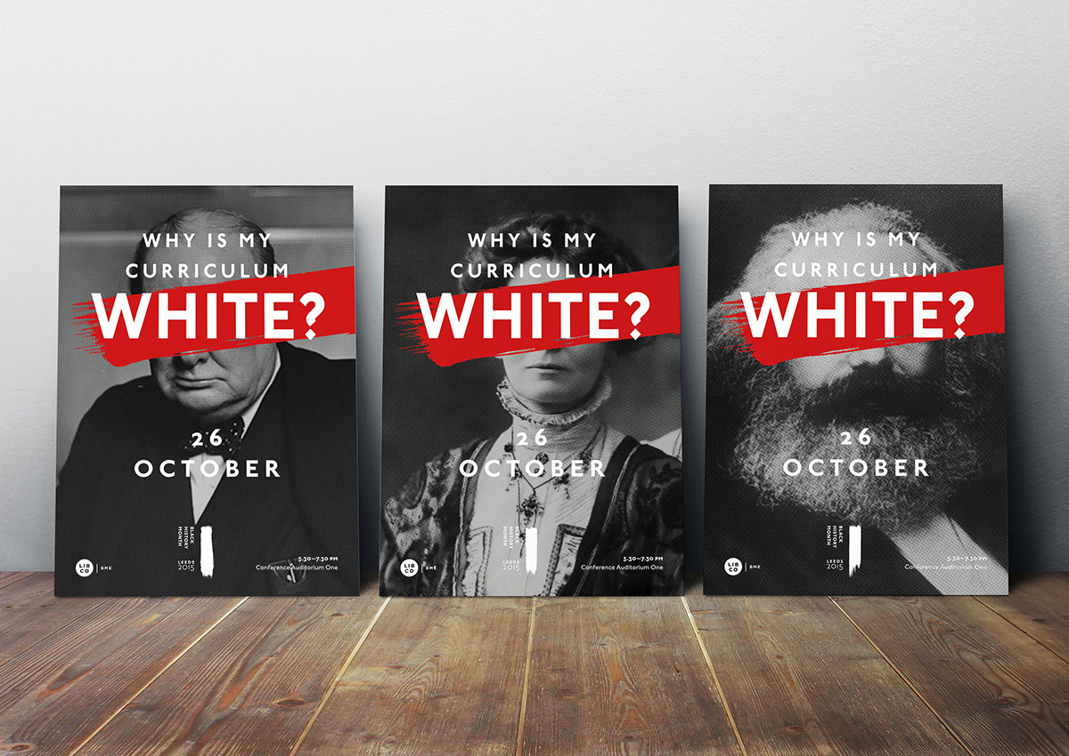

Slide 4
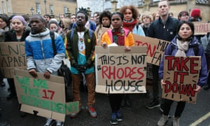
Why is this?
Educational approaches continue to be informed by ideas of ‘western’ superiority (i.e. ideas around conceptualisations of the human, human nature, progress, the individual etc)
Academic institutions play a key role in maintaining of colonial structures
Colonial attitudes deeply embedded in education systems
Education systems stratified along lines of race, gender and class
Presence of colonial iconography
Education systems designed to dominate or produce ‘paternalism’ towards,
or ‘civilise’ non-western populations
Educational material ethnocentric or
essentialising
Curriculum privileges ‘western’ knowledge

Slide 5
Why is this?
Teaching materials tend to be decontextualised and dehistoricised
Often focuses on Cartesian subject- all-knowing, self-sufficient, able to choose
Promotes binaries between western self (dominant) and colonial other (deficient, lacking)
Non-western culture viewed as deficient or backwards
People of non-western heritage viewed as needing to be ‘emancipated’ for ‘progress’ to be made.
Privileges notions of ‘objectivity’ and ‘neutrality’ and ‘universality’ while actually representing an ethnocentric, exclusionary or subjugating set of beliefs and discourses
Promotes notions of meritocracy
Underrepresentation of BME people in positions of leadership and influence in educational institutions

Slide 6
What does this matter for career education and guidance?
Poverty rates higher across ethnic minority households compared with white British households in the UK (Hughes, 2015)
In 2017, just under 4% of White people were unemployed, compared with 8% of people from all other ethnic groups combined (Department for Work and Pensions, 2019).
Labour markets in Europe and other western countries have been racially segregated throughout the 20th century (Roedinger, 1991, Penn; 2004), and racial segregation in the labour market is still significant (Chadderton & Wischmann, 2014; Hughes, 2015).
Despite minority ethnic people being reasonably well represented in some, high status and highly paid jobs, such as medicine or academia, particularly in countries such as England and the US, they are still under-represented in the highest positions, and over-represented in part-time, more precarious posts (Bhopal & Jackson, 2013).
The ‘ethnic pay-gap’ is well-documented in England (e.g. Brynyn & Guveli, 2012; Bhopal & Jackson 2013)
Vocational education and apprenticeships are raced in Europe and the US (Penn, 2004; Chadderton & Wischmann, 2014).

Slide 7
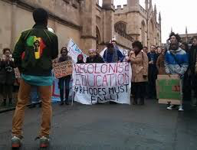
BME students tend to attend post ’92 universities (lower tier) (Reay, 2018)
Acceptance rate at e.g. Oxford: 29% white, 6.7% Bangladeshi, 6.5% Pakistani, 14.3% Black Caribbean students
Some evidence that BME students do not believe they would stand a chance of getting into elite universities, so do not apply (Mirza, 2018)
Evidence of ‘unconscious bias’ among admissions staff at universities (Boliver, 2018)
Evidence of racist incidents at universities against BME staff and students (Arday, 2018)
BME students more likely to leave university without completing a course (Mirza, 2018)
BME students least likely to get a first or
2:1 in their degree (Mirza, 2018)

Slide 8
How does careers work contribute to this?
Has contributed to the stereotyping and racialisation of young people which has had implications for education, training and work decisions (Cross, Wrench & Barnett, 1990; Mirza, 1992; Reid, 2005; Solorzano et al, 2005; Beck, Fuller & Unwin, 2006).
Guidance models and practices are based an idea of an ideal client being white, middle class and male (Cook et al, 2002; Malik & Aguado, 2005),
‘Culture’ tends to be regarded as an essentialised, narrow and homogenous set of values and beliefs tied to the student’s perceived ethnic background (Sultana, 2017)
‘Culture’ as something which is holding students back and they need to escape from (Reid, 2005; Solorzano et al, 2005).
Careers advisors and teachers push people of colour into stereotypical occupations or towards low status vocational routes partly based on deficit-based stereotypes about their academic ability (Cross et al, 1990; Mirza, 1992); or towards technical and vocational education and training when they wanted a job (Cross et al, 1990; Britton et al., 2002);
Teachers, vocational trainers and careers advisors often assume that minority ethnic young people aspire only to jobs which require a university degree, despite them actually having similarly diverse aspirations to white young people (Black Training and Enterprise Group 2008: 10).

Slide 9
Decolonising education
Challenging colonial discourses
Challenging essentialisation and stereotyping
Notion of collaboration, mutuality, reciprocity
Plurality of voices, self and identity
Knowledge as partial, provisional and situated rather than objective, neutral, universal
Valuing of ‘non-western’ knowledge and experiences
Blurring boundaries between self and other
Understanding of both local and global context
Based upon non-coercive relationships
Recognition that colonial relationships fuel and shape both colonised and coloniser mentalities and identities
‘Culture’ as shifting and non-essentialised
Interrogating assumptions which underpin
policies, curricula and materials
Diversifying sources of knowledge and materials
People of non-western heritage seen
as active creators of knowledge rather than passive receivers.

Slide 10
Questions to consider
Is your work fuelling postcolonial hierarchies? How?
Is your work already informed by the notion of decolonisation? How?
Are there ways of changing the way you work to incorporate decolonisation?
What are the barriers to decolonisation in careers work?
Some would argue that since we are all in certain ways complicit with the postcolonial structures and institutions, are the only way of avoiding this is to disengage completely. Do you agree?

Slide 11
Bibliography
Arday, J. (2018) Being black, male and academic: navigating the white academy. In Dismantling race in Higher education. Racism, whiteness ad decolonising the academy, Arday, J. and Mirza, H.S. (eds.). Switzerland: Palgrave Macmillan
Andreotti, V. (2011) Actionable postcolonial theory in education. Basingstoke: Palgrave Macmillan
Beck, V., Fuller, A. & Unwin, L. (2006). Safety in Stereotypes? The Impact of Gender and ‘Race’ on Young People’s Perceptions of their Post-compulsory Education and Labour Market Opportunities. British Education Research Journal, 32 (5), 667–686.
Bhopal, K., & Jackson, J. (2013). The Experiences of black and minority ethnic academics: Multiple identities and career progression. Southampton. Retrieved from http://blackbritishacademics.co.uk/wp-content/uploads/2013/04/Research-Report-The-Experiences-of-Black-and-Minority- Ethnic-Academics-Dr-Bhopal.pdf.
Black Training & Enterprise Group (BTEG). (2008). Improving equalities in apprenticeships. London: Black Training and Enterprise Group.
Boliver, V. (2018) Ethnic inequalities in admission to highly selective universities. In Dismantling race in Higher education. Racism, whiteness ad decolonising the academy, Arday, J. and Mirza, H.S. (eds.). Switzerland: Palgrave Macmillan
Britton, L. B., Chatrik, B. Coles, G. Craig, C. Hylton, G. Mumtaz, P. Bivand, R. & Burrows Convery, P. (2002). Missing Connexions. The career dynamics and welfare needs of black and minority ethnic young people at the margins. Bristol: The Policy Press.
Brynyn, M. & Guveli A. (2012). Understanding the ethnic pay gap in Britain. Work employment and society, 26(4), 574-587.
Chadderton, C. & Wischmann, A. (2014) Racialised norms in apprenticeship systems in England and Germany. Journal of Vocational Education & Training, 66 (3), 330-347.
Cook, E. P., Heppner, M. J. & O'Brien, K. M. (2002). Career Development of Women of Color and White Women: Assumptions, Conceptualization, and Interventions From an Ecological Perspective. The Career Development Quarterly, 50, 291–305.
Cross, M., Wrench, J. and Barnett, S. (1990). Ethnic Minorities and the Careers Service. An Investigation into Processes of Assessment and Placement. Warwick, RI: Department of Employment.
Hughes, D. (2013). The changing UK careers landscape: tidal waves, turbulence and transformation. British Journal of Guidance & Counselling, 41(3), 226-239.
Malik, B. & B. Aguado. (2005). Cultural diversity and guidance: myth or reality? In B. Irving, & B. Malik (Eds.) Critical reflections on Career Education and Guidance: Promoting social justice within a global economy. London: RoutlegeFalmer,
Mirza, H. S. (1992) Young, female and black. London and New York: Routledge.
Mirza, H. S. (2018) Black bodies ‘out of place’ in academic spaces: gender, race, faith and culture in post-race times. In Dismantling race in Higher education. Racism, whiteness ad decolonising the academy, Arday, J. and Mirza, H.S. (eds.). Switzerland: Palgrave Macmillan
Penn, R. (1998). Social Exclusion and Modern Apprenticeships: A Comparison of Britain and the USA. Journal of Vocational Education and Training, 50 (2), 259–276.
Peters, M. A. (2018) Why is my curriculum white? A brief genealogy of resistance. In Dismantling race in Higher education. Racism, whiteness ad decolonising the academy, Arday, J. and Mirza, H.S. (eds.). Switzerland: Palgrave Macmillan
Reay. D. (2018) Race and elite universities in the UK. In Dismantling race in Higher education. Racism, whiteness ad decolonising the academy, Arday, J. and Mirza, H.S. (eds.). Switzerland: Palgrave Macmillan
Reid, H. (2005). Beyond the toolbox: integrating multicultural principles into a career guidance intervention model. In B. Irving & B. Malik (Eds.) Critical reflections on Career Education and Guidance: Promoting social justice within a global economy. London: RoutlegeFalmer.
Roediger, D. (1991). The Wages of Whiteness: Race and the Making of the American Working Class. London: Verso.
Solorzano, D. Villalpando, O. & Osegura, L. (2005). Educational Inequities and
Latina/o Undergraduate Students in the United States: A Critical Race
Analysis of Their Educational Progress Journal of Hispanic Higher Education, 4 (3), 272-294
Sultana, R.G. (2017). Career guidance in multicultural societies: identity, alterity, epiphanies and pitfalls, British Journal of Guidance & Counselling, 45 (5), 451-462.

