Slide 1


Career guidance and social justice
What does it look like in practice
Tristram Hooley
NICEC network meeting
20th September 2019

Slide 2
Career guidance, social justice and neoliberalism
2 book project to create space for a different kind of discussion about career guidance.
It builds on and extends a long tradition of thinking about career guidance and social justice.
Includes contributions from a wider range of countries including those in the global south.
Notes:
Rie

Slide 3
The two volumes
2018
Career guidance for social justice – Explores context, critique and theory.
2019
Career guidance for emancipation – Explores diverse experiences of neoliberalism and possibilities for challenging and changing things.
Notes:
Rie

Slide 4
Social justice
Social justice is a contested concept with a long history.
We have adopted it because it brings together a concern with the collective good and a recognition that there are injustices to be righted.
Social justice is not an ideology, which offers a clear set of rules. Rather is a conversation that people can approach from a range of different perspectives.
The fact that it is ambiguous and open to debate, whilst also seeking to focus our attention on creating a better world is one of the reasons why it appeals to us.

Slide 5

Career guidance
“Career guidance supports individuals and groups to discover more about work, leisure and learning and to consider their place in the world and plan for their futures… Career guidance can take a wide range of forms and draws on diverse theoretical traditions. But at its heart it is a purposeful learning opportunity which supports individuals and groups to consider and reconsider work, leisure and learning in the light of new information and experiences and to take both individual and collective action as a result of this.”
Notes:
Rie

Slide 6

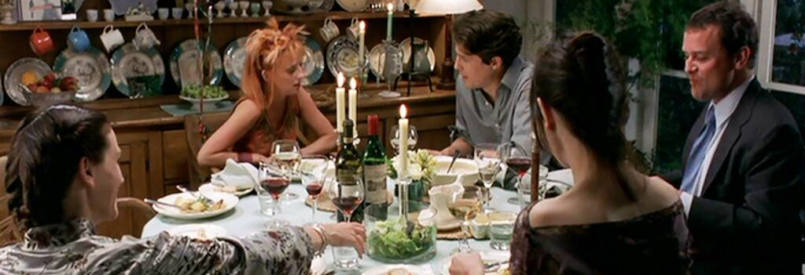
Contesting the idea of the
‘normal’ career

Slide 7

Key elements of the critique
Opportunity structure
Neoliberalism
inequality
Power
Oppression
responsibilisation

Slide 8
OK, but so what
Sociological and critical approaches have often favoured critique over possibility.
Practitioners have been justified in saying ‘OK, but so what’.
On the other hand psychologically based approaches along with those drawing on human capital theory have been very inventive in terms of practice ideas.
Today’s session and the wider project is trying to redress this balance

Slide 9

Social justice inspired approaches should broaden the possibilities for practice and offer a wider range of ways to help people

Slide 10
The five signposts towards socially justice career guidance
Build critical consciousness
01
Name oppression
02
Question what is normal
03
Encourage people to work together
04
Work at a range of levels
05
Notes:
Tristram

Slide 11

Career guidance for social justice website
https://careerguidancesocialjustice.wordpress.com
Notes:
Tristram

Slide 12
About me
Tristram Hooley
Professor of Career Education, University of Derby/ Professor II, Inland Norway University of Applied Sciences/ Chief Research Officer, Institute of Student Employers
Email: tristram.hooley@gmail.com
Twitter: @pigironjoe
Blog: https://adventuresincareerdevelopment.wordpress.com/

Slide 13
Schedule for today
1400 - Tristram Hooley, Career guidance and social justice
1430 - Charlotte Chadderton, Decolonising careers education?
1500 - Elnaz Kashefpakdel & Chris Percy, Access to employers in British Schools: How can we even the playing field?
1530 – Break
1545 - Rosie Alexander, Social justice / spatial justice
1615 - Phil McCash, Social justice and continuing professional development (CPD)
1645 – Wrap up

