Slide 1

Career guidance and social justice
Putting theory into practice in Norwegian schools
Tristram Hooley
Workshop in Sandvika, Norway
6th September 2019

Slide 2
Who are you and why are you here?
Introduce yourself
Where do you work and in what role?
What are the main concerns that your students have about their futures?
What are you hoping for from today?

Slide 3
Overview
Background
Rationale
A socially just career guidance: The five signposts
Build critical consciousness
Name oppression
Question what is normal
Encourage people to work together
Work at a range of levels

Slide 4
Overview
Background
Rationale
A socially just career guidance: The five signposts
Build critical consciousness
Name oppression
Question what is normal
Encourage people to work together
Work at a range of levels

Slide 5
Career guidance, social justice and neoliberalism
2 book project to create space for a different kind of discussion about career guidance.
It builds on and extends a long tradition of thinking about career guidance and social justice.
Includes contributions from a wider range of countries including those in the global south.
Notes:
Rie

Slide 6
The two volumes
2018
Career guidance for social justice – Explores context, critique and theory.
2019
Career guidance for emancipation – Explores diverse experiences of neoliberalism and possibilities for challenging and changing things.
Notes:
Rie

Slide 7

Career is the individual’s journey through life, learning and work
Career is where the individual interacts with organisations, structures and wider society.
We pursue our careers in relation to others rather than alone.
Career is not just about paid work or hierarchical progression.
Everyone had a career. But, not everyone knows this.
Career is often constructed as a problem which needs to be solved by the individual, by career guidance and by public policy.
Notes:
Tristram

Slide 8
Social justice
Social justice is a contested concept with a long history.
We have adopted it because it brings together a concern with the collective good and a recognition that there are injustices to be righted.
Social justice is not an ideology, which offers a clear set of rules. Rather is a conversation that people can approach from a range of different perspectives.
The fact that it is ambiguous and open to debate, whilst also seeking to focus our attention on creating a better world is one of the reasons why it appeals to us.

Slide 9

Career guidance
“Career guidance supports individuals and groups to discover more about work, leisure and learning and to consider their place in the world and plan for their futures… Career guidance can take a wide range of forms and draws on diverse theoretical traditions. But at its heart it is a purposeful learning opportunity which supports individuals and groups to consider and reconsider work, leisure and learning in the light of new information and experiences and to take both individual and collective action as a result of this.”
Notes:
Rie

Slide 10
Overview
Background
Rationale
A socially just career guidance: The five signposts
Build critical consciousness
Name oppression
Question what is normal
Encourage people to work together
Work at a range of levels

Slide 11
How do you deal with life being unfair?
Discuss how you deal with when your students raise concerns that life isn’t fair?
Have you ever had a student who has…
expressed concerns that they will end up doing a job that doesn’t pay well or won’t give them a good standard of living?
been being marginalised at school? E.g. feeling that they aren’t respected.
been fed up with being told what to do all the time by their teachers/parents?
been forced to conform to ‘norms’ by others? e.g. being told how to dress, act or behave in a way that makes them uncomfortable.
experienced aggression that makes them uncomfortable or actual physical violence?

Slide 12

The politics of career guidance
Careers education and guidance is a profoundly political process. It operates at the interface between the individual and society, between self and opportunity, between aspiration and realism. It facilitates the allocation of life chances. Within a society in which such life chances are unequally distributed, it faces the issue of whether it serves to reinforce such inequalities or to reduce them.
Tony Watts
Notes:
Tristram

Slide 13
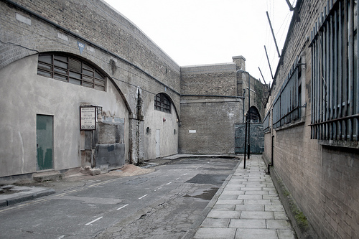

Ken Roberts and ‘opportunity structure’
Notes:
Tristram

Slide 14
The centrality of neoliberalism
We describe the global political system that we are operating within as ‘neoliberal’.
It exists across the world, but manifests in different ways in different places.
It is a political project that is being made rather than a complete system that exists.
Key features include the downsizing of the public sector, privatisation of state assets, deregulation of markets, and the withdrawal or restriction of funding for welfare regimes.
We argue that career guidance can contribute to or oppose neoliberalism?
Notes:
Ronald

Slide 15
How career guidance is positioned as a solution to the problems of neoliberalism
The ‘competition state’ - career guidance will support people in maximising their potential and develop flexibility towards the need for labour.
Globalisation – career guidance will support the mobility of labour nationally and internationally
The current state of welfare is unsustainable – reforms of the education system are needed - career guidance can increase individual responsibility, and guide individuals to make wise investments in the development of their individual human capital.
Notes:
Rie

Slide 16


Responsibilisation?
Neoliberalism is not just political and economic sources acting on us, it is also within us.
We tend to believe that the way things are organized politically and economically are natural or normal rather than arbitrary.
Neoliberalism colonises our ethics and our psychologies. It reframes the way that we think in ways that serve the interests of the powerful.

Slide 17
Overview
Background
Rationale
A socially just career guidance: The five signposts
Build critical consciousness
Name oppression
Question what is normal
Encourage people to work together
Work at a range of levels

Slide 18
Thinking about career guidance differently
Career/education as a critical social practice with the aim of enhancing awareness and understanding of the diverse ways in which life-careers might be meaningfully constructed and enacted (Irving)
Career guidance with the role of conscientisation and helping individuals to explore the inter-relationship between their career development, technological change and political transformation (Buchanan, Hooley)
Resituate career guidance as a practice that does not, per se, promote geographic mobility (of theories, models and labour) but instead invites both practitioners and people to include a socio-spatial perspective to the notion of career and to think critically from both a local and a global perspective (Alexander, Ribeiro & Fonçatti)
Notes:
Rie

Slide 19
The five signposts towards socially justice career guidance
Build critical consciousness
01
Name oppression
02
Question what is normal
03
Encourage people to work together
04
Work at a range of levels
05
Notes:
Tristram

Slide 20
Overview
Background
Rationale
A socially just career guidance: The five signposts
Build critical consciousness
Name oppression
Question what is normal
Encourage people to work together
Work at a range of levels

Slide 21
Critical consciousness
Helping people to understand the world as it is.
Thinking about why things are organised in the way that they are. E.g. asking who benefits from the current order.
Considering what can be changed and how we might go about changing it.

Slide 22
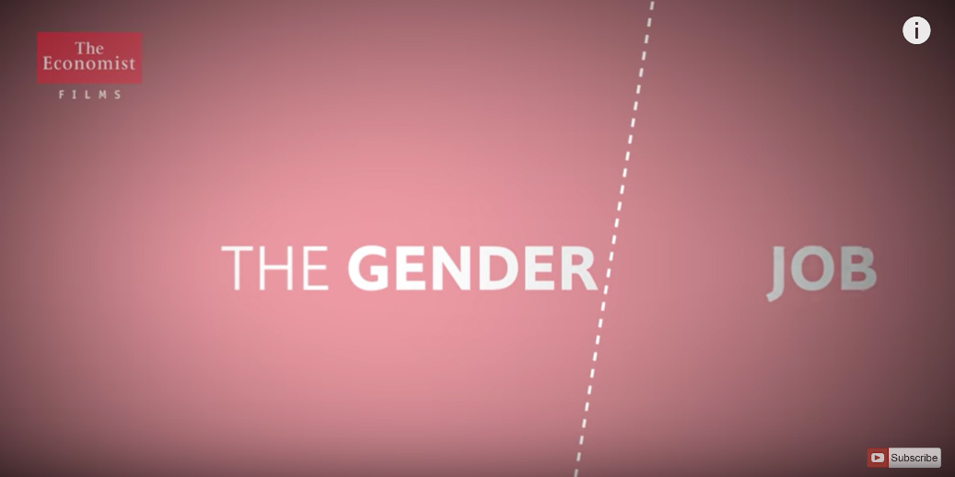
Example: I want to make a difference?
From Anne Delazon at the University of Reading
Full workshop at https://careerguidancesocialjustice.wordpress.com/2019/06/14/i-want-to-make-a-difference-social-justice-and-your-career/

Slide 23
Overview
Background
Rationale
A socially just career guidance: The five signposts
Build critical consciousness
Name oppression
Question what is normal
Encourage people to work together
Work at a range of levels

Slide 24

The faces of oppression
Exploitation
Marginalisation
Powerlessness
Cultural imperialism
Violence
Unfair compensation and coercion
Loss of work, power and respect
Always being on the receiving end of orders
Imposing ‘norms’ on people
Random, unprovoked attacks
For every oppressed group there is a group that benefits from that oppression and is privileged in relation to that group (Iris Marion Young, 2004)
Notes:
Ronald

Slide 25
Example: Career counselling
Help your clients to understand where their experiences are examples of oppression.
Challenge self-blaming behaviours.
Suggest possible names for what they have experienced and see how they feel about that.

Slide 26
Overview
Background
Rationale
A socially just career guidance: The five signposts
Build critical consciousness
Name oppression
Question what is normal
Encourage people to work together
Work at a range of levels

Slide 27
Question what is normal
Our societies define what we assume is normal and natural.
This includes what constitutes a career, career success, a ‘good education’, a fulfilled life and so on.
What is seen as normal also varies for different kinds of people.
This doesn’t mean that what is normal is always bad.
But, by questioning what is normal and asking why it is normal we open up possibilities for people.

Slide 28
Example: Norm criticism in Sweden
Look for (and reduce/challenge) examples of stereotypes and bias in labour market information.
Challenge assumed pathways (e.g. certain people go to university and others into vocational education).
Encourage students and clients to reflect on what they see as normal and consider whether they are happy with this. E.g. do they aspire to have a heterosexual nuclear family, is this the only way to live your life?
Encourage practitioners to be reflexive about their own use of norms.
See Frida Wikstand talking at https://careerguidancesocialjustice.wordpress.com/2019/02/14/frida-wikstrand-norm-criticism/

Slide 29
Overview
Background
Rationale
A socially just career guidance: The five signposts
Build critical consciousness
Name oppression
Question what is normal
Encourage people to work together
Work at a range of levels

Slide 30
Encourage people to work together
Career is not an individual activity.
We pursue our career alongside others – sometimes co-operating, sometimes competing.
Strategies for improving your career can be collective as well as individual.
Recognising the importance of co-operation and collective struggle opens up a lot of new opportunities for career development.

Slide 31
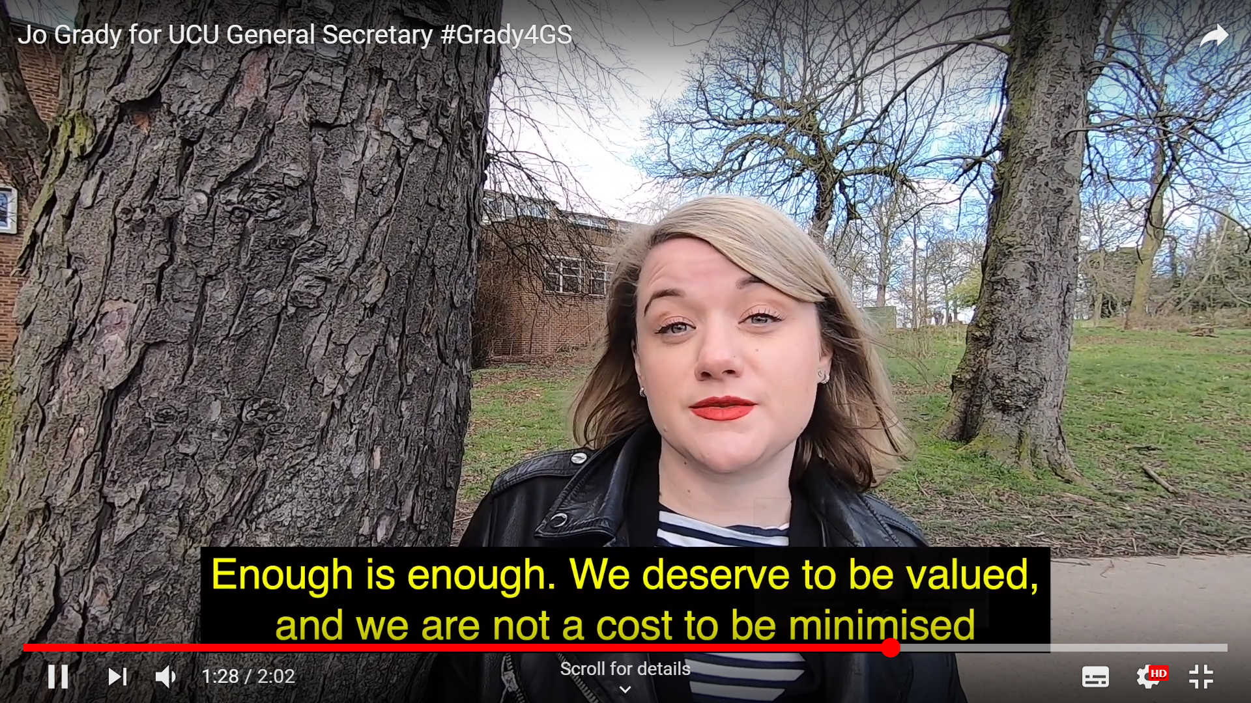
Example: Writing an open letter
Work together to write an open letter
What makes academic employment unjust?
What evidence do you have for this?
What could be done about this?
What evidence do you have that this would be a good thing?
What are your demands? Make them clear?
What power do you have? Why should your employers listen?
Slides are available at: https://careerguidancesocialjustice.wordpress.com/2019/06/14/what-kind-of-researcher-academic-do-you-want-to-be/

Slide 32
Overview
Background
Rationale
A socially just career guidance: The five signposts
Build critical consciousness
Name oppression
Question what is normal
Encourage people to work together
Work at a range of levels

Slide 33
Working at a range of levels
Our careers take place at the level of:
  Our own psychology
  In our families
  In our workplaces
  In our communities
  In national politics
As a career counsellor you should feel free to intervene at any of these levels.
Sometimes people will be best helped by individual support, other times by system change (often by both at the same time).

Slide 34
Example: Subject choices
Career counsellors often help young people to make subject choices.
One told me that in his school he was regularly hearing about timetable clashes meaning that students couldn’t take the subjects that they wanted.
He continued to help students to manage the system, but started to campaign with the school leadership and administration to deal with the problem.
This is an example of feedback and system change within one institution. Often there is a need to work across even more levels e.g. engaging in political campaigning about benefit changes whilst helping individuals to deal with them.

Slide 35
Putting it into practice
Build critical consciousness
01
Name oppression
02
Question what is normal
03
Encourage people to work together
04
Work at a range of levels
05
Consider one of the following examples:
You are asked to rework the Educational Choice subject to help students to learn about their career and make decisions about their future.
You are arranging a programme of work experience where students will work for local employers for a short period to learn about the world of work. You might want to think about how you will prepare and debrief them from this experience.
You are working with a group young people who are failing at schools and at risk of dropping out. How are you going to help them to re-engage or make a successful transition.
You are working with young people in a community where there is high unemployment.
Or choose an example from your own practice.
How would you engage with the five signposts in the example that you have chosen.

Slide 36

Career guidance for social justice website
https://careerguidancesocialjustice.wordpress.com
Notes:
Tristram

Slide 37
References
Harvey, D. (2005). A brief history of neoliberalism. Oxford: Oxford University Press.
Hooley, T., Sultana, R.G. & Thomsen, R. (2018). Career guidance for social justice: Contesting neoliberalism. London: Routledge.
Hooley, T. Sultana, R.G. & Thomsen, R. (2019). Career guidance for emancipation: Reclaiming justice for the multitude. London: Routledge.
Roberts, K. (1977). The social conditions, consequences and limitations of career guidance’, British Journal of Guidance and Counselling, 5, 1-9.
Skovhus, R.B. & Thomsen, R. (2017). Popular problems. British Journal of Guidance & Counselling, 45(1), 112-131, doi: 10.1080/03069885.2015.1121536
Watts, A.G. (2015). Socio-political ideologies of guidance. In Hooley, T. and Barham, L. (Eds.). Career Development Policy and Practice: The Tony Watts Reader. Stafford: Highflyers.
Young, I.M. (2004). Five Faces of Oppression. In Heldke, L. & O’Connor, P. (Eds.). Oppression, privilege, & resistance. Boston: McGraw Hill.
Wikstrand, F. (2019). Norm criticism: A method for social justice in career guidance. In Hooley, T. Sultana, R.G. & Thomsen, R. (2019). Career guidance for emancipation: Reclaiming justice for the multitude (pp.216-231). London: Routledge.

Slide 38
In summary
Our careers are not just an expression of our psychology or personal will, they are embedded in social structures.
The kind of (neoliberal) society in which we currently live means that many of us experience our careers through injustice and oppression.
Career guidance can play a variety of roles variously supporting or challenging the way that things are.
There is a growing literature which provides us with resources to think about career guidance differently.
The five signposts provide a basic framework within which we can develop more socially just forms of practice.
There are a growing number of examples that we can lend and borrow to help us to develop our practice in socially just ways.

Slide 39
About me
Tristram Hooley
Professor of Career Education, University of Derby/ Professor II, Inland Norway University of Applied Sciences/ Chief Research Officer, Institute of Student Employers
Email: tristram.hooley@gmail.com
Twitter: @pigironjoe
Blog: https://adventuresincareerdevelopment.wordpress.com/

