Slide 1

Understanding inequalities
ECADOC School, Malta 2019
Anna Bilon, Ph.D.
University of Lower Silesia
Wrocław, Poland

Slide 2
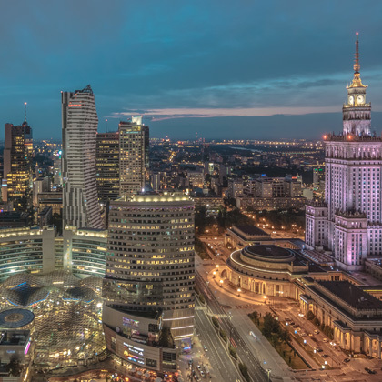
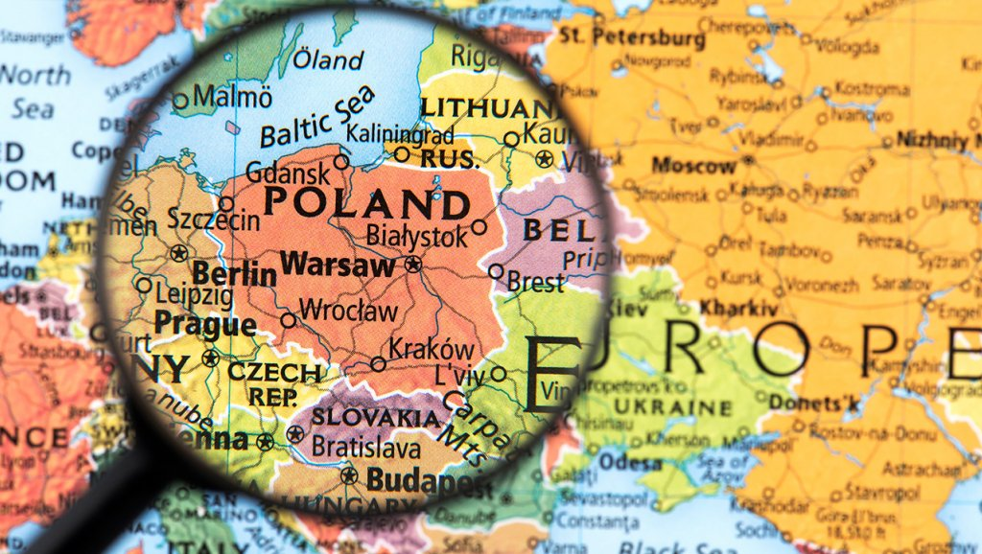

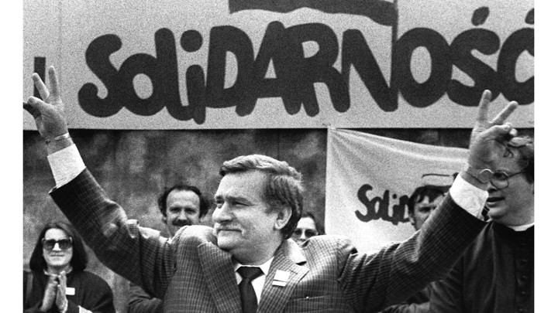
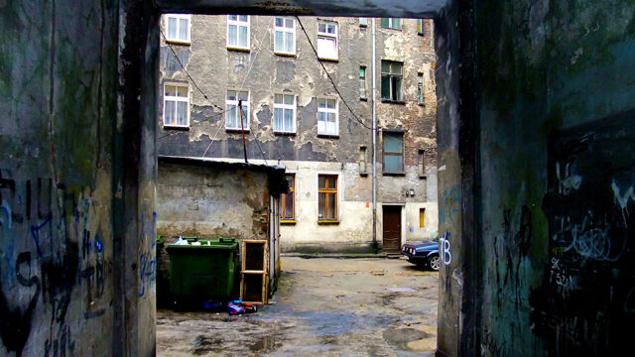
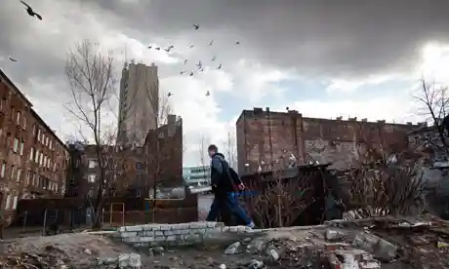
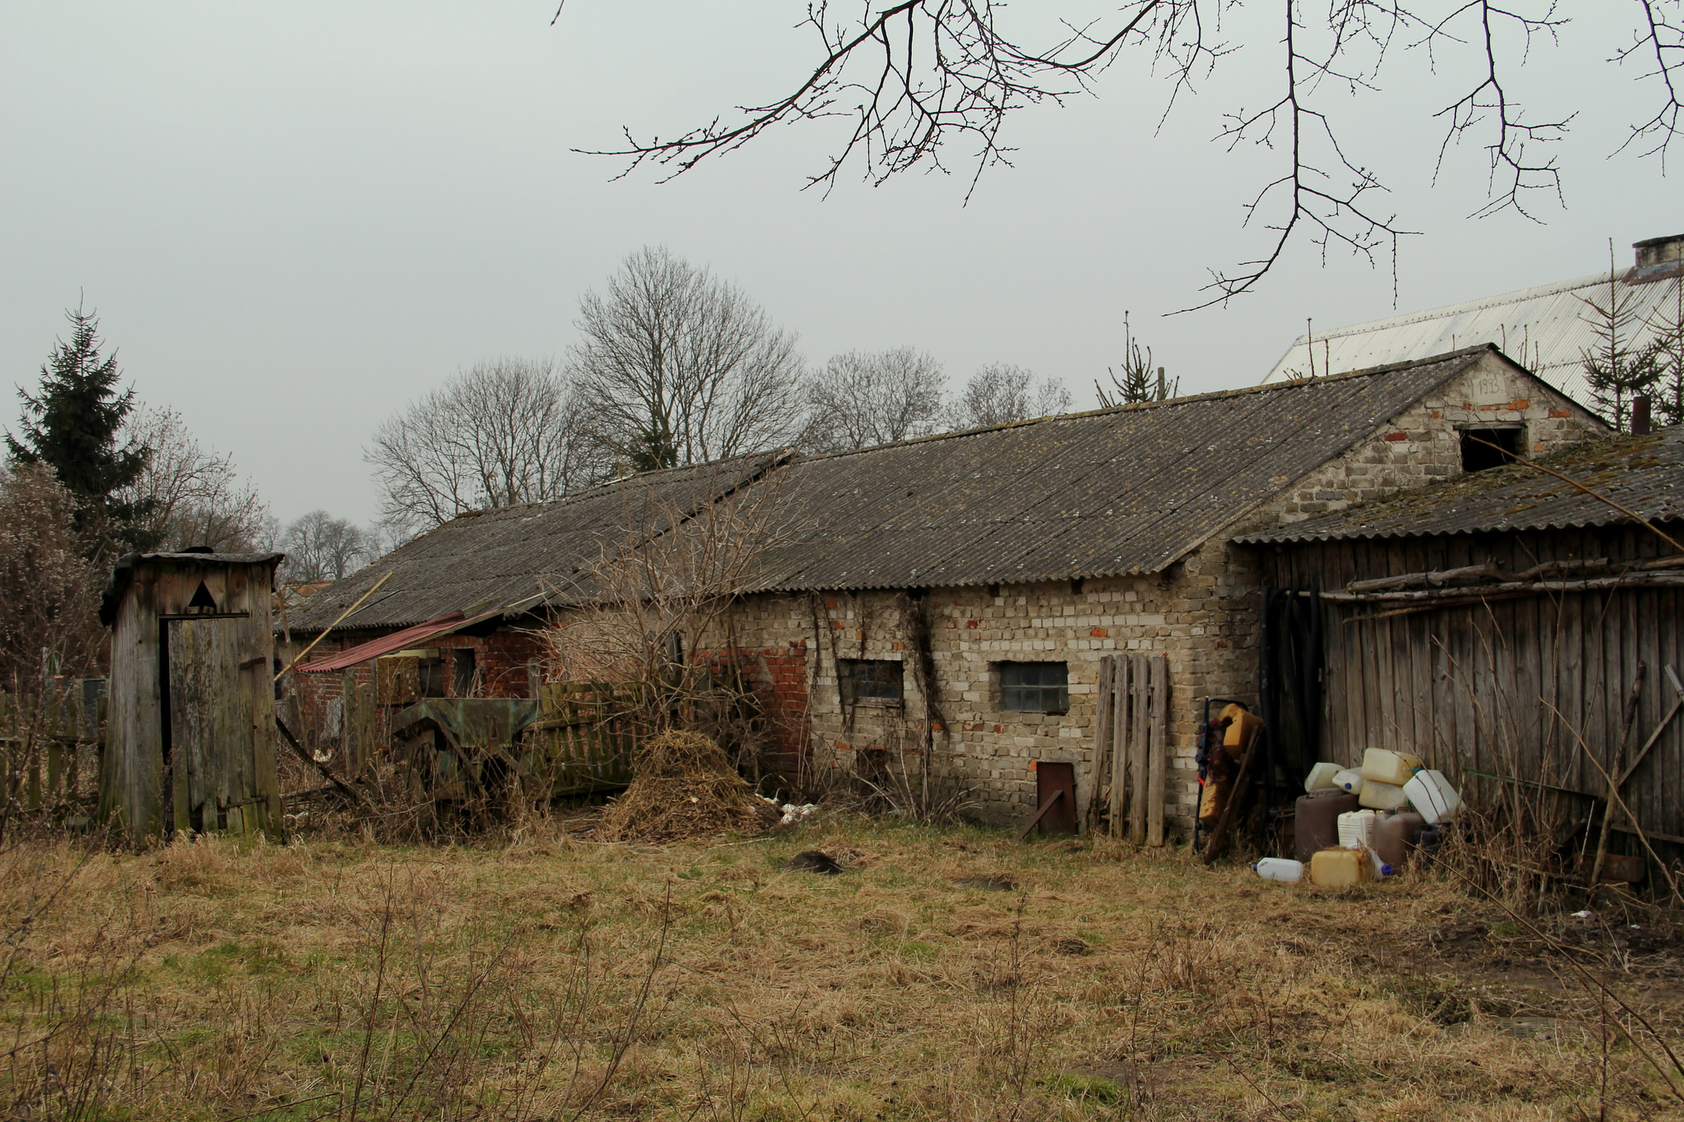
Pierwszy poziom

Slide 3
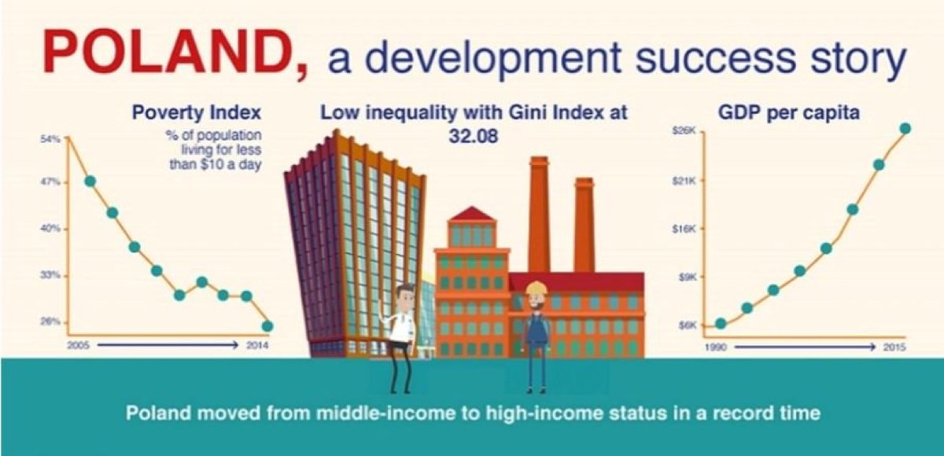
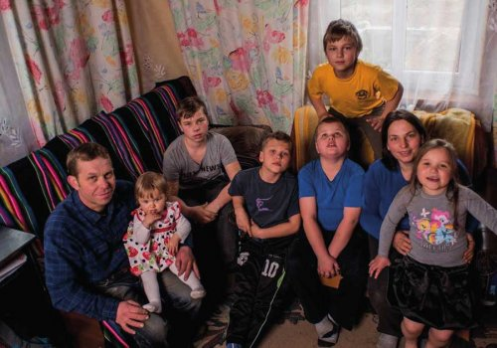
Social inequalities?
A „half-truths”?
„winners and losers of transformation”?
social costs of transformation?

Slide 4


Social inequalities – dimensions
geographical
historical
political/
ideological
economic
anthropological/
cultural
moral/
ethical

Slide 5
The complexity of relationships
career guidance: social and cultural phenomenon
social inequality: social and cultural phenomenon
social justice: social and cultural phenomenon
We need theory allowing us to understand this complexity

Slide 6
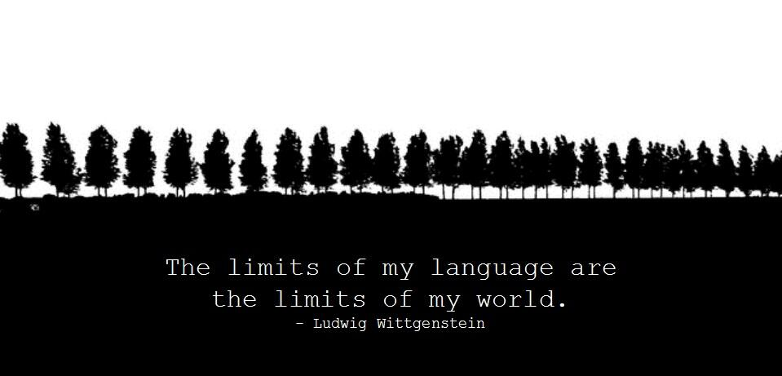
Why and what for?
To resolve theoretical/methodological dilemmas
To organize data and… complexity
To understand better both, career guidance and its social contexts
To analyse different kinds of subjects
To apply a new language and questions
Układ Tytuł i zawartość z wykresem

Slide 7

Intensive rules
socio-political and cultural
related to the labour market
common in many countries
typical of the particular country/institution
common in many countries
typical of the particular country/institution
Changes and transformations of societies (fluidity of reality, mass media development etc.)
Socio-political Neoliberalism (commodification of social relationships etc.)
Migrations (multiculturalism)
What is the value of equality?
What are the „tacit” assumptions/stereotypes used in CG practices ?
Economic crisis
‘the world of disappearing jobs’
Knowledge economy
Neoliberalism (or post-neoliberalism)
How does the labour market rules support the social equality?
Notes:
First of all I recognized the rules and the resources of the career counselling structuration processes. On this slide you can see only the one part of the picture I’ve presented in my dissertation. I divided up these rules into the rules being socio-political and cultural as well as economic in their character. This was done because of the special significance and connection between career counselling, labour market and economy. As you can also see there are some rules labeled as “common in many countries” and “typical of the Netherlands”. This differentiation has appeared because – in its specific way – career counselling is located “between the global economy, local labour market and the individual’s needs”. This means, that the career counselling structuration process is embedded not only in the Dutch society but also the global transformations.

Slide 8
Quotation from interview
„ (...) today's world requires… competent people... our students… they must know that they are responsible for themselves and ... without this…they will be unemployed...that is the job market....everyone must be competent...you understand…you must know a lot and…learn a lot all the time…you must be aware of what you are learning”

Slide 9

Towards a radical career guidance…
„just anger of the people” (return of rage)
local communities development
„after capitalism?”
radical pedagogy and philosphy
the battle against social inequalities and social
exclusion

Slide 10
Thank you for your attention!
anna.bilon@dsw.edu.pl

