Slide 1

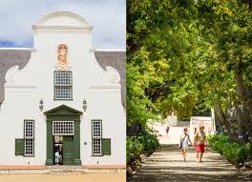
South African Case Study
Dr. Anouk Jasmine Albien
anouka@sun.ac.za
06.06.2019

Slide 2
South African Overview
South Africa has a plethora of cultures and religions.
SA has 12 official languages by law of which each citizen is required to learn at least three.
Apartheid classified citizens into five racial groups: Indian, Coloured, White, Black and Other.
These categories are still used today, although Apartheid was abolished in 1994.
There have now been 20 years of democracy but Apartheid traces linger.
Race and socio-economic disadvantage remain interlinked.
Geographical engineering of separation by using railway tracks or highways has the function of keeping racial groups separate even today.
SA citizens were allocated careers according to racial groups during Apartheid, although now careers are open to any race, structural disadvantages remain.
Unemployment rate 27.6% (2019), youth unemployment rate 55.2%

Slide 3

Other Research Involvement
DVC: Strategy & Internationalisation involved research on Higher Education, strategic functioning of HEIs, Nursing Advancements and business models.
Moral sensitivity Prof Lea Ferrari & Johannes Katsarov
Critical Moments in marginalised youth career development Dr. Sanna Manniken & Rosie Alexander
ECADOC: Rie Thomsen & Ronald Sultana
Prof Maree

Slide 4
Stellenbosch Winelands
Stellenbosch is notorious for its vineyards.
Stellenbosch is surrounded by Townships one each side.
Coloured Townships include: Cloetesville, Idas Valley, Jamestown, Kylemore, etc.
Only one Black Township exists in Stellenbosch: Kayamandi which means sweet home in isiXhosa.
Townships housed farmworkers who worked in the vineyards and were historically paid with wine.
Predominant language: Afrikaans & introducing more English with more internationalisation.
Viewed as the last fort of the Afrikaner culture: This is the place for Afrikaans young men and women to study & find life partners.

Slide 5


Slide 6
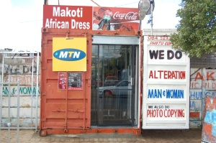
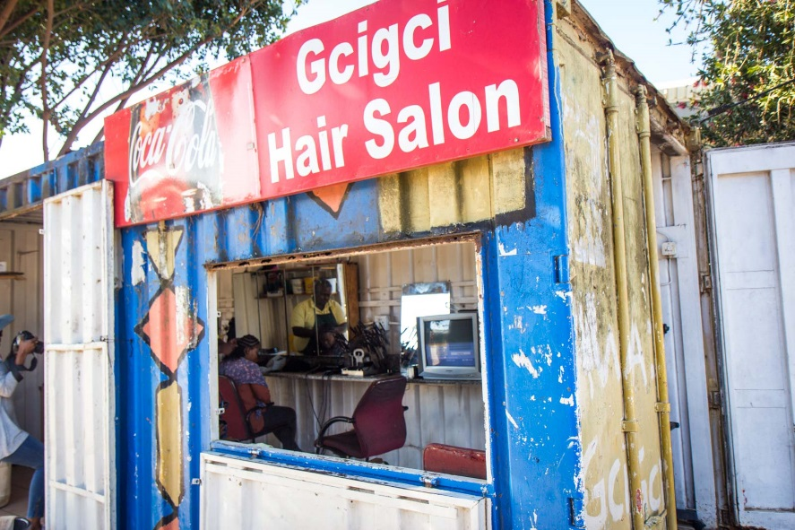

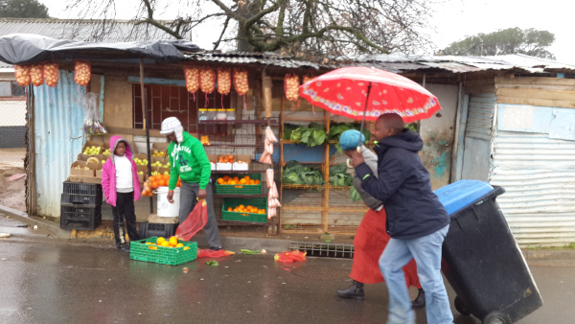
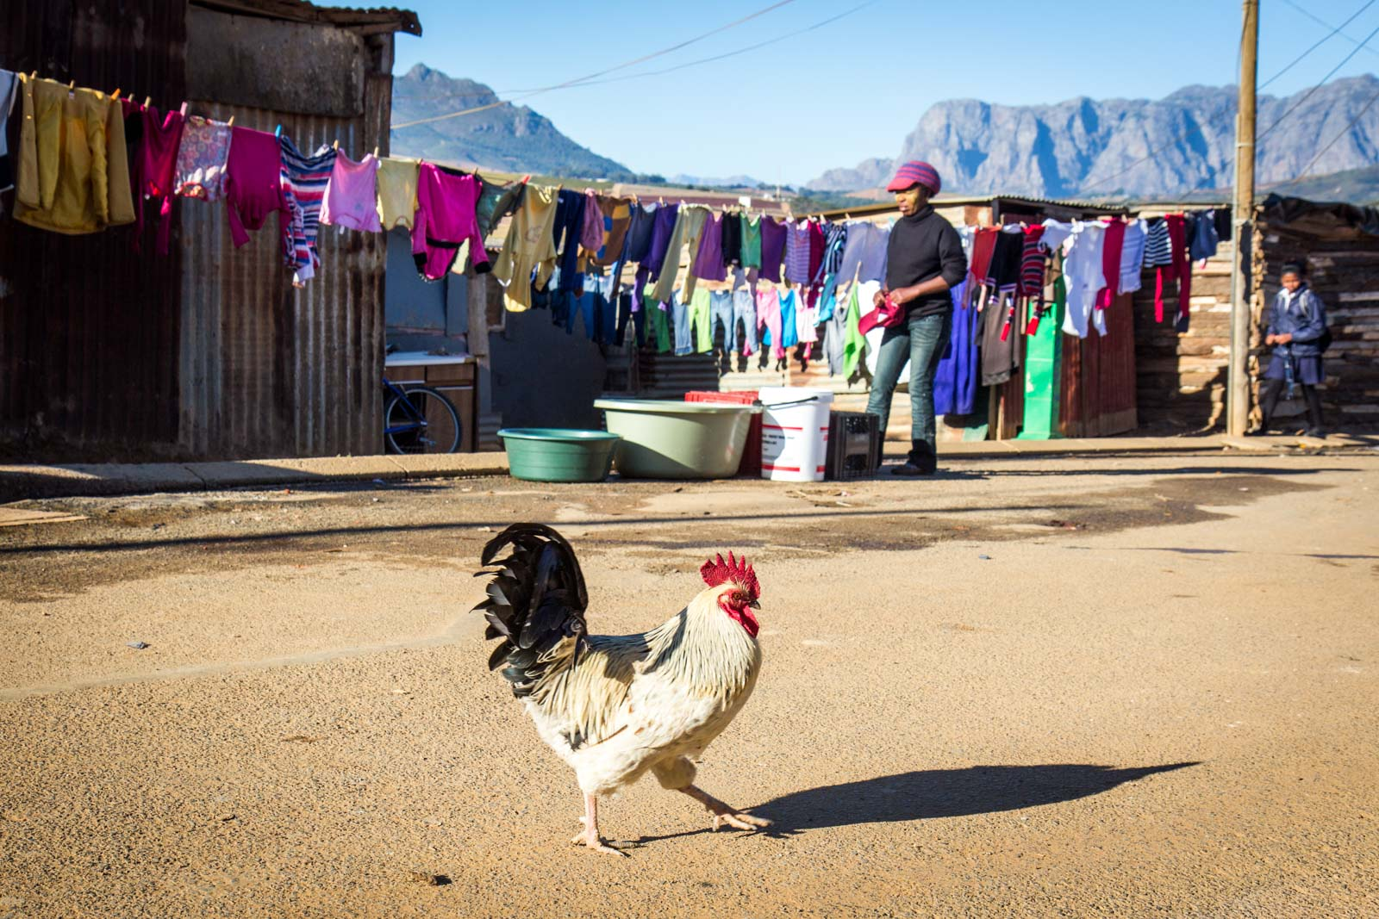
Kayamandi Township
.

Slide 7
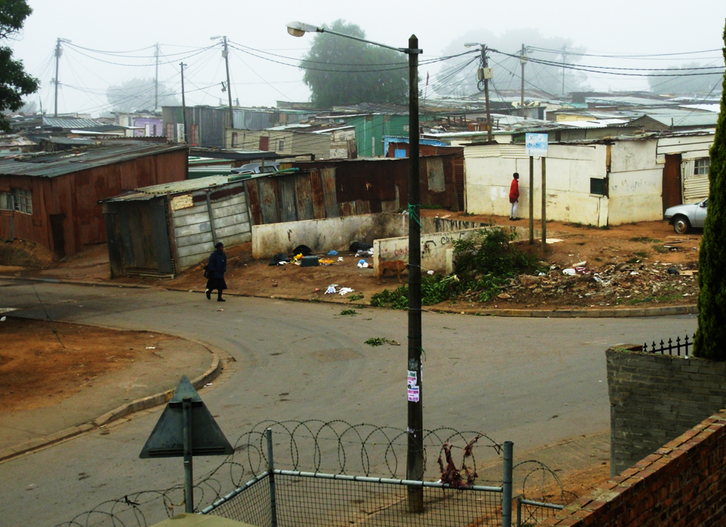

Slide 8
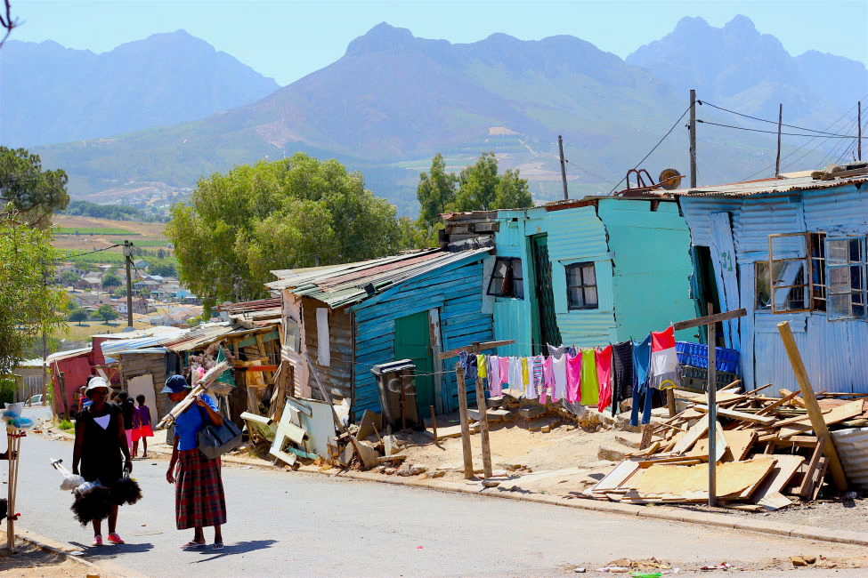

Slide 9
Kayamandi Township
75.06 hectares in size, bordered by farmland, a major road & Stellenbosch town.
Designated ‘black area’ during Apartheid in 1942.
Initially housed migrant farm workers, from the Eastern Cape.
Average migration growth 4.5-5% annually.
Unemployment 62% in 2008.
Employed in lower paying sectors (i.e. Domestic work, gardening, transport & other manual labour (Darkwa, 2006; Kiangi, 1998).
Population estimates of approx. 40 000 in 2011 (10% growth annually).
62-65% reside in Shacks (informal housing structures)
https://www.youtube.com/watch?v=A3E5qHalxpo
https://www.youtube.com/watch?v=Q6jtxBtwdVg
https://www.youtube.com/watch?v=PCnJIFCOQtg
https://www.youtube.com/watch?v=YlOTdRuYcIE&t=84s
https://www.youtube.com/watch?v=uQIwOCUEx5k

Slide 10
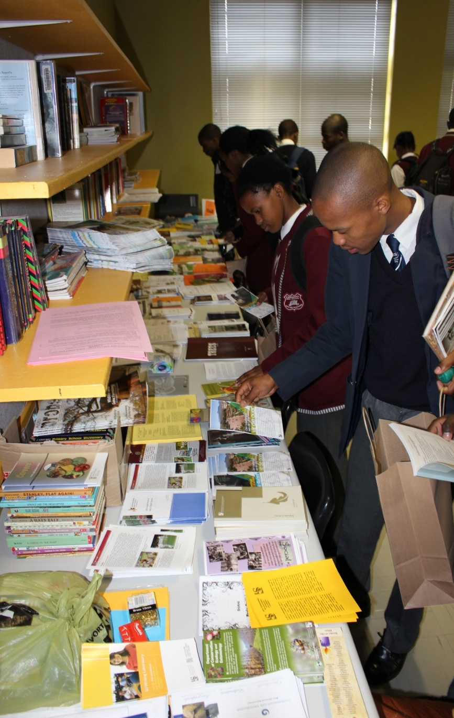
Disadvantaged learner’s career influences
Limited access to career education services
Little exposure to the world of work
Scarcity of knowledge of tertiary training institutions
Insufficient self-awareness impacts curriculum choices
Limited financial resources
Lack of real-life exposure (role models & job shadowing)
Stereotypes or irrational occupational beliefs (Ebersöhn & Mbetse, 2003; Stead & Nqweni, 2006; Stead, Watson, & Foxcroft, 1993).

Slide 11
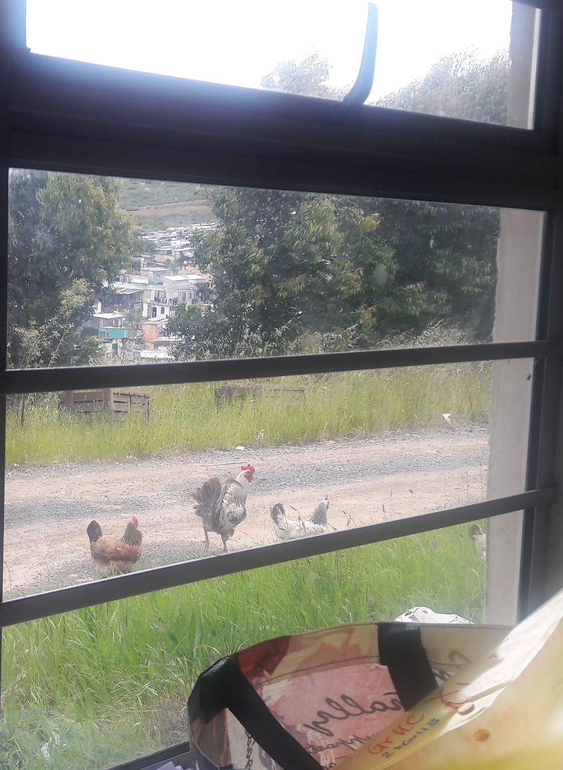
Research Challenges
Crime & Violence
Gang members interfering with research
Restricted hours that are ‘safe’
Children: Economic & family responsibilities
‘Long’ weekends
Feeding schemes
Negotiation & communication
Transport problems
‘African’ time
Education levels
Language barriers
Racial positioning (i.e. Umhlungu)

Slide 12

Ikasi/ Township Culture

Slide 13
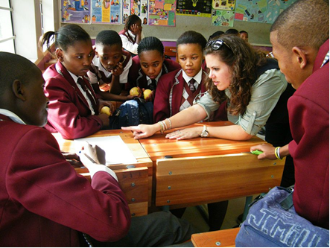
A MIXED-METHODS ANALYSIS OF BLACK ADOLESCENTS’ VOCATIONAL IDENTITY STATUS AND CAREER ADAPTABILITY COMPETENCIES IN A SOUTH AFRICAN TOWNSHIP

Slide 14
Research Problem
Career behaviour re-conceptualised as situated within contexts, with values & indigenous understandings (Stead & Watson, 1998).
Identify career competencies & vocational identity statuses.
Major gaps exist in understanding career development in marginalised groups, such as disadvantaged adolescents or unemployed youth in township settings.
The problem statement is whether a qualitative career intervention based on the life-designing approach (Maree, 2017; Savickas et al., 2009) can enhance the career adaptability competencies and vocational identity scores of Grade 10, 11 and 12 learners from Kayamandi.

Slide 15
Research Methodology
PHASE 1
PHASE 2
PHASE 3
PHASE 4
PHASE 5
PHASE 6
Intervention creation
[Qualitative]
CAAS & VISA pilot
[Quantitative & Qualitative]
Intervention pilot
[Quantitative & Qualitative]
Final intervention
[Qualitative & qualitative]
Intervention Feedback
[Qualitative]
Taken at T₄
Focus group
[Qualitative]
1 week 1 week 3 months
T₁
QN*
T₂
Pre- test
QN*
Intervention
Qualitative
T₃
Post-test
QN*
T₄
QN*
T₅**
QN*

Slide 16
Research phases | Research objectives
Phase 1: Intervention development (2015) | Objective 1: Include role players in a qualitative process that informed the creation of the Shaping Career Voices Intervention Booklet.
Phase 2: Psychometric pilot (2015) | Objective 2: Assess suitability of CAAS and VISA measures for application in a South African township context.
Phase 3: Intervention Pilot (2016) | Objective 3: Determine how the content, structure and process of the pilot intervention was received by Grade 11 high school participants and if higher post-intervention measures resulted.
Phase 4: Final Implementation of Shaping Career Voices Intervention (2016) | Objective 4: Determine if the career intervention resulted in improved scores for Grade 10, 11 and 12 township high school learners on the CAAS and VISA Objective 5: Examine if gender or school grade would result in unique quantitative scoring patterns that could be indicative of adolescent’s adaptations to the township context.
Phase 5: Evaluative written feedback (2016) | Objective 6: Explore the highest scoring participants’ subjective evaluations of the career intervention upon completion using reflective feedback forms.
Phase 6: Focus group (2017) | Objective 7: Conducting a focus group interview to gain insight into participants’ perceptions of their post-intervention adaptations in career ideations, career decisions and career identities.

Slide 17
Phase 4: Shaping Career Voices Intervention participants
The intervention group consisted of 582 Black township high school learners between the ages of 14 and 22 years (M = 17, SD = 1.3).
The participants included 314 Grade 10 learners (55%), 237 Grade 11 learners (41%) and 31 Grade 12 learners (5%) learners were assessed over five different points in time (T₁, T₂, T₃, T₄ & T₅) using the CAAS and VISA.
The number of learners who completed the career assessments differed according to time period, with 579 learners assessed at T₁, 496 learners at T₂, 377 learners at T₃, 265 learners at T₄ and 30 learners at T₅. The participants comprised of 169 (31%) males and 369 (69%) females.
Learners were recruited from both high schools in Kayamandi, with 390 leaners (67%) from Kayamandi High School and 192 learners (33%) from Makupula High School.

Slide 18
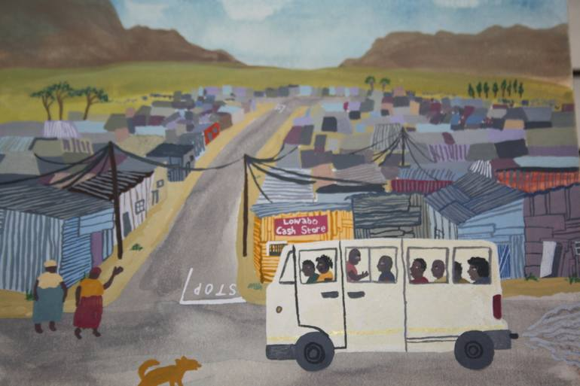

Slide 19
Results Summary
Over time all the CAAS subscales scores increased, except the contribution subscale, and the most significant changes were seen between T₁ and T₄.
Grade 10, 11 and 12 participants’ scores all seemed to increase differently over time, concern and contribution subscales, specifically in the Grade 12 participants.
Female participants scored higher on concern and contribution subscales.
Significant differences between T₁ and T₄ for the VISA subscales (SD, ICM and IB subscales).
Males and females scored similarly, except that the male participants scored significantly higher on three subscales, namely the CF, SD and CR.
There were grade effects on the CE, IB, ID, and ICM subscales, for which the scores increased the most for the Grade 12 participants, and there were significant differences between the mean scores of the different grades. In CR, a significant difference was seen in the mean scores between the Gr 10 and 11 participants. SD showed that the Grade 12 participants had the lowest scores in comparison to the Grade 10 participants, who had the highest scores on this subscale.

Slide 20
Vocational Identities Summary
Upon follow-up at T₄, the identity statuses had not changed much from T₃, but remained significantly different from before the start of the intervention.
The most interesting findings of the present research are that the first new identity status emerged at T₁ (m_m_m), and that the second new vocational identity status (h_h_m) emerged at T₂ and remained the highest occupied status until T_{4.}
The first vocational identity status of m_m_m was likened to the moratorium status, it was renamed undifferentiated moratorium. The qualitative strands of this research point to a lack of future perspective, with a struggle for making an identity decision in the present, which is best described by a moratorium status.
Similarly, h_h_m status was renamed, foreclosed moratorium. Instead of a self-constructed sense of identity and self-designed future time perspective (Taber & Blankemeyer, 2015). These individuals view the future as a plan created for life and that they seek to fulfil obligations related to others’ expectations, which is very similar to the foreclosed identity status.

Slide 21
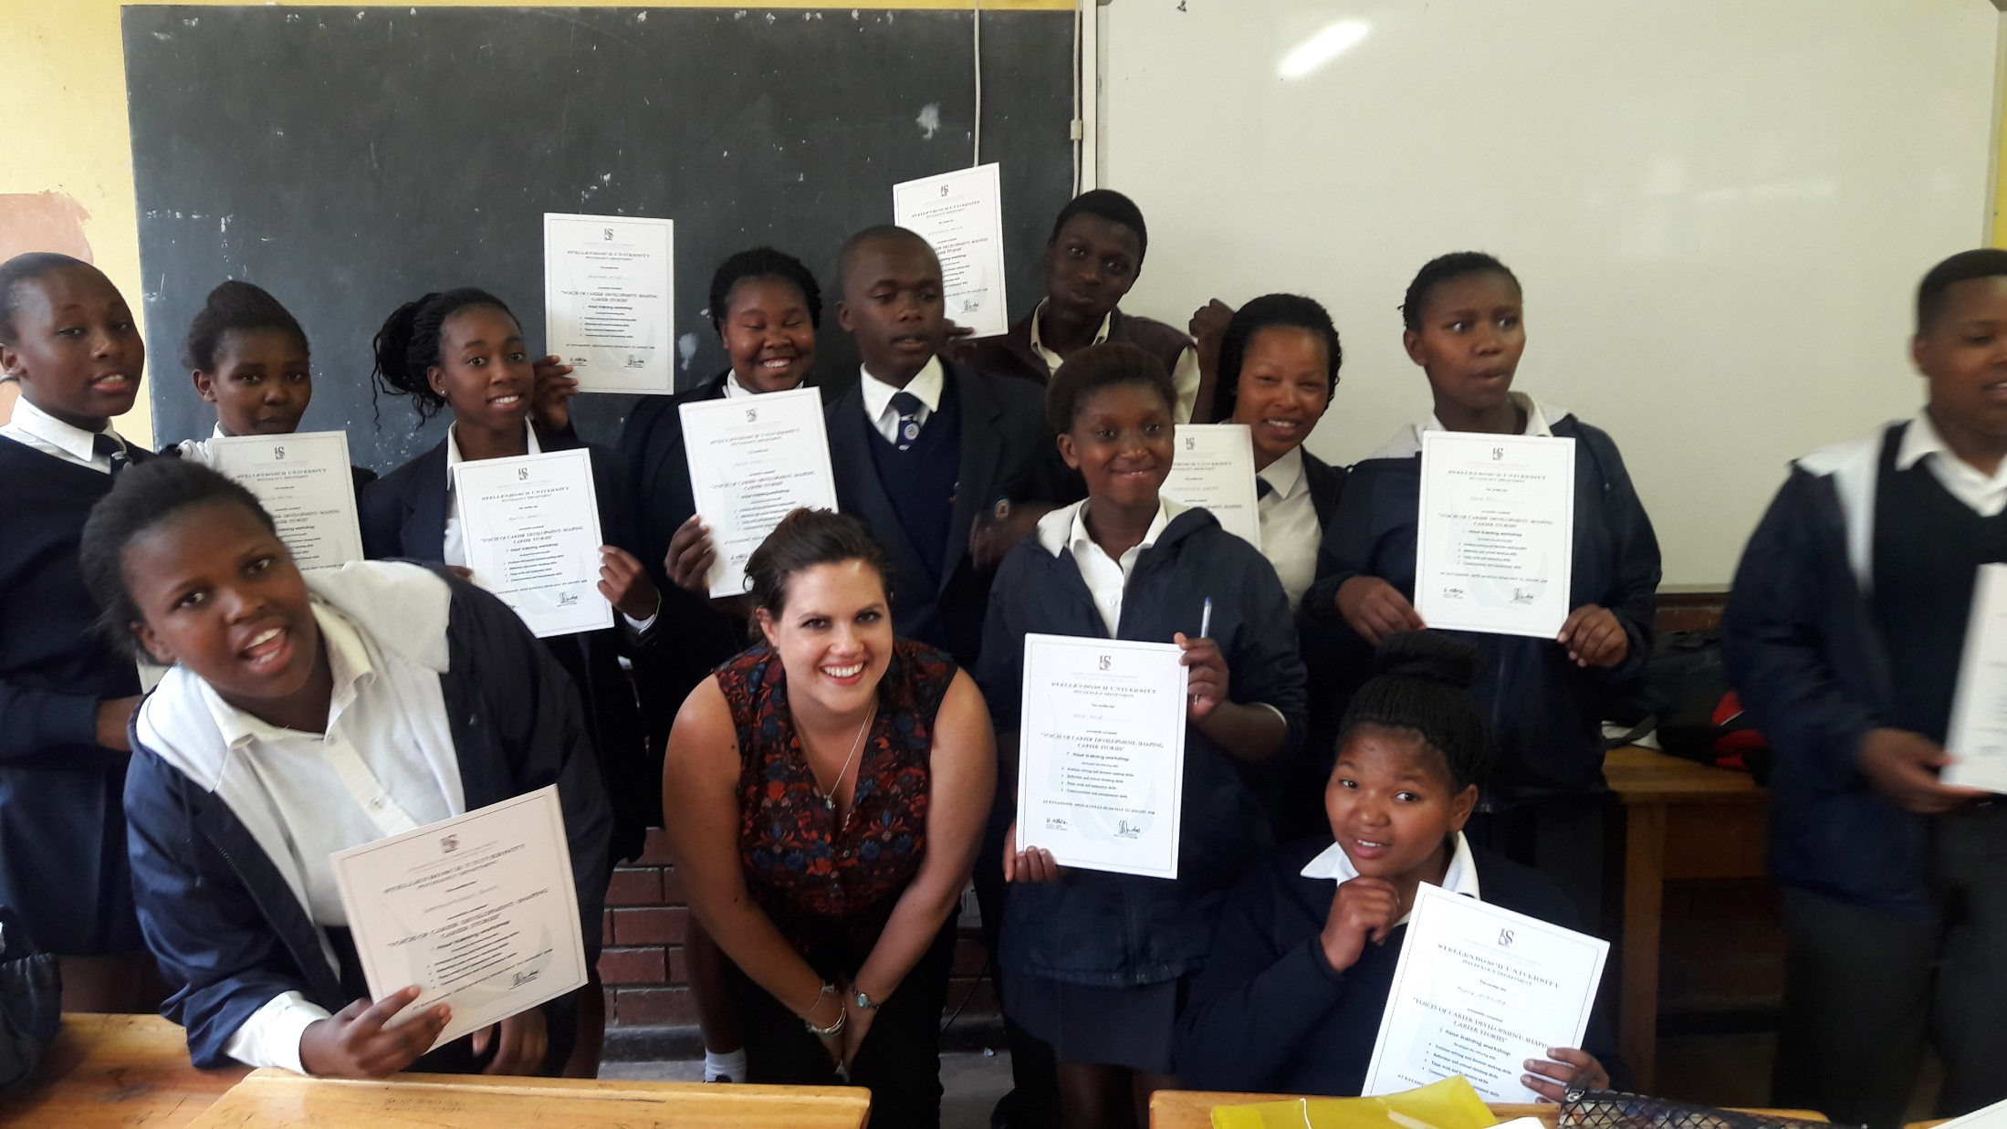
Institutional Plan 2019-2024

Slide 22
PhD Research Conclusions
The current study was conducted in a low socio-economic sample, which means that distinctive findings resulted.
The influence of social comparison, social conformity and the construction of the self, primarily in reference to social relations, was highlighted, as well as how this has affected time perspectives as well as vocational identity development (Ames et al., 1994).
Ubuntu or collectivistic cultural underpinnings: it can be argued that there would be an internal struggle to fulfil family obligations or duties, to find a career that they suited in terms of their abilities.
But also the need for participants to find a career that had enough prestige to base their SIF or self-worth. As a result, adolescents navigate by wavering between future time perspectives designed by others, & are consumed by present time perspectives in their struggle for an identity.
Social and collectivistic influences have not yet been documented in the formation of vocational identity statuses.
The qualitative strand informed the interpretation of quantitative results throughout the six phase process & provided far deeper insight into the trends.

Slide 23

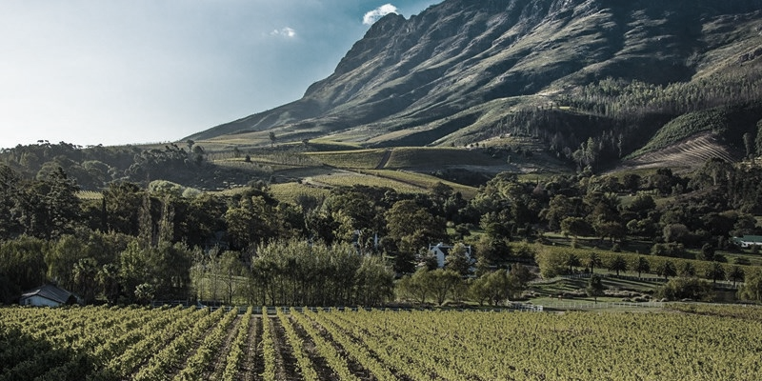

Contents
Thank you!
Dankie!
Enkosi!

