Slide 1

The Personal and Political in Career Guidance
- Some Reflections about Malta
Manwel Debono

Slide 2
Themes
Saints
Success
Strategy

Slide 3


Notes:
Ggantija temples (5,500)

Slide 4


Like saints,
politicians,
serve as intermediaries
Notes:
Role of saints – intervene
Politics – prime minister – direct contact with them- but HIGH POWER DISTANCE
The link with religion. Politicians, likes saints serve as intermediaries
Public sector – huge employer. People like to work in the public sector

Slide 5
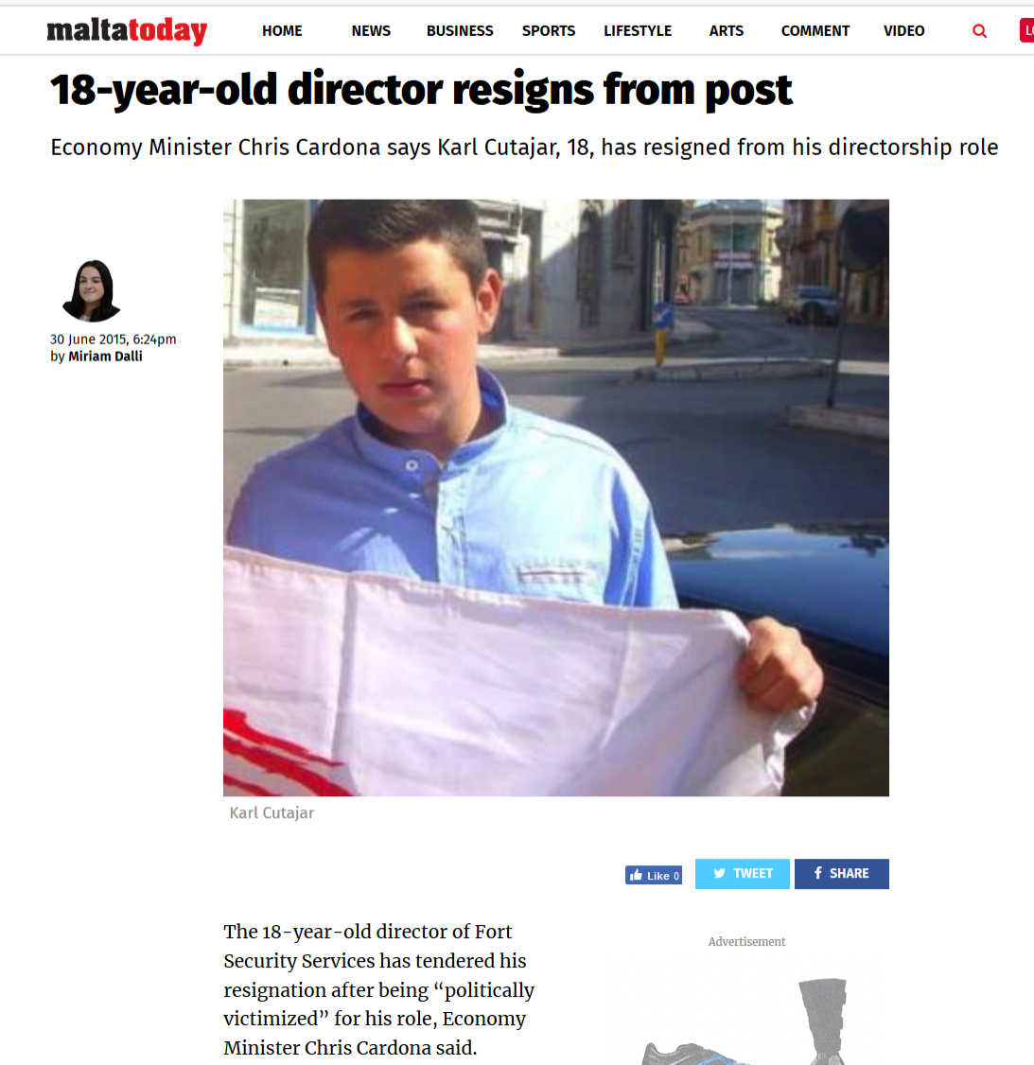
“Who you know is more imp than what you know”
System favours nepotism
Minister: “Age is irrelevant as long as he is legally qualified to hold the role”
Notes:
Is all that is legal, also ethical?
MERIT?
What are the social consequences on this system? (social injustice)
How should career practitioners behave?

Slide 6
Themes
Saints
Success
Strategy

Slide 7






Economic
Growth
Individual
Investor
Programme
iGaming
Notes:
-Apart from being a large employer, Government develops and implements policies
-In line with neoliberal trends
- Blockchain – a way of recording data transactions that make cryptocurrencies possible (bitcoin)
- MOST PEOPLE ARE HAPPY -

Slide 8
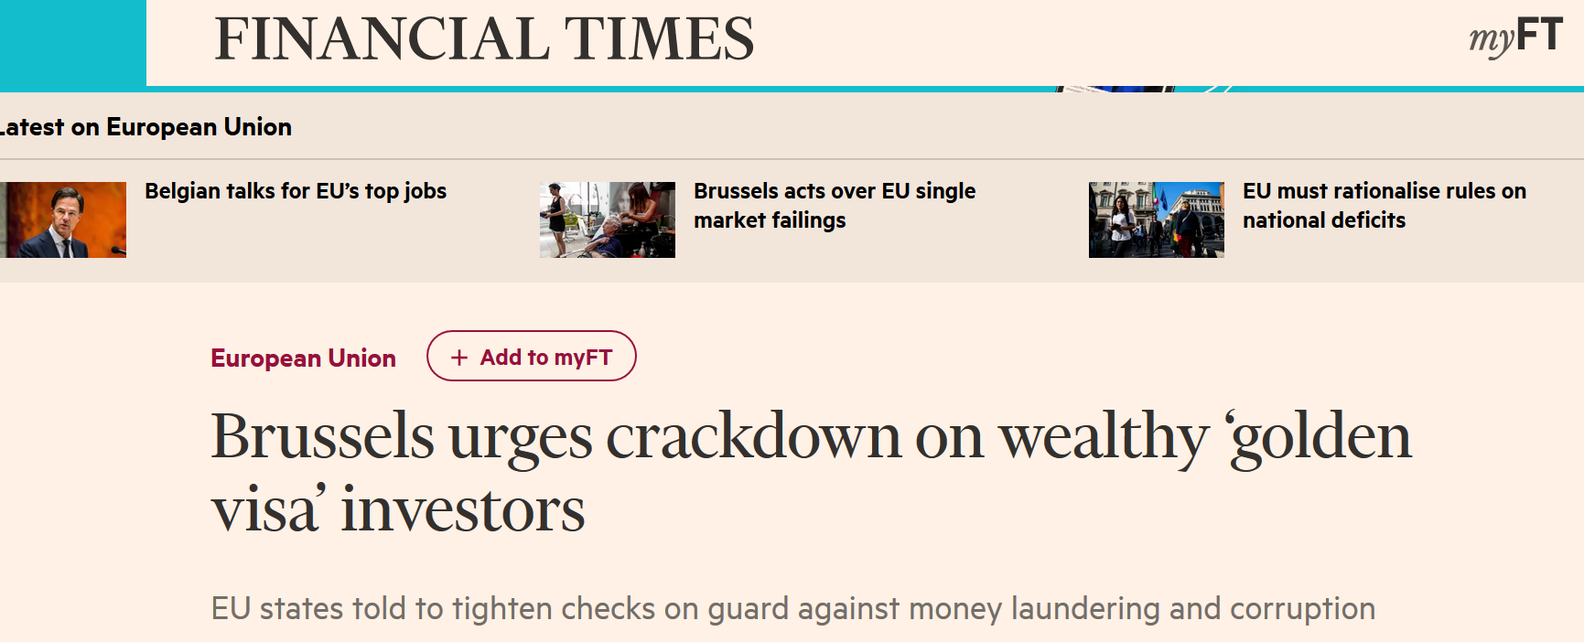
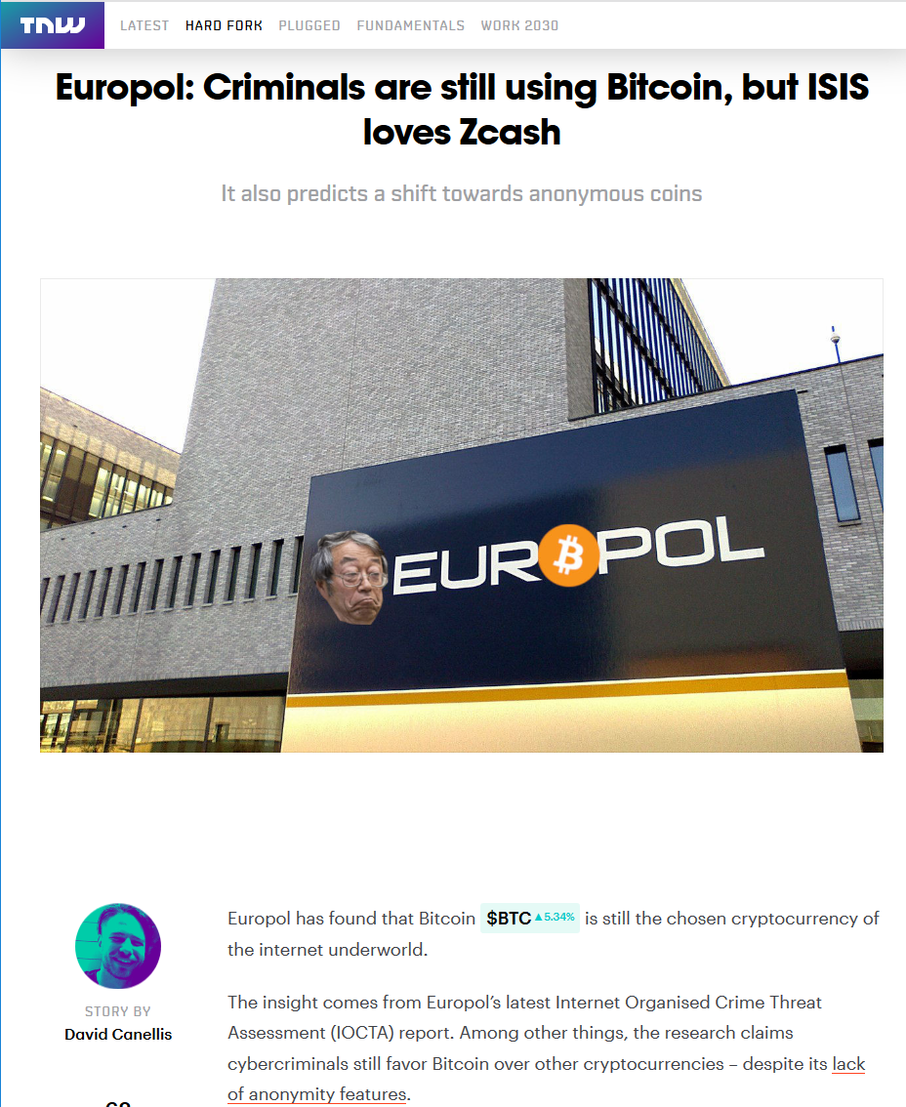
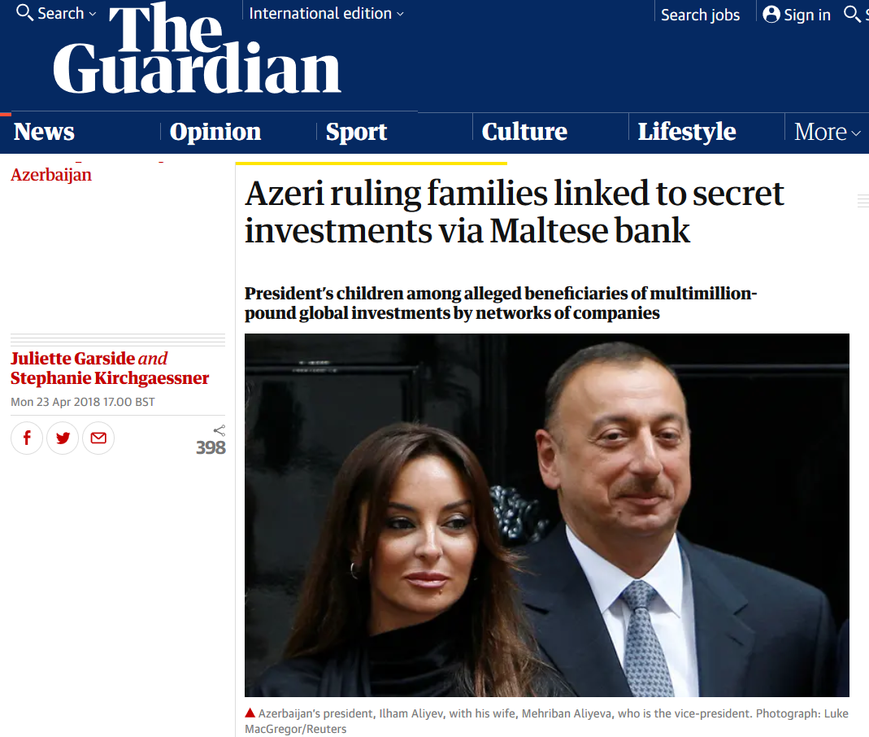
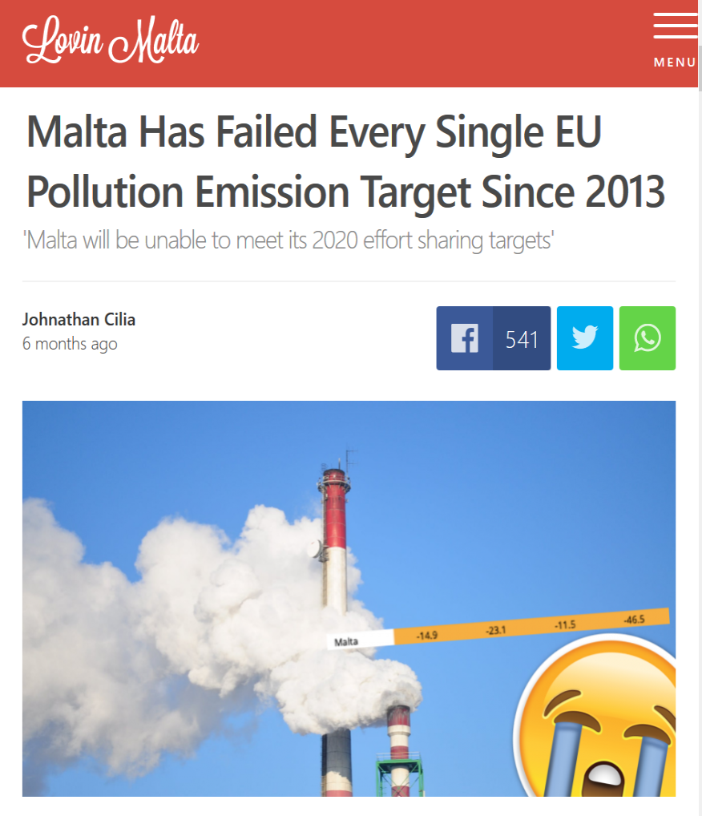
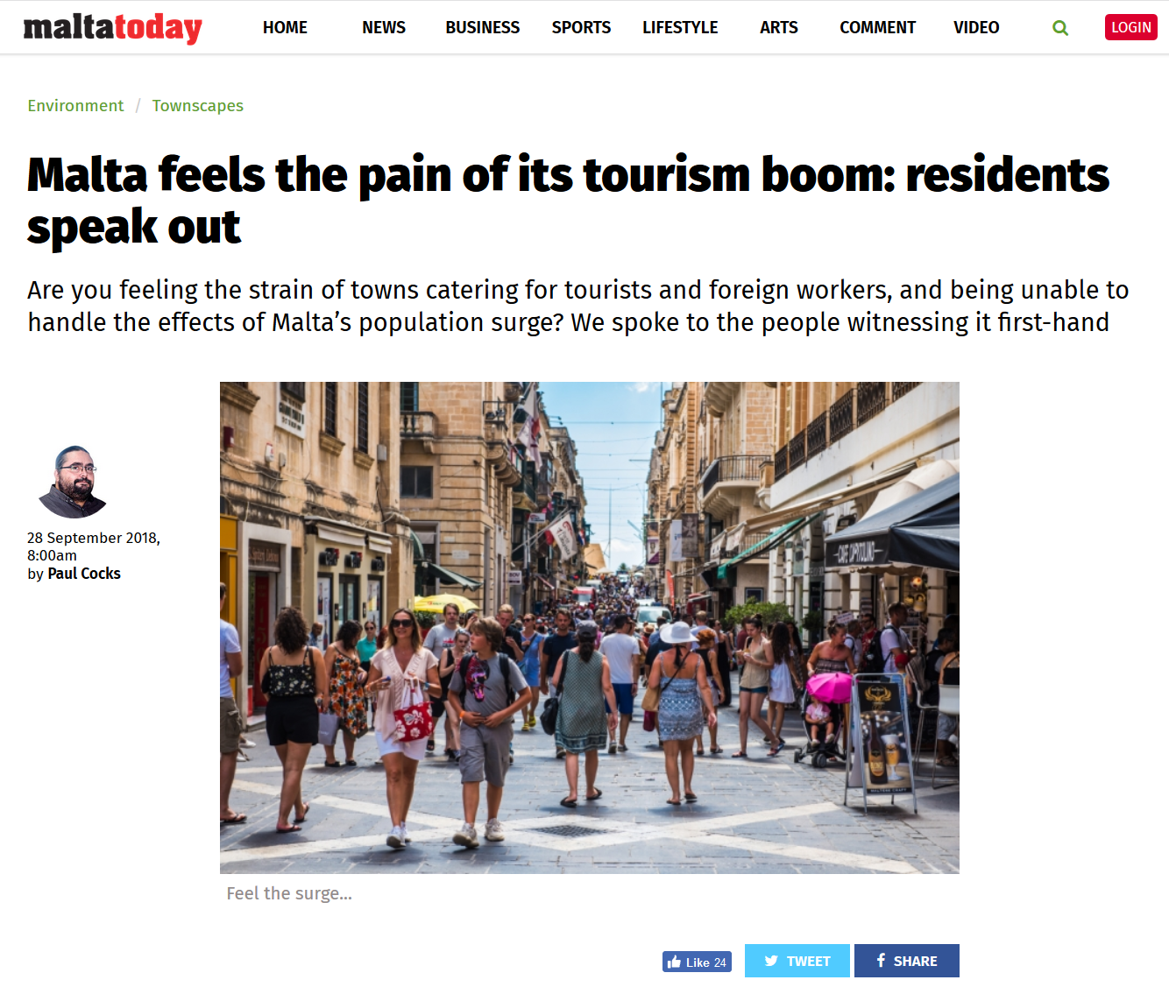
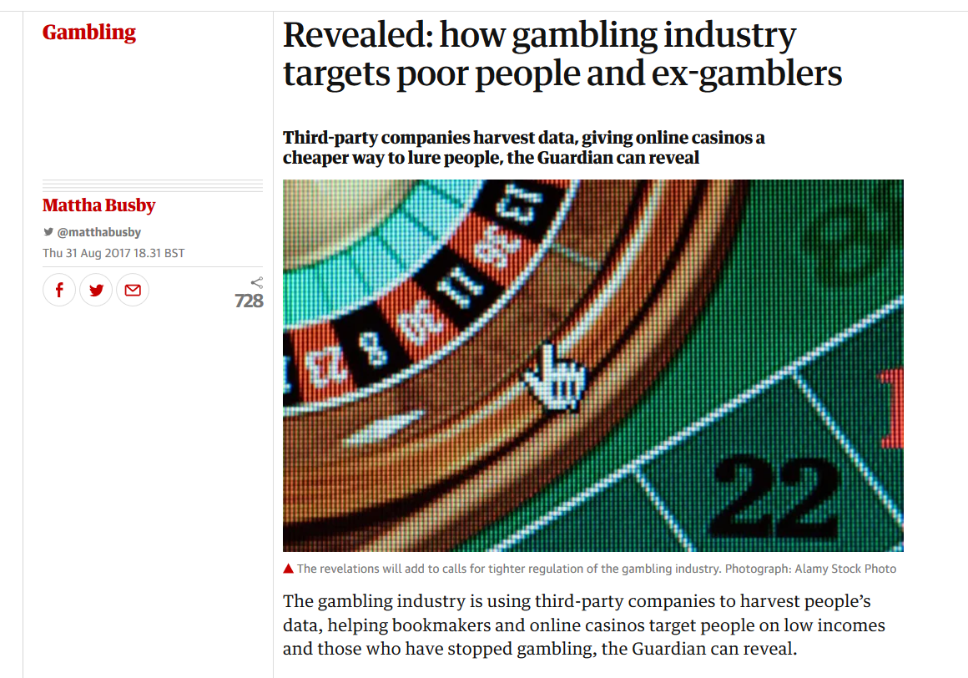
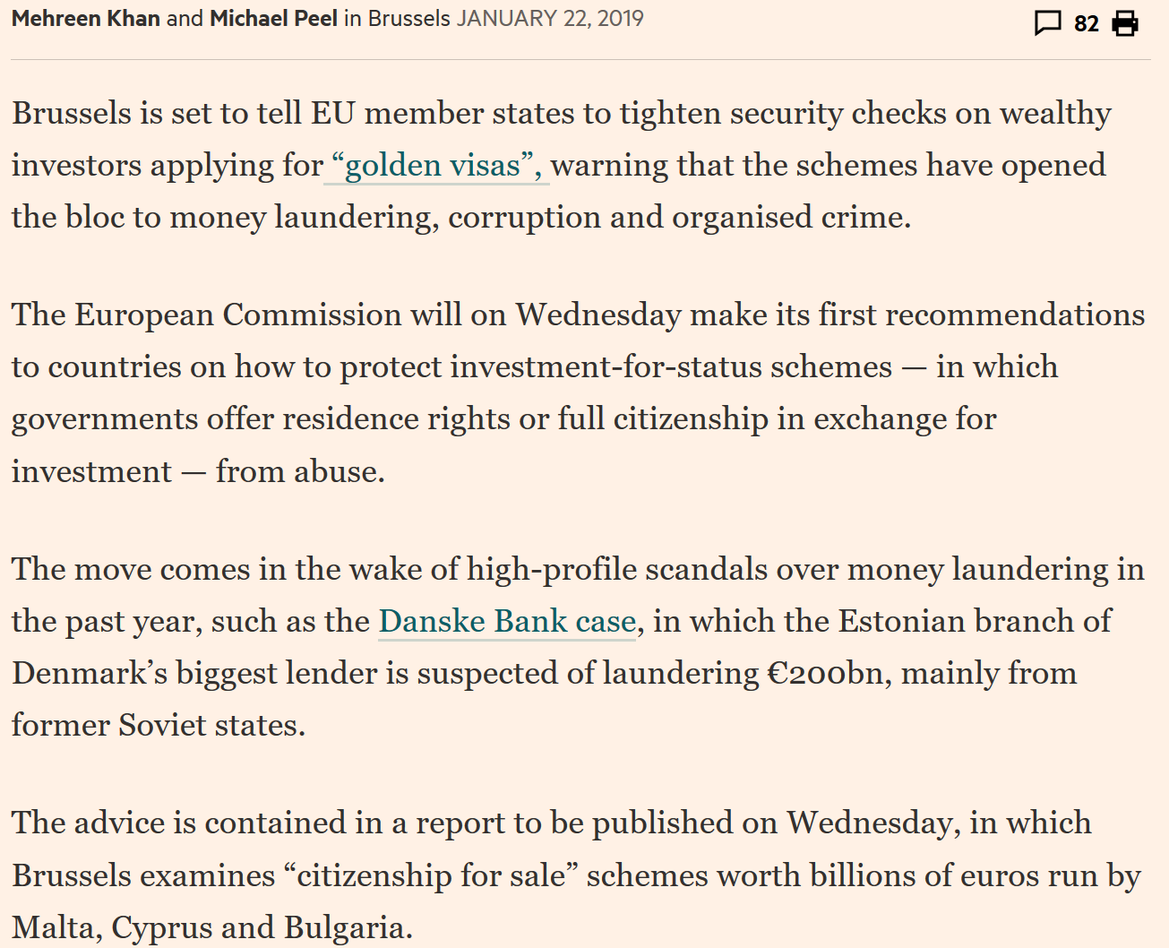
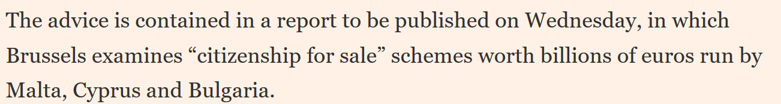
Sustainability?
Notes:
From moral & environmental perspective
Consturction – polution, waste, greenspace
Increasing number of persons – pressure on infrastructure (water, electricity, roads)
Financial sector – synonymous with tax haven; shakira & bono used Malta to evade or avoid taxes back at home.
Ethical issues regarding promoting gambling & selling of passports very apparent.
Exposing Malta and EU to money laundering, corruption and organised crime
SO WHAT ROLE DOES CAREER GUIDANCE PLAY ? IS IT CONTRIBUTING TO SOCIAL INJUSTICE BY PROMOTING UNSUSTAINABLE ECONOMIC SECTORS?

Slide 9
Themes
Saints
Success
Strategy

Slide 10
The role of career guidance
Balance interests & responsibilities of stakeholders
Cannot be politically neutral
Support individuals in developing their lives
Notes:
1.Whose interests does it serve? Guidance as policy instrument; needs of clients – adverse social outcomes. Bridge; importance of sharing of responsibilties
2.Not obvious how to address injustice & sustainability… Elephants in the room. (highlight tensions and contradictions)
3.Support individuals to become actively involved; about happiness and life satisfaction

Slide 11
“How do you reconcile the task of helping individuals to develop themselves in the world as it is, while struggling for a world as it could and should be?”
Notes:
Pierre Bourdieu’s metaphor of the game
..but should not simply enculturate individuals (perpetuate domination and aggression)
Critical awareness of context (sociology lecture)
Also inspire people to think of alternative futures – empowered (stronger agents of change)
SUMMARY – career guidance can promote agency by increasing awareness of structure.

Slide 12

Thank You!

