Slide 1
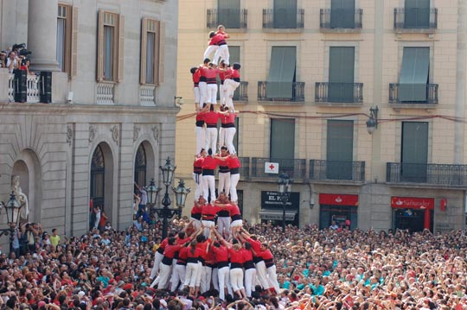

Career guidance, collaboration and community
ECADOC - Malta
Màrius Martínez Muñoz
DO - Diversity and Guidance
Marius.martinez@uab.cat
@mariusmartinez6

Slide 2
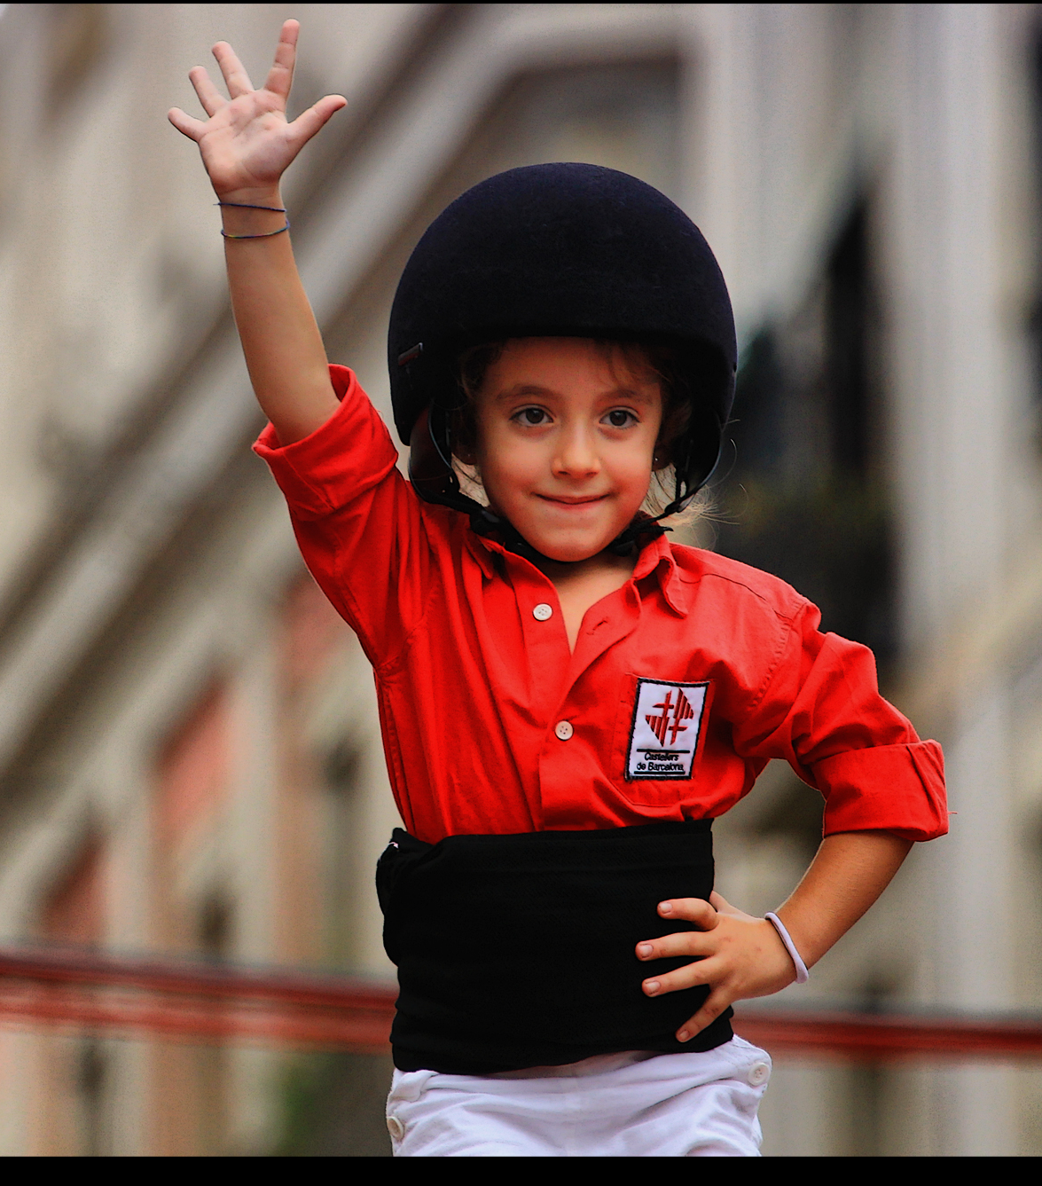
Her name is Clara, she reached the top of the tower...

Slide 3

1.- Contemporary (?) double edged concepts
Guidance as a service (not a programme)
Information as guidance
ICTs will solve everything (24/7)!
Credentials and empowerment that’s all you need (let’s make them competitive!!)
Well, also some experience would be welcome
Entrepreneurship (nobody will look after you)
You are responsible! (civil society is responsible)
Notes:
How guidance is concevied in public policies and in institutional practices. Sometimes they tend to reduce/limitate the scope of some concepts affecting social justice.

Slide 4
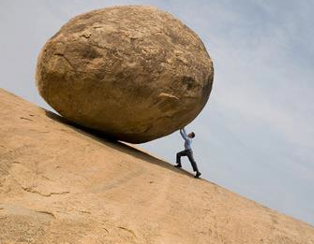
2.- Two confronted rationalities (II)
The superman /superwoman discourse in training and Guidance:
  Individual base
  Training credentials
  Experience,
  Entrepreneurship
  Competitiveness (awareness of crisis)
  Linear perspective of itineraries
Discourses of collaboration, empowerment and groups
  Group / community based
  Quality training + relevant experience
  Awareness of barriers (human / interests creation)
  Collaborative competencies
  Non linear itineraries - perspectives
Notes:
Very prominent in the discourses, goals and activities, the solipsistic, individualistic conception of superheros, competing and fighting for (individual) better chances and opportunities in front of an emerging conception of guidance as a group / community based concept.

Slide 5
7 barriers / 20 Skills to fight them
Economic model.
Economic crisis.
Socioeconomical policies.
Socieconomic unequalities.
Stereotypes, discrimination on the basis of age, gender, etnicity, origin, sexual orientation, training credentials.
Educational sistem under permanent legal changes and not tuned with the labour market.
Guidance with shortcomings.
Speaking in public | Critic analysis | Dialogue and active listening | Complex texts comprehension and expression | ICT and social media
Using resources to protect rights | Social selfmanagement | Resilience | Selfmanagement | Management of emotions
Enterpreneurship * | Self discipline | Empathy and taking care of others | Open minded | Conflict management
Learning to learn | Creativity | Initiative | Teamworking / colaboration | Understanding and respecting diversity

Slide 6
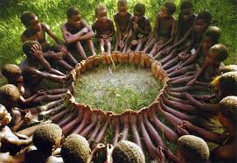
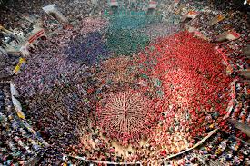
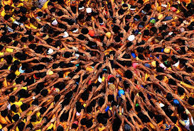
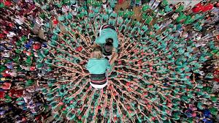
4.- Guidance means collaboration, community

Slide 7
Guidance and the community
In order to have social wellfare, we need everybody
To educate a single infant, we need all the tribe
Ubuntu: I am because you are, I am who I am because you are like (the way that) you are.
Cultures of collaboration, communities, territories, local / global

Slide 8
5.- She reached the top thanks, not only to the “Colla” but to all the community,

Slide 9
6.-This also means that everybody / every group / every community has different perspectives and we should be permanently learning from the others

Slide 10

7.- Collaborative Networking

Slide 11
8.- Collaboration is a fractal concept...

Slide 12
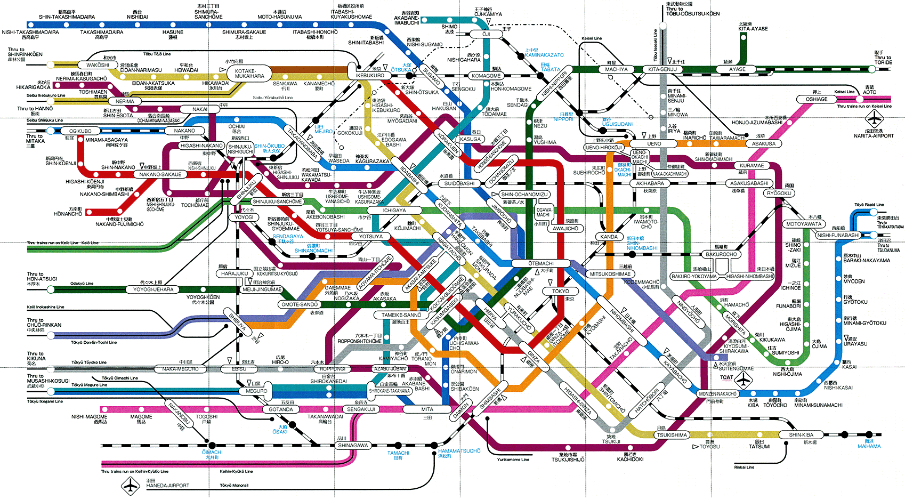
9.- A community netting a safety network
L’error és una inestimable font d’aprenentatge
Molts itineraris no són lineals
Trobar l’horitzó I redefinir el teu itinerari

Slide 13
10.-
1.- Not your fault!
2.- Not linear!
3.- Not alone!

Slide 14
3 references (1 in spanish, 2 in english)
Martínez Roca, C., Martínez, M., Pineda, P. (2014). The role of Career Guidance in the Development of Competences for Socially fair Employability. Procedia – Social and Behavioral Sciences. Vol 139, 343-350.
Martínez, M. ,Martínez-Roca, C. (2017). Guidance in Catalan secondary education. R. G. Sultana (Ed.). Career Guidance and Livelihood Planning across the Mediterranean, 389–400. Sense Publishers and Mediterranean Journal of Educational Studies.
Martínez-Roca, C., Martínez, M. (2017) GPS to a Better future: Career Guidance for social justice in adult learning centres. Hooley, T.,Sultana, R. Thomsen, R.(Eds.). Career Guidance for Social Justice. Contesting Neo-Liberalism. Routledge.

