Slide 1

What kind of researcher/academic do you want to be?
What does a good and just career look like?
Tristram Hooley
Notes:
Tristram

Slide 2

Career is the individual’s journey through life, learning and work
Career is where the individual interacts with organisations, structures and wider society.
Career is not just about paid work or hierarchical progression.
Everyone had a career. But, not everyone knows this.
Career is often constructed as a problem which needs to be solved by the individual, by career guidance and by public policy.
Notes:
Tristram

Slide 3

So how are you going to solve the ‘problem’ of your career
What is the problem represented to be?
Is it about how to ‘get to the top’, ‘how to make the most money’, ‘how to do something worthwhile with your life’ or ‘how to help others’?
As a ‘careers’ academic and researcher you have a duty to ‘practice what you preach’ and spend some time thinking about your career.

Slide 4
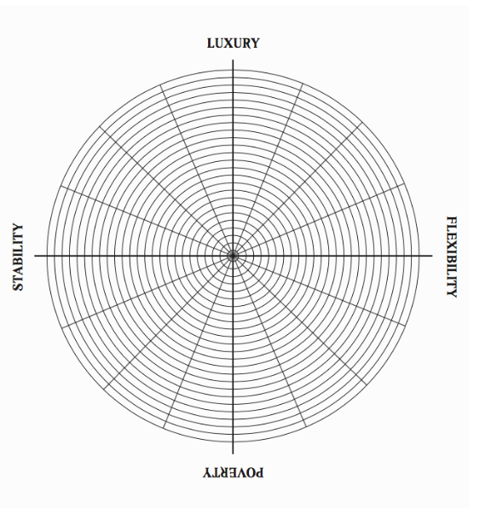
UNIVERSITY
RESEARCH
SOCIAL
ETHICAL
Leading others
BLUE SKIES
APPLIED
NOT INVOLVED IN LEADERSHIP
UNCONCERNED
SOLITARY
TEACHING
OUTSIDE THE UNIVERSITY

Slide 5

Designing your iDEAL JOB DESCRIPTION
Job descriptions
About the organisation
Contractual details (pay, working conditions etc.)
Duties
Person specification
Key skills
Work in groups – but you may want to create more than one for each group.
Look at the sample job descriptions for inspiration

Slide 6
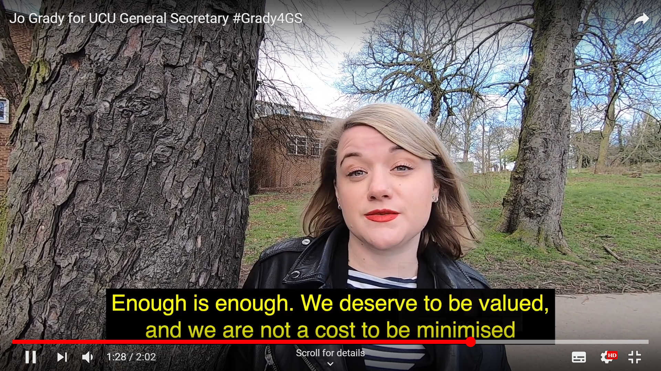
Forms of academic practice: #GRADY4GS

Slide 7
An open letter to academic employers
What makes academic employment unjust?
What evidence do you have for this?
What could be done about this?
What evidence do you have that this would be a good thing?
What are your demands? Make them clear?
What power do you have? Why should your employers listen?
We will post these (if you are happy for us to do so) on the Career Guidance for Social Justice website.

Slide 8
An example: Dear Calvert22
We notice that you have recently advertised an unpaid gallery volunteer placement for your forthcoming exhibition “…how is it towards the east?”
Whilst we acknowledge that you are aiming to take the time and effort to train young people who want to work in the arts, we are concerned that the tasks described in your volunteer placement sound very much like work that should be paid: ‘invigilating the exhibition’, ‘assisting with Front of House duties’ and ‘working in the Calvert Café’, as well as ‘the option to help out with our diverse talks and events programme’. We are curious as to why this work is not paid? We know that it is possible for arts organisations to avoid legal problems with volunteer positions through using the exemption to the National Minimum Wage legislation designed for charities. We would hope however, that such weak legal frameworks for our sector do not act as our only ethical guide on such matters.
We are concerned that by not paying people to carry out these jobs, only those who can afford to work for free will be able to benefit from your placement scheme: such placements contribute to producing a cultural sector in London that is increasingly reserved for the privileged. Surely such exclusionary employment practices are in direct contradiction of your constitution as a charity, and to the Foundation’s stated mission of connecting the gallery to histories of political radicalism and activism in the local area of East End? We also note that the exhibition ‘examines modes of self-organisation’ focusing on the histories of those on the left who have struggled for worker’s rights, specifically on the 1st May 1886, when they called for 8-hour working day – a date which coincides with the opening of the exhibition. We find that the use of unpaid labour in this context to be particularly paradoxical.

Slide 9
Furthermore, we note from your website, Calvert 22’s partnership with VTB Capital. Whilst we find there to be an incredible contradiction between your partnership with the investment banking sector, and the stated aims of artistic programmes such as the “…how is it towards the east?” we would at least hope that these kinds of partnerships would ensure that everyone who works on the programme is paid at least a Minimum Wage.
We raise these issues with you, not to single out Calvert 22 for such practices, but as our friends at Artleaks have succinctly expressed, to draw attention to concrete situations that:
“[…] underscore the precarious condition of cultural workers, and the necessity for sustained protest against the appropriation of politically engaged art, culture and theory by institutions embedded in a tight mesh of capital and power.’
Like Artleaks, we are concerned that:
“By co-opting cultural activity, these sponsors obtain social credibility, which they then proceed to mis-use: by refusing decent conditions for cultural workers through oppressive measures – the same workers whose labor makes their subsistence possible."
The normalisation of practices of free labour through volunteer positions such as this, contributes to a situation where it is acceptable to abstractly question the role of sponsorship and free labour on panel discussions, but unacceptable to concretely act against them. Volunteers, speakers and artists are often subtly frozen out of the sector if they challenge this non-payment or under-payment, and thus feel coerced to prop up the system further.

Slide 10
We have been organising around issues of free labour and precarity in the arts and culture for several years, analysing corporate cynicism and the increasingly intense contradictions in our sector. In this climate of enforced austerity, brought about by investment banks, we encounter over and over again a culture of resignation and silence in art schools and art institutions. Do programmes such as “…how is it towards the east?” simply perpetuate the damaging paradox of providing a subject of discussion that is clearly not to be acted upon? Do they not in effect, simply add to this silencing? We wonder what Calvert 22 want to achieve in this exhibition and programme, what the motivations of the foundation are? We wonder what position the foundation wants to take in relation to its own workers, its own work culture and the community in which it is situated?
There are many guidelines available today that might help you develop a new and more equitable approach to work. Please see the links below:
  Art Council England’s guidelines Internships in the Arts: http://www.artscouncil.org.uk/publication_archive/internships-arts
  Counter Guide to Free Labour in the Arts: http://carrotworkers.wordpress.com/counter-internship-guide/
  Intern Aware: http://www.internaware.org/about/why-unpaid-internships-are-wrong/
  Artquest’s Intern Culture report: http://www.artquest.org.uk/articles/view/intern_culture
  Interns: Volunteer or Employee? volunteernow.co.uk/news/item/61
We would like to ask the foundation to consider the ethics of offering unpaid volunteer placements in your organisation, and to hear your response to this open letter.
With best regards,
Precarious Workers Brigade

Slide 11
An open letter to academic employers
What makes academic employment unjust?
What evidence do you have for this?
What could be done about this?
What evidence do you have that this would be a good thing?
What are your demands? Make them clear?
What power do you have? Why should your employers listen?
We will post these (if you are happy for us to do so) on the Career Guidance for Social Justice website.

Slide 12
What you have to produce by 11
Two slides
1 setting out the key duties of your ideal job
1 setting out the terms and conditions of your ideal job.
A 1 page (maximum) open letter to academic employers. You will read this out. It should be INSPIRATIONAL!
Each group will have a maximum of 10 minutes to present. But remember that ‘brevity is a virtue’.

Slide 13

https://careerguidancesocialjustice.wordpress.com
Notes:
Tristram

Slide 14
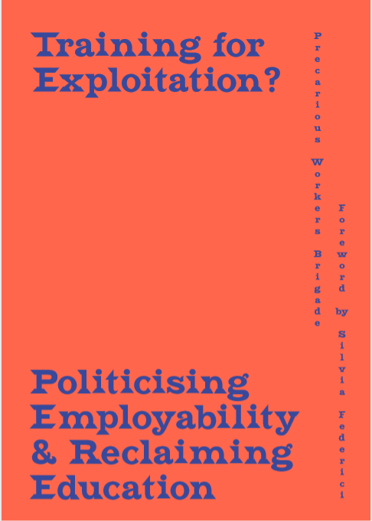
References
Available to download for free from http://joaap.org/press/pwb/PWB_Text_FINAL.pdf.

