Slide 1
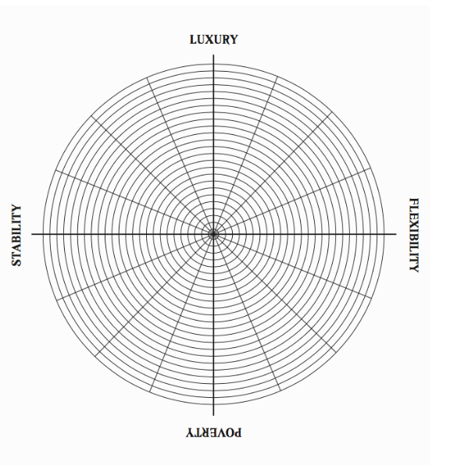
UNIVERSITY
RESEARCH
SOCIAL
ETHICAL
Leading others
BLUE SKIES
APPLIED
NOT INVOLVED IN LEADERSHIP
UNCONCERNED
SOLITARY
TEACHING
OUTSIDE THE UNIVERSITY

