Slide 1

Career guidance and social justice
Exploring a critical framework for research at ECADOC 2019
Tristram Hooley
Ronald Sultana
Rie Thomsen
Notes:
Tristram

Slide 2
Ontologies and epistemologies
There are different ways that we see the world and different traditions through which we try to understand it.
Over the next week we are going to ask you to spend some time understanding traditions that are informed by critical theory and an emancipatory tradition.
You don’t have to agree with us. You don’t have to adopt these positions yourselves. But we would like you to understand this perspective better and consider what it has to offer the study of career and career guidance.
Notes:
Tristram

Slide 3

Career is the individual’s journey through life, learning and work
Career is where the individual interacts with organisations, structures and wider society.
Career is not just about paid work or hierarchical progression.
Everyone had a career. But, not everyone knows this.
Career is often constructed as a problem which needs to be solved by the individual, by career guidance and by public policy.
Notes:
Tristram

Slide 4
What’s the problem represented to be?
Problems do not merely exist
Rather descriptions and perceptions of problems are constructed.
‘Once we stop thinking about categories, concepts, theories and “problems” as fixed and determined, it becomes ever more useful to analyse critically the forms of problematisation upon [which] they rely’ (Bacchi, 2010, p.7).
Bacchi’s (2009) five step ‘what is the problem represented to be’ approach (WPR approach)
Notes:
Rie

Slide 5

Brief history of the term ‘social justice’
Greeks
Middle Ages
Renaissance/Reformation
1843
1848 revolutions
1900s
1919
1969
1971
1973
1980
1990s
Justice as fairness/ promoting common interest: but only for the élite
Aquinas and metaphysical notions of justice: serving God
Notions of attaining one’s potential (e.g. Spinoza)
Luigi Taparelli S.J. (Civilta’ Cattolica) – Rerum Novarum (1891 – Leo XIII)
Increasingly used as a rallying cry (labour movements)
In international law and institutions: e.g. Treaty of Versailles (1919)
ILO "universal and lasting peace … only if based on social justice.”
UN ‘social justice’—influence of Soviet Union: redistributive policies
John Rawls A Theory of Justice
Hayek: the term means nothing, or too many things
Green/cosmic notions of justice: responsibility to future generations
Plural theories of justice/intersectionality: Nancy Fraser, Iris Young
Notes:
Ronald

Slide 6

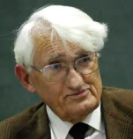
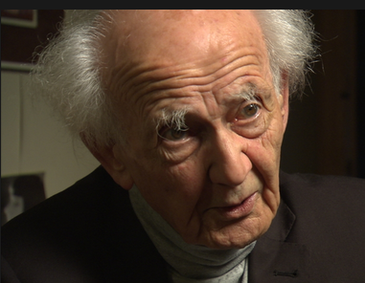

A. MacIntyre
communitarian justice
[fulfil role in society]
retributive justice
[merit/just deserts]
re-distributive justice
[‘corrective’: level field]
recognitive justice
[hospitalité]
Social harmony | Socrates, Plato “arete”
Equality | Kant “fairness”
Equity | Rawls “veil of ignorance”
Difference | Levinas, Derrida “alterity”
………
………
………
………
…between autonomy and solidarity…
N. Fraser
Notes:
Ronald

Slide 7
Key concepts for studying career
Opportunity structure
The faces of oppression
Neoliberalism
Responsibilisation
Notes:
Tristram

Slide 8
Key concepts for studying career
Opportunity structure
The faces of oppression
Neoliberalism
Responsibilisation
Notes:
Tristram

Slide 9
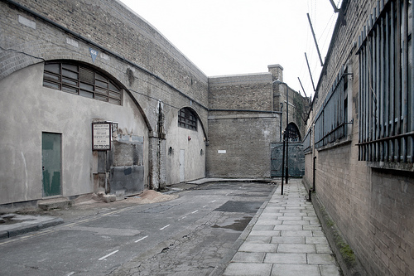

Ken Roberts and ‘opportunity structure’
Notes:
Tristram

Slide 10
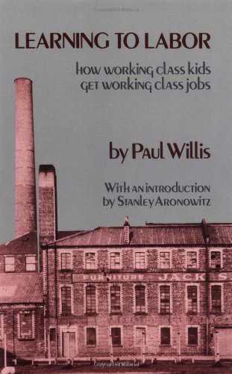
The sociological tradition
People make very few career choices.
They work within the structures that they are presented with.
This offers the illusion of choice and even of resistance. But actually most people end up following very predictable career paths.
Notes:
Tristram

Slide 11
Key concepts for studying career
Opportunity structure
The faces of oppression
Neoliberalism
Responsibilisation
Notes:
Ronald

Slide 12

the faces of oppression
For every oppressed group there is a group that benefits from that oppression and is privileged in relation to that group (Iris Marion Young, 2004)
Exploitation
Marginalisation
Powerlessness
Cultural imperialism
Violence
Unfair compensation and coercion
Loss of work, power and respect
Always being on the receiving end of orders
Imposing ‘norms’ on people
Random, unprovoked attacks
Notes:
Ronald

Slide 13
Key concepts for studying career
Opportunity structure
The faces of oppression
Neoliberalism
Responsibilisation
Notes:
Ronald

Slide 14
The centrality of neoliberalism
Understanding neoliberalism as a political project rather than a complete system.
Downsizing of the public sector, privatisation of state assets, deregulation of markets, and the withdrawal or restriction of funding for welfare regimes.
Recognising that career guidance can contribute to or oppose neoliberalism?
Notes:
Ronald

Slide 15

The impact of neo-liberalism:
Policy contexts enabling the ‘new’ economy:
liberalisation
competition
deregulation
privatisation
business-friendly climate
individual responsibility
performativity
accountability & NPM
There... There it is again…
the invisible hand of the market
giving us the finger!
Notes:
Ronald

Slide 16
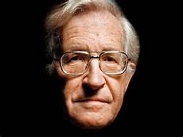
Impact of Neo-liberalism
Reduced ability of states to conduct social and economic policy on their own terms
Eroded democracy: ‘virtual senate’ of investors and lenders
Increased concentration of wealth and monopolisation of profits
Deepened social gap and intensified global inequality
Promoted the dismantling of the welfare state
Individualisation of structurally-induced problems
Self-governing responsibility for insuring onself against insecurity and precarity
Notes:
Ronald

Slide 17
Key concepts for studying career
Opportunity structure
The faces of oppression
Neoliberalism
Responsibilisation
Notes:
Tristram

Slide 18


Responsibilisation?
Neoliberalism colonises our ethics and our psychologies. It reframes the way that we think in ways that serve the interests of the powerful.

Slide 19
So what about career guidance?
Notes:
Rie

Slide 20

The politics of career guidance
Careers education and guidance is a profoundly political process. It operates at the interface between the individual and society, between self and opportunity, between aspiration and realism. It facilitates the allocation of life chances. Within a society in which such life chances are unequally distributed, it faces the issue of whether it serves to reinforce such inequalities or to reduce them.
Tony Watts
Notes:
Tristram

Slide 21

Defining career guidance
“Career guidance supports individuals and groups to discover more about work, leisure and learning and to consider their place in the world and plan for their futures… Career guidance can take a wide range of forms and draws on diverse theoretical traditions. But at its heart it is a purposeful learning opportunity which supports individuals and groups to consider and reconsider work, leisure and learning in the light of new information and experiences and to take both individual and collective action as a result of this.”
Notes:
Rie

Slide 22
Neoliberal problem representations and solutions
The ‘competition state’ - career guidance will support people in maximising their potential and develop flexibility towards the need for labour.
Globalisation – career guidance will support the mobility of labour nationally and internationally
The current state of welfare is unsustainable – reforms of the education system are needed - career guidance can increase individual responsibility, and guide individuals to make wise investments in the development of their individual human capital.
Notes:
Rie

Slide 23
Alternative problem-representations
Career/education as a critical social practice with the aim of enhancing awareness and understanding of the diverse ways in which life-careers might be meaningfully constructed and enacted (Irving)
Career guidance with the role of conscientisation and helping individuals to explore the inter-relationship between their career development, technological change and political transformation (Buchanan, Hooley)
Resituate career guidance as a practice that does not, per se, promote geographic mobility (of theories, models and labour) but instead invites both practitioners and people to include a socio-spatial perspective to the notion of career and to think critically from both a local and a global perspective (Alexander, Ribeiro & Fonçatti)
Notes:
Rie

Slide 24
Career guidance, social justice and neoliberalism
2 book project to create space for a different kind of discussion about career guidance.
It builds on and extends a long tradition of thinking about career guidance and social justice.
Includes contributions from a wider range of countries including those in the global south.
Notes:
Rie

Slide 25
The two volumes
2018
Career guidance for social justice – Explores context, critique and theory.
2019
Career guidance for emancipation – Explores diverse experiences of neoliberalism and possibilities for challenging and changing things.
Notes:
Rie

Slide 26





























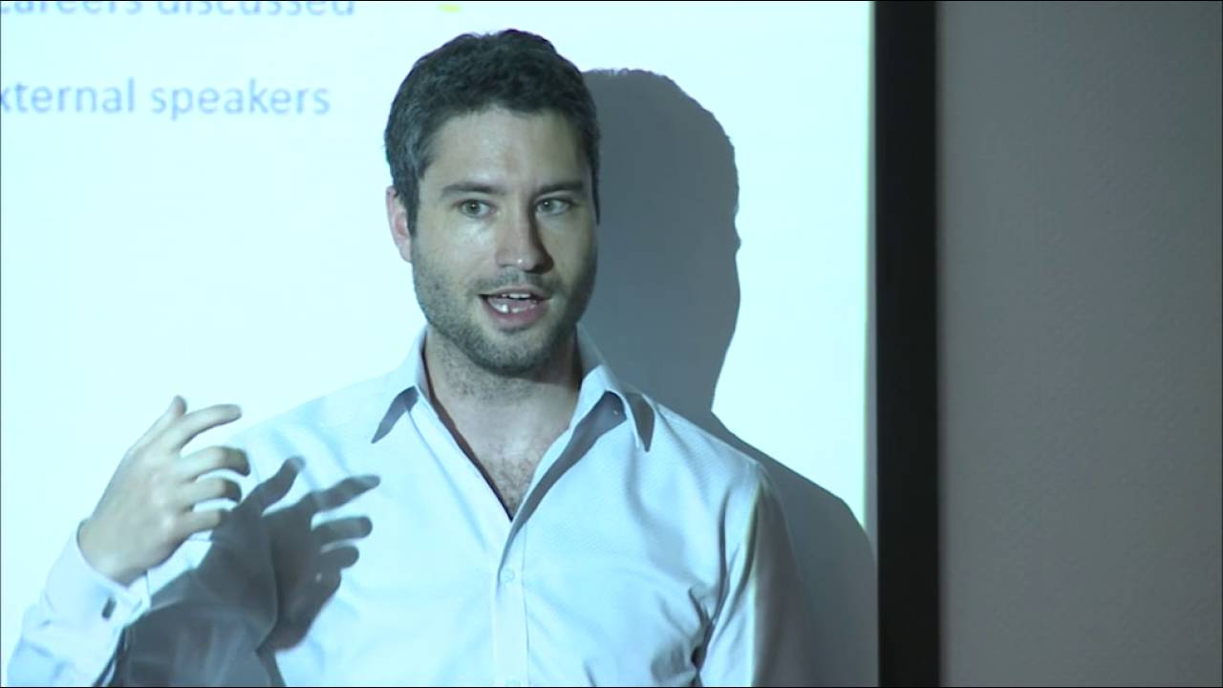














Alan
Alex
Anita
Barrie
Charlotte
Mark
Linden
Randi
Anki
Chad
Frida
Laura
Salvatore
Lia
Elnaz
Anna
Ingela
Carme
Phil
Suzanne
Steve
Bruno
Mary
Guilherme
Bo
Jacques
Jean
Hazel
Mark
Christian
Rachel
Tijana
Sara
Jenny
Marius
Rosie
Marco
Toby
Kristin
Marcelo
Helle
Victor
Maria
M. Cristina

Slide 27
We are joined in the Summer school by…
Contributors to the books
Other colleagues
David Blustein / Ingela Bergmo-Prvulovic / Anna Bilon / Rachel Buchanan / Marius Martínez Muñoz / Helle Merete Nordentoft / Marcelo Afonso Ribeiro/ Rosie Alexander / Bo Kint Pousen
By video: Chad Olle / Anita Ratnam / Victor Wong & Toby Yip (by video)
Anouk Jasmine Albien / Peter Weber / Manwel Debono / Tonio Axisia / Nicole P. Cassar & Ylenia Vella / Mario Gerada / Dorianne Gravina
Notes:
Rie

Slide 28
The five signposts towards socially justice career guidance
Build critical consciousness
01
Name oppression
02
Question what is normal
03
Encourage people to work together
04
Work at a range of levels
05
Notes:
Tristram

Slide 29

https://careerguidancesocialjustice.wordpress.com
Notes:
Tristram

Slide 30
References
Bacchi, C. (2009). Analysing policy: What’s the problem represented to be? Frenchs Forest, NSW: Pearson Australia.
Bacchi, C. (2010). Foucault, policy and rule: Challenging the problem-solving paradigm. Presented at the FREIA – Feminist Research Center in Aalborg, Department of History, International and Social Studies, Aalborg University, Aalborg.
Harvey, D. (2005). A brief history of neoliberalism. Oxford: Oxford University Press.
Hooley, T., Sultana, R.G. & Thomsen, R. (2018). Career guidance for social justice: Contesting neoliberalism. London: Routledge.
Hooley, T. Sultana, R.G. & Thomsen, R. (2019). Career guidance for emancipation: Reclaiming justice for the multitude. London: Routledge.
Skovhus, R.B. & Thomsen, R. (2017). Popular problems. British Journal of Guidance & Counselling, 45(1), 112-131, doi: 10.1080/03069885.2015.1121536
Roberts, K. (1977). The social conditions, consequences and limitations of career guidance’, British Journal of Guidance and Counselling, 5, 1-9.
Watts, A.G. (2015). Socio-political ideologies of guidance. In Hooley, T. and Barham, L. (Eds.). Career Development Policy and Practice: The Tony Watts Reader. Stafford: Highflyers.
Willis, P. (1977). Learning to labour. Farnborough: Saxon House.
Young, I.M. (2004). Five Faces of Oppression. In Heldke, L. & O’Connor, P. (Eds.). Oppression, privilege, & resistance. Boston: McGraw Hill.

Slide 31
Questions

Slide 32
Things to think about during the summer school
How do these ideas (opportunity structure, the faces of oppression, neoliberalism and responsibilisation) speak to your research?
Does career guidance have a role in challenging inequality and oppression?
What role do you want to play in relation to social justice?
What role do you want your research to play in relation to social justice?

